Slide 1
Evidence-Informed Health Policymaking
What is evidence?
What is the role of research evidence in informing health policy decisions?
What is evidence-informed policymaking?

Slide 2
“There is nothing a politician likes so little as to be well informed, it makes decision making so complex and difficult.”
John Maynard Keynes

Slide 3
Who would prefer uninformed decisions about health care?
You can’t make an informed choice without information
If a decision is going to be well informed rather than misinformed, you need good information!

Slide 4
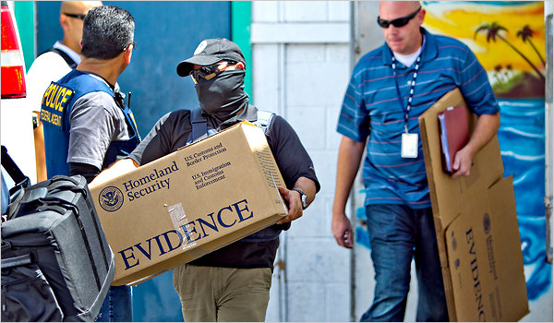
What is evidence?

Slide 5
What is evidence?
“Evidence concerns facts (actual or asserted) intended for use in support of a conclusion”
  A fact is something known by experience or observation
  Evidence is used to support a conclusion; it is not the same as the conclusion

Slide 6
Examples
Facts
I had spinal manipulation, then I had less back pain
I operated on 100 patients and all of the patients (that survived the operation) did well
My feeling is that the benefits of treatment are worth the risk of side effects
Conclusions
The spinal manipulation was effective
The operation is effective
Well-informed patients would want to be treated

Slide 7
Is expert opinion evidence?

Slide 8
Expert opinion
Expert opinion is not the same as evidence
  It combines facts, appraisal of those facts, and conclusions
  There is evidence behind expert opinions
  Expert opinion should be used appropriately by:
    Identifying the facts (experience or observations) that are the basis of the opinions
    Appraising the extent to which the facts support the conclusions (not how persuasive the expert is)

Slide 9
How should we decide how much confidence to place in evidence?
Not all evidence is equally convincing
How convincing evidence is (for effects) should be based on criteria such as
  What sort of observations (study design)
  How well they were done (risk of bias)
  How consistent they are (consistency)
  How directly relevant they are (directness)
  How many there are (precision)
  How strong an association is (large effects)
NOT on who says it or how they say it

Slide 10
Judgements about confidence
Judgements about how much confidence to place in different types of evidence are made either implicitly or explicitly
It is better to make these judgements systematically and explicitly to help
  protect against errors
  resolve disagreements
  facilitate critical appraisal
  communicate information
http://www.gradeworkinggroup.org/

Slide 11
What is the role of evidence in policy and practice?
The role of evidence is to inform policy and practice
Evidence is essential, but not sufficient
Judgements are needed, including judgements about confidence (the quality of the evidence), what to expect in a specific setting, equity and trade-offs

Slide 12
What is evidence-informed health policymaking?
An approach to policy decisions that aims to ensure that decision making is well-informed by the best available research evidence
Characterised by access to, and appraisal of, evidence as an input into the policymaking process that is
  Systematic to ensure that relevant research is identified, appraised and used appropriately
  Transparent so that others can examine what research evidence was used to inform policy decisions, as well as the judgements made about the evidence and its implications

Slide 13
Comments or questions about what evidence, its role in policymaking or what evidence-informed health policy is?

Slide 14
Who cares?
Three examples of how the use of research evidence to inform policy decisions affects people’s lives

Slide 15
Magnesium sulphate for the treatment of eclampsia and pre-eclampsia
An example of inadequate health system arrangements to support an inexpensive and effective intervention
High quality evidence of effectiveness
Still not widely available in many LMIC due to
  Failures in the registration
  Failure to include it on essential medicines lists
  Procurement and distribution mechanisms
  Lack of guidelines
  Failure to implement existing guidelines
As a consequence tens of thousands of women die unnecessarily each year

Slide 16
Paying for performance
An example of the widespread use of a health system arrangement with uncertain effects and inadequate impact evaluation
Money or material goods conditional on people taking a measurable action or achieving a performance target (P4P) is widely advocated and used
Limited evidence of effectiveness and cost-effectiveness, particularly in LMICs
Potential undesirable effects include motivating unintended behaviours, distortions and gaming
Good intentions may be doing more harm than good

Slide 17
Seguro Popular in Mexico
An example of an evidence-informed approach to extending health insurance coverage and evaluating its impacts
A new system of health insurance with the aim of extending coverage to 50 million Mexicans
Need for reform sparked by evidence that the health system, contrary to popular belief, was funded largely regressively through out-of-pocket payments
Taking advantage of a progressive rollout, the government set up a controlled trial comparing outcomes in communities receiving the scheme with those still waiting for it
Legislation requiring impact evaluations recognises
  Government’s political and ethical obligation to evaluate the impact of policy decisions
  Value of learning what works (and why) to inform future decisions, such as whether to continue, modify or end the policy

Slide 18
Evidence-informed health policymaking addresses common policymaking problems

Slide 19

SUPPORT Tools for evidence-informed health Policymaking (STP)
Developed by SUPporting POlicy relevant
Reviews and Trials (SUPPORT), funded
by the EC 6th Framework Programme
For people responsible for making
decisions about health policies and
programmes and for those who support them
To help ensure that their decisions are
well-informed by the best available research evidence
Series of articles in Health Research Policy and Systems, Dec 2009 -
www.health-policy-systems.com/supplements/7/S1
Spanish, Portuguese, French and Chinese translations – www.support-collaboration.org
Book version - www.kunnskapssenteret.no/Publikasjoner/8879.cms

Slide 20
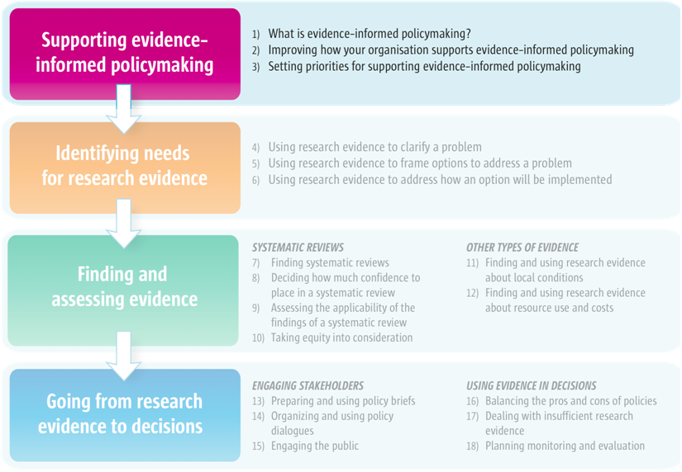
Supporting evidence-informed policymaking

Slide 21
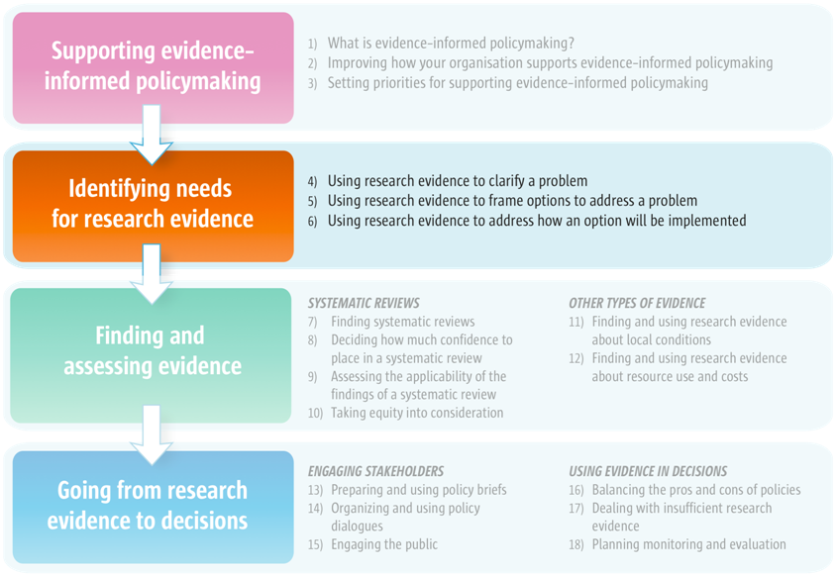
Identifying needs for research evidence

Slide 22
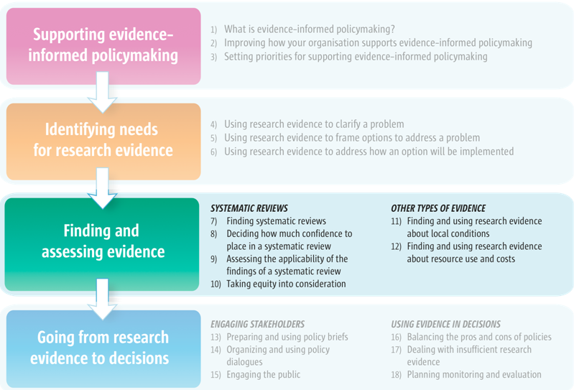
Finding and assessing evidence

Slide 23
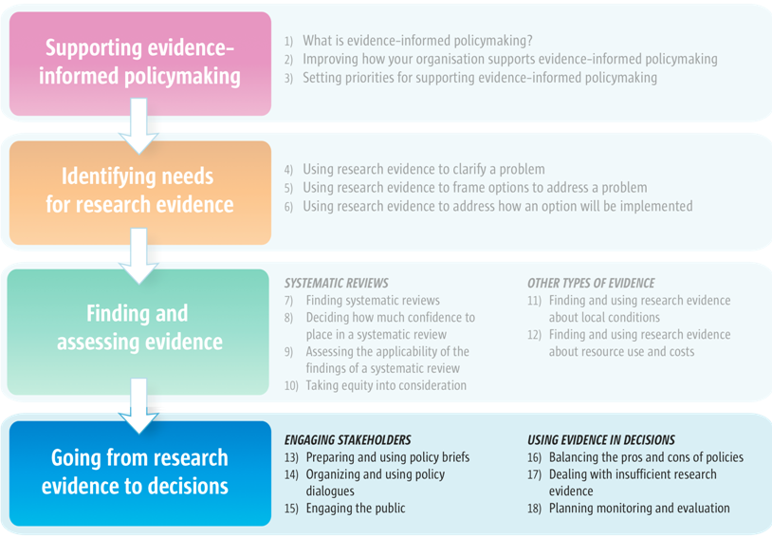
Going from research evidence to decisions

Slide 24
Why systematic reviews?
Systematic reviews are summaries of research evidence that address a clearly formulated question using systematic and explicit methods to
  identify, select, and critically appraise relevant research
  collect and analyse data from the studies that are included in the review
Systematic reviews of research evidence constitute a more appropriate source of research evidence for decision-making than the latest or most heavily publicized research study

Slide 25
Advantages of systematic reviews
Systematic reviews
Reduce the risk of bias in selecting and interpreting the results of studies
Reduce the risk of being misled by the play of chance in identifying studies for inclusion, or the risk of focusing on a limited subset of relevant evidence
Provide a critical appraisal of the available research and place individual studies or subgroups of studies in the context of all of the relevant evidence
Allow others to appraise critically the judgements made in selecting studies and the collection, analysis and interpretation of the results

Slide 26
Why evidence-based policy briefs?
Evidence-based policy briefs
  Bring together ‘global’ research evidence (from systematic reviews) and local evidence
  To inform deliberations about health policies and programmes
They begin with a policy problem and summarise the best available evidence to
  Clarify the size and nature of the problem
  Describe the likely impacts of key options for addressing the problem
  Inform considerations about potential barriers to implementing the options and strategies for addressing those

Slide 27
Advantages of evidence-based policy briefs
Evidence-based policy briefs
Build on systematic reviews and the advantages of those, including
  Improving the accessibility of research evidence and the likelihood that it will be used appropriately
  Reducing the risk of bias in selecting and interpreting the evidence and the risk of being misled by focusing on a limited subset of the relevant evidence
  Critically appraising the evidence
Contextualise the evidence
Foster dialogue and judgements that are informed by the best available evidence

Slide 28
Comments or questions about the SUPPORT Tools for evidence-informed health Policymaking (STP), systematic reviews or evidence-based policy briefs?

Slide 29
An international and historical perspective
58th World Health Assembly resolution

Slide 30

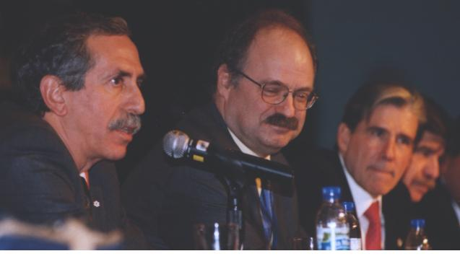
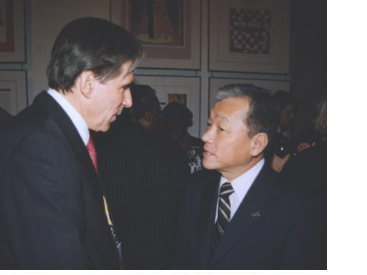
Ministerial Summit on Health Research, Mexico City, November 16-20, 2004

Slide 31
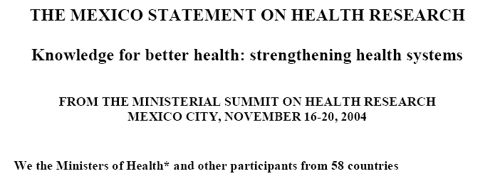
www.who.int/rpc/summit/agenda/en/mexico_statement_on_health_research.pdf

Slide 32
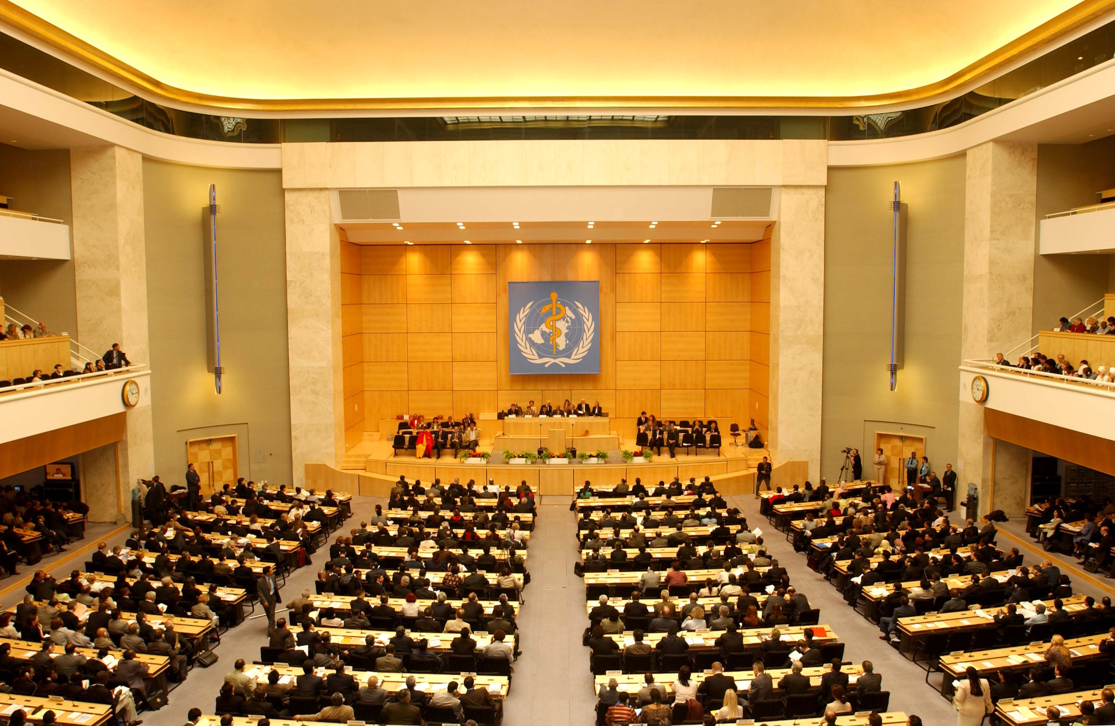
58th World Health Assembly, Geneva, May 16-25, 2005

Slide 33
The 58TH meeting of the World Health Assembly passed the following resolution:
ACKNOWLEDGES the Mexico Statement on Health Research resulting from the Ministerial Summit on Health Research (Mexico City, 16-20 November 2004)
Urges Member States
to establish or strengthen mechanisms to transfer knowledge in support of evidence-based public health and health care delivery systems, and evidence-based health-related policies
www.who.int/gb/ebwha/pdf_files/WHA58/A58_22-en.pdf

Slide 34

EVidence Informed Policy Network
Working with countries to:
Enhance links between producers & users of evidence
Acquire, access, adapt evidence relevant to needs of decision makers
Provide decision makers with a rapid response and one stop shopping for evidence
Build capacity to access & apply evidence
Commission systematic reviews and research
Develop partnerships

Slide 35
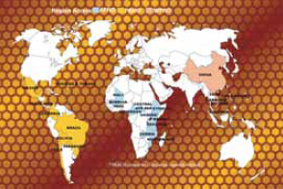


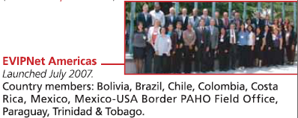
EVidence Informed Policy Network (EVIPNet)
www.evipnet.org

Slide 36




Supporting the Use of Research Evidence (SURE) for Policy in African Health Systems
Working with EVIPNet Africa, the Regional East African Community Health (REACH) Policy Initiative and the Zambian Forum for Health Research (ZAMFOHR)
In Cameroon, Burkino Faso, Centrafrique, Ethiopia, Mozambique, Zambia, Uganda and the East African Community (Burundi, Kenya, Rwanda and Tanzania)
With support from Canada, France, Norway, Sweden and WHO
Funded by the European Commission’s Seventh Framework Programme 2009 - 2014
www.evipnet.org/sure

Slide 37
SURE objectives
Produce evidence-based policy briefs
Develop and evaluate strategies for improving access to and use of research evidence in policy development
  User-friendly policy briefs
  Clearing houses
  Rapid response mechanisms
  Policy dialogues
  Informing and engaging stakeholders
Develop capacity for evidence-informed health policy
Evaluate country initiatives to support evidence-informed health policymaking

Slide 38
Historical perspective
1948 - Streptomycin treatment of pulmonary tuberculosis: a Medical Research Council investigation. BMJ 1948; ii:769-82
- WHO established
1972 - Cochrane AL. Effectiveness and Efficiency. Random Reflections on Health Services
1992 - The term EBM was coined
1993 - Cochrane Collaboration launched
2005 - WHA resolution on evidence-based health- related policies
- EVIPNet established

Slide 39
Comments or questions about EVIPNet, REACH, SURE or the history of evidence-informed health policymaking?

Slide 40
Professional good intentions and plausible theories are insufficient for selecting policies and practices for protecting, promoting and restoring health
Iain Chalmers

Slide 41
Humility and uncertainty are preconditions for unbiased assessments of the effects of the prescriptions and proscriptions of policymakers and practitioners for other people
Iain Chalmers

Slide 42
We will serve the public more responsibly and ethically when research designed to reduce the likelihood that we will be misled by bias and the play of chance has become an expected element of professional and policy making practice, not an optional add-on
Iain Chalmers

Slide 43
Final message
Both policymakers and researchers must continue struggling to help ensure that judgments about health policies are well informed by research evidence
The alternative is to acquiesce to poorly informed health policies
Informing Judgment: Case Studies of Health Policy
and Research in Six Countries.
Milbank Memorial Fund, September 2001
www.milbank.org/2001cochrane/010903cochrane.html

Slide 44
What’s good about what you are doing now and what can be improved to ensure better health care by using research evidence to informed decisions about health systems?

