Slide 1

Managing Search Strategies & Results
Complying with MECIR and PRISMA
Michelle Fiander, MA, MLIS
Effective Practice & Organisation of Care (EPOC) Group

Slide 2

Sources of Funding/Support
Canadian Institutes of Health Research (CIHR)
http://www.cihr.ca/
Centre for Practice Changing Research, Ottawa Hospital Research Institute (OHRI)
http://www.cihr.ca/

Slide 3
Agenda
Requisite search documentation for Cochrane SRs
Review of PRISMA
MECIR Background/Purpose
Overview--MECIR Standards re Searching
Strategies to ensure compliance

Slide 4
PRISMA
Preferred Reporting Items for Systematic Reviews & Meta-Analyses
www.prisma-statement.org

Slide 5
Notes:
PRISMA is not our focus, but Flow Diagram is requisite and documenting searches AND results is part/parcel

Slide 6
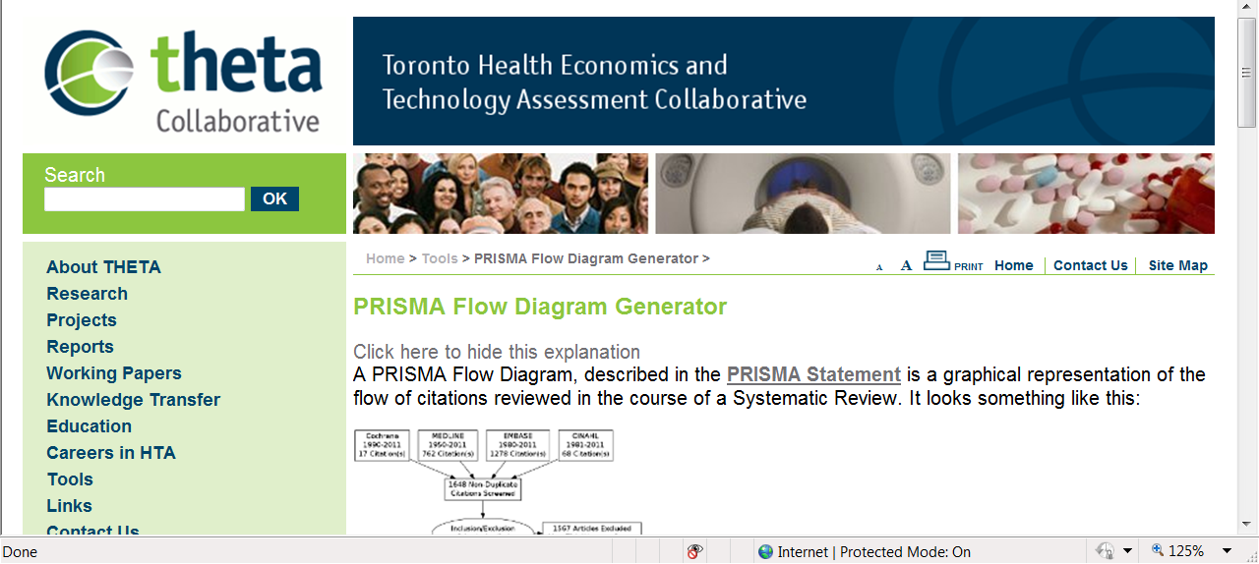
http://theta.utoronto.ca/tools/prisma

Slide 7
MECIR
Methodological Expectations for the reporting of new Cochrane Intervention Reviews

Slide 8
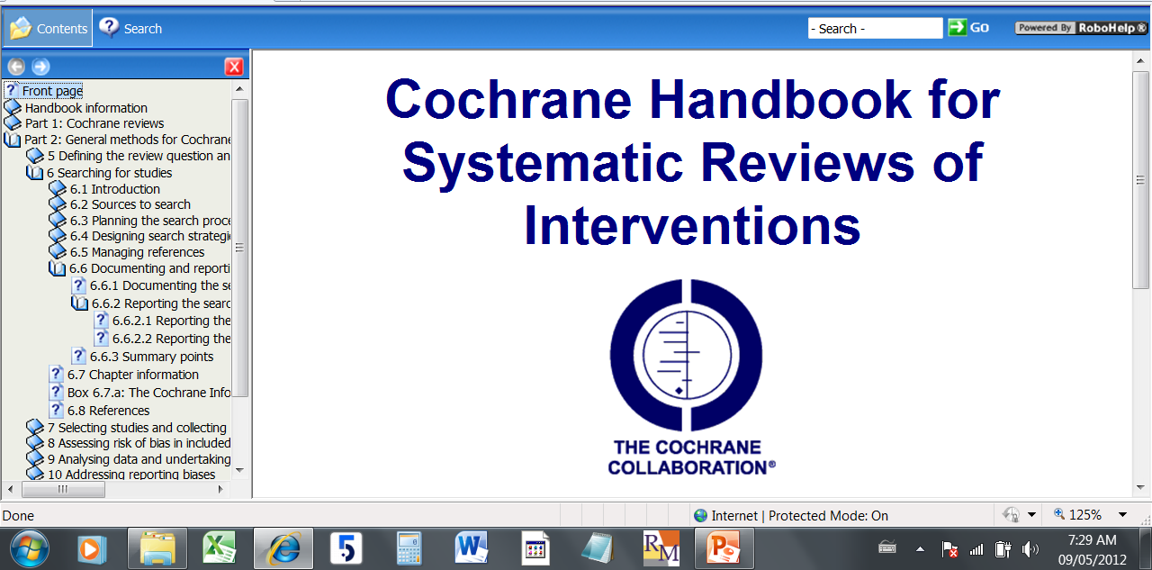
All MECIR Standards Based on
http://www.cochrane-handbook.org/

Slide 9
MECIR Background
Initiated in 2008.
Co-ordinated by a team from the Methods Application and Review Standards (MARS) Working Group and the Cochrane Editorial Unit.
Six (6) target areas identified; separate working groups convened to address each area.
Feedback was sought and incorporated:
http://www.editorial-unit.cochrane.org/sites/editorial-unit.cochrane.org/files/uploads/Development_of_conduct_%20standards_%20Annex_2_%20consultation_%20response_0.pdf

Slide 10
Handbook Part 2: 6.6.2.2 Reporting search process
Reporting the search process in the review abstract
List all databases searched.
Note the dates of the last search for each database or the period searched.
Note any language or publication status restrictions (but refer to Section 6.4.9).
List individuals or organizations contacted.
For further guidance on how this information should be listed see Chapter 11 (Section 11.8).
Reporting the search process in the Methods section
In the ‘Search methods for identification of studies’ section(s):
List all databases searched.
Note the dates of the last search for each database AND the period searched.
Note any language or publication status restrictions (but refer to Section 6.4.9).
List grey literature sources.
List individuals or organizations contacted.
List any journals and conference proceedings specifically handsearched for the review.
List any other sources searched (e.g. reference lists, the internet).
The full search strategies for each database should be included in an Appendix of the review to avoid interrupting the flow of the text of the review. The search strategies should be copied and pasted exactly as run and included in full together with the line numbers for each search set. They should not be re-typed as this can introduce errors. For further detailed guidance on this contact the Trials Search Co-ordinator.
Reporting the date of the search
A single date should be specified in the 'date of search' field, to indicate when the most recent comprehensive search was started. For more information on specifying this date, see Chapter 3 (Section 3.3.3).

Slide 11
MECIR aims to…
specify methodological expectations for Cochrane Protocols, Reviews, and Updates
ensure that these…expectations are supported and implemented across The Cochrane Collaboration
provide authors and users of The Cochrane Library with clear and transparent expectations of review conduct and reporting
enable Cochrane Review Groups to hold authors accountable during the editorial process
facilitate support and monitoring functions co-ordinated by the Cochrane Editorial Unit (CEU)
improve liaison between methodologists and editorial teams.
Notes:
Standardize reporting
Improve reporting
Provide greater detail than Cochrane Handbook for Systematic Reviewers
To communicate common standards for authors and editors within and outside of Cochrane

Slide 12
MECIR Compliant Search Documentation
Printed Educational Materials Review

Slide 13
MECIR Categories
1. Developing a question and deciding the scope of the review
2. Searching for studies
3. Selecting studies and collecting data
4. Assessing risk of bias in studies
5. Analysing data and undertaking meta‐analyses
6. Interpretation and presenting results
Today’s focus—item 2:
Searching and documenting searches

Slide 14
Mandatory or
Highly Desirable
Each MECIR category includes a number of standards. Each standard is designated as…

Slide 15
  Mandatory
  Highly Desirable
  A process always undertaken for a Cochrane SR.
  A process which must be reported.
  Publication of a review will be delayed (or cancelled) if a mandatory item is not reported.
  A process usually undertaken for a Cochrane SR.
  If not undertaken, should be justified.
  If undertaken must be reported.
Justified omissions will have no impact on publication.

Slide 16
Documenting the Search Process
MECIR Standard 36
Mandatory
Description:
Document the search process in enough detail to ensure that it can be reported correctly in the review.
The search process (including the sources searched, when, by whom, and using what terms) needs to be documented in enough detail throughout the process to ensure that it can be reported correctly in the review, to the extent that all the searches of all the databases are reproducible.
Cochrane Handbook:
6.6.1

Slide 17
Include PRISMA Flow Chart
MECIR Standard 41
Mandatory
Description:
Cochrane Handbook:
Document the selection process in sufficient detail to complete a PRISMA flow chart and a table of ‘Characteristics of excluded
studies’.
6.6.1
11.2.1

Slide 18
Searching Key Databases
MECIR Standard 24
Mandatory
Description:
Cochrane Handbook:
Search the Cochrane Review Group's Specialized Register (internally, e.g. via the Cochrane Register of Studies, or externally via CENTRAL).
Ensure that CENTRAL and MEDLINE/PubMed) have been searched (either for the review or for the Review Group’s Specialized Register).
6.1.1
6.2.1.1

Slide 19
Searching ‘Specialised’ Databases
MECIR Standard 25
Desirable
Description:
Cochrane Handbook:
Search the Cochrane Review Group's Specialized Register (internally, e.g. via the Cochrane Register of Studies, or externally via CENTRAL).
Ensure that CENTRAL and MEDLINE/PubMed) have been searched (either for the review or for the Review Group’s Specialized Register).
6.1.1
6.2.1.1

Slide 20
Searches for “different” types of evidence
MECIR Standard 26
Mandatory
Description:
Cochrane Handbook:
If the review has specific eligibility criteria around study design to address adverse effects, economic issues or qualitative research questions, undertake searches to address them
13.3
14.5
15.3
20.3.2.1

Slide 21
Searching Trial Registers
MECIR Standard 27
Mandatory
Description:
Cochrane Handbook:
Search trials registers and repositories of results, where relevant to the topic through ClinicalTrials.gov, the WHO International Clinical Trials Registry Platform (ICTRP) portal and other sources as appropriate.
6.2.3.1
6.2.3.2
6.2.3.3

Slide 22
Search for Grey Literature
MECIR Standard 28
Desirable
Description:
Cochrane Handbook:
Search relevant grey literature sources such as reports, dissertations/theses databases and databases of conference abstracts
6.2.1.7
6.2.1.8
6.2.2

Slide 23
Searching within other reviews
MECIR Standard 29
Desirable
Description:
Cochrane Handbook:
Search within previous reviews on the same topic.
6.2.2.5

Slide 24
Searching Reference Lists
MECIR Standard 30
Mandatory
Description:
Cochrane Handbook:
Check reference lists in included studies and any relevant systematic reviews identified.
6.2.2.5

Slide 25
Contact Relevant Individuals/Organisations
MECIR Standard 31
Mandatory
Description:
Cochrane Handbook:
Contact relevant individuals and
organisations for information about
unpublished r ongoing studies.
6.2.3

Slide 26
Construct Strategies
MECIR Standard 32, 33
Mandatory
Description:
Cochrane Handbook:
Use MeSH and other controlled vocabulary as appropriate.
Use PICO to help devise a strategy, but typically do not search on outcomes [MF]
6.4.2
6.4.4
6.4.5
6.4.6
6.4.7
6.4.8

Slide 27
Use Filters
MECIR Standard 34
Desirable
Description:
Cochrane Handbook:
Use specially designed and tested search filters where appropriate including the Cochrane Highly Sensitive Search Strategies for identifying randomized trials in MEDLINE.
DO NOT use filters in pre-filtered databases e.g. do not use a randomized trial filter in CENTRAL or a systematic review filter in DARE
6.4.11
6.4.2
13.3.1.2
14.5.2
15.3.1
17.5
20.3.2.1

Slide 28
Restricting database searches
MECIR Standard 35
Mandatory
Description:
Cochrane Handbook:
Justify the use of any restrictions in the search strategy on publication date, publication format or language.
6.4.9

Slide 29
Documenting Searches
Listing databases
Saving searches “ as run” in databases
Tracking the number of gross and net results
Notes:
Many sources are searched for SRs. Databases such as Medline, Pubmed, Cochrane Library are the most familiar

Slide 30
Listing Databases…Accurately
Database
Interface/platform/provider
Date coverage
Notes:
Ask for examples.

Slide 31
Database
Platform / Provider
Medline
EMBASE
Cochrane Library
CINAHL
OVID
Ebscohost
Wiley
ProQuest
Scopus

Slide 32


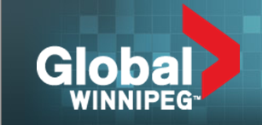
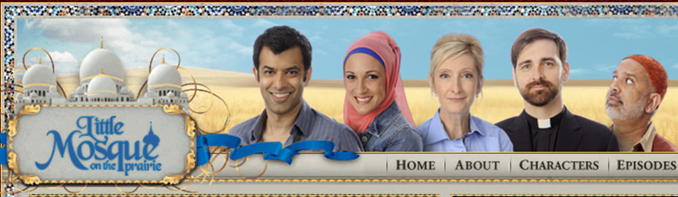
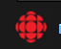
TV Show=Database (Medline)
Channel = Platform (OVID)
Notes:
If you want to tell me to watch a show…you might have to tell me where I can watch it.

Slide 33

Delivery Channel Makes a Difference to the Search Conducted & Reported

Slide 34
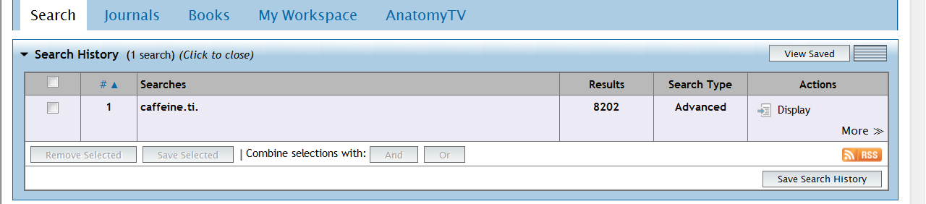
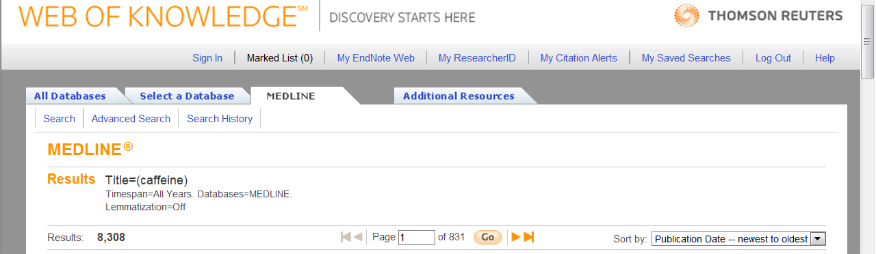
Interface used for each database influences search syntax, choice of terminology and number of results.
Notes:
Different results for same search of ‘same’ database. THUS important to know which interface was used.

Slide 35
Identifying Platforms or Interfaces
Sometimes a bit tricky

Slide 36
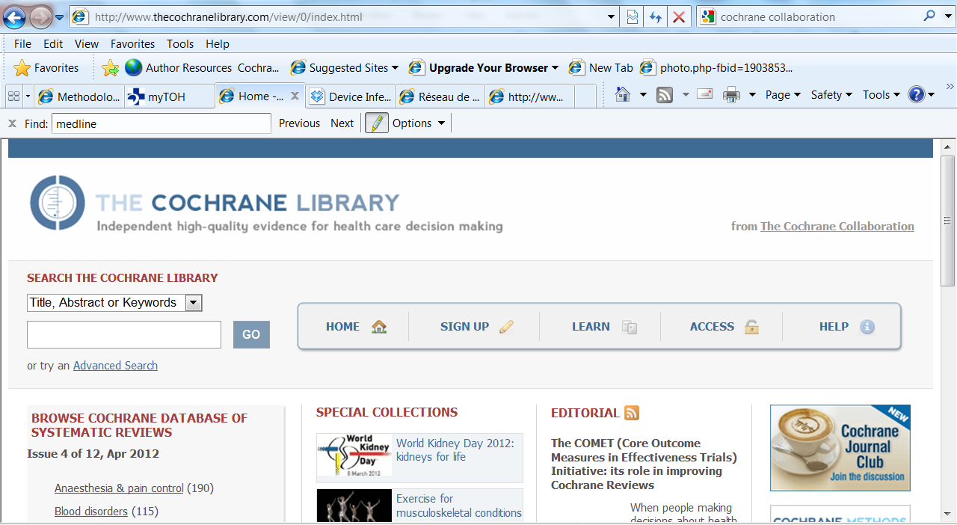
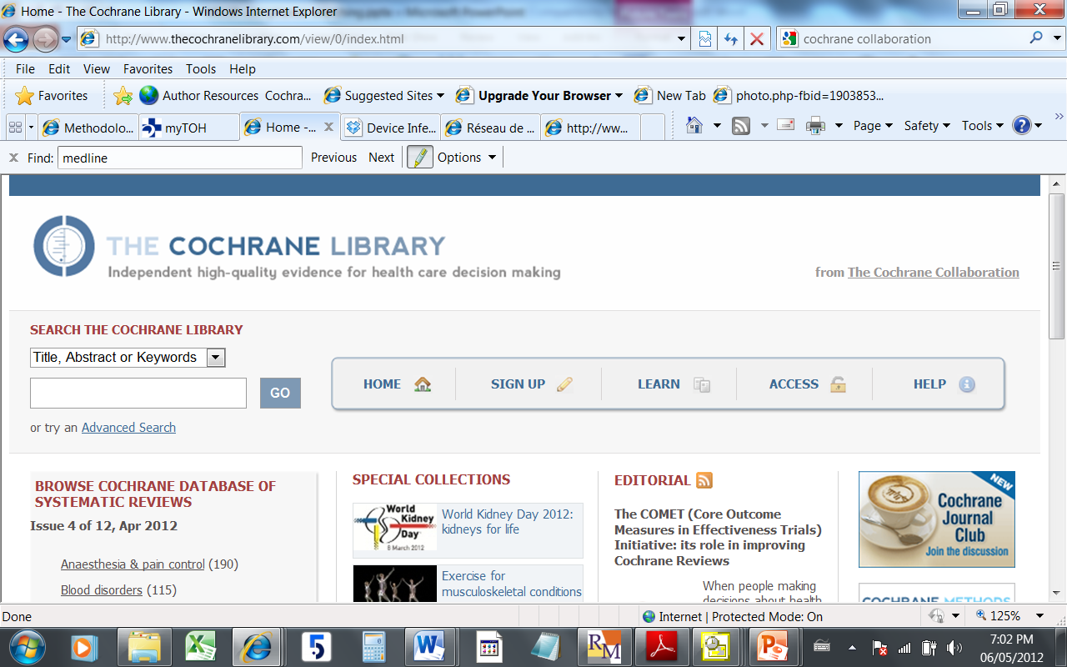
The Cochrane Central Register of Controlled Trials (CENTRAL) 2012, Issue 4, part of the The Cochrane Library. www.thecochranelibrary.com
Notes:
Recommended citation for CENTRAL fr Handbook

Slide 37
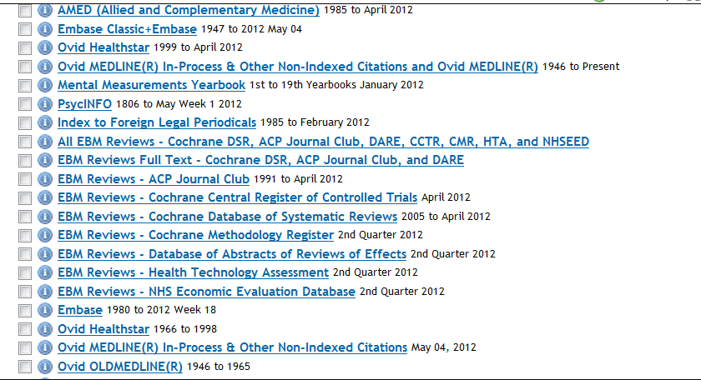
OVID Databases/Sections
Notes:
Be aware of which section you are searching; usually want all.

Slide 38
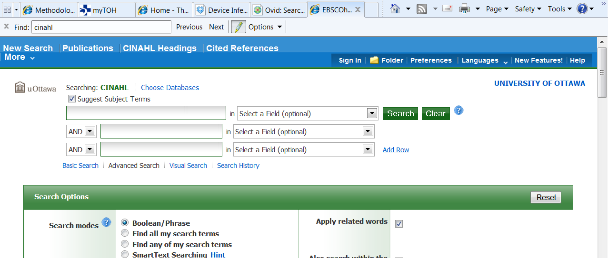
CINAHL…who is provider?

Slide 39
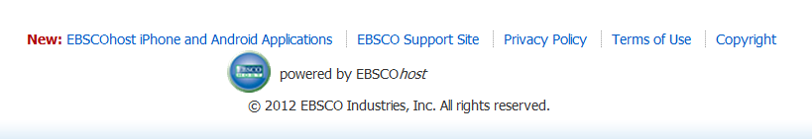
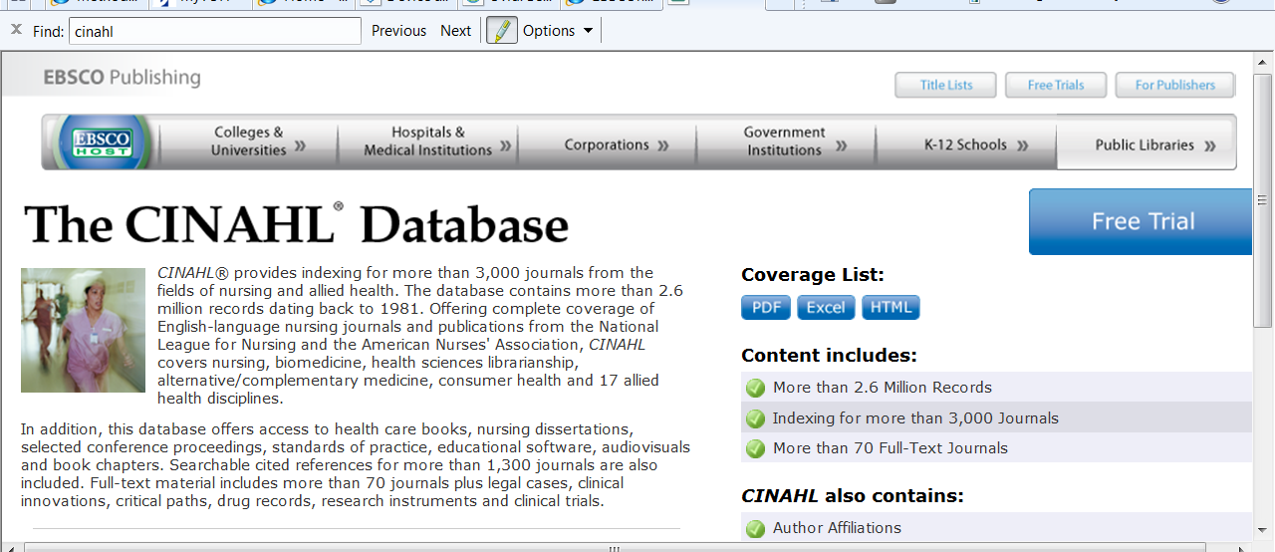
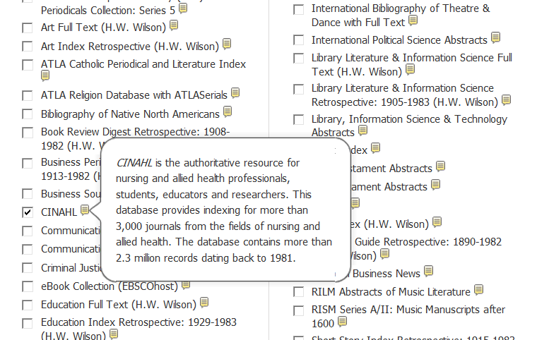
Investigate…
Found at bottom of page
Google search finds EbscoHost Website
Cumulative Index to Nursing and Allied Health Literature CINAHL, EbscoHost [1981-]
Notes:
Scroll down…name but no dates; look for help Icon or “about” icon; Google the database name

Slide 40
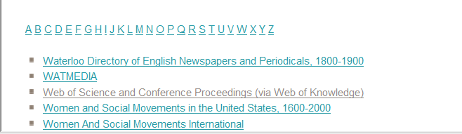
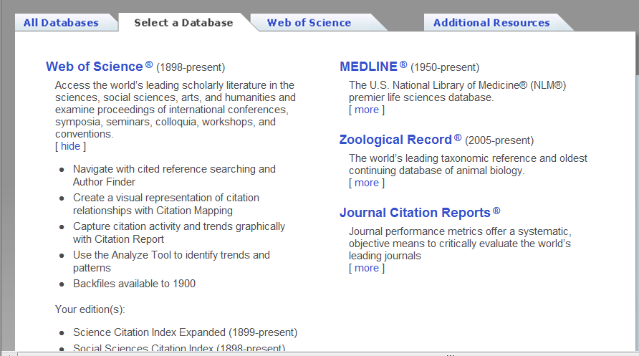
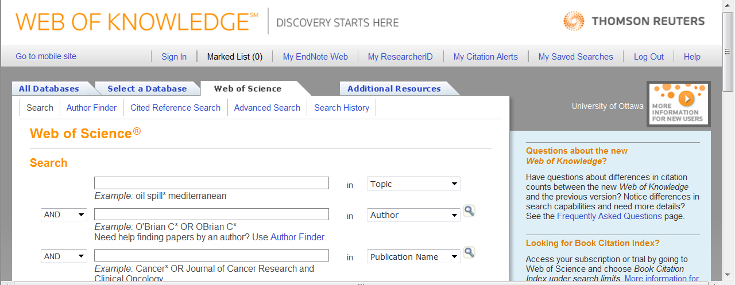
Web of Science
Web of Science, Citation Indexes, Web of Knowledge [1898-]
Notes:
Web of Science—think CITATION INDEXES, but also provides access to Medline, Biosis and more.

Slide 41
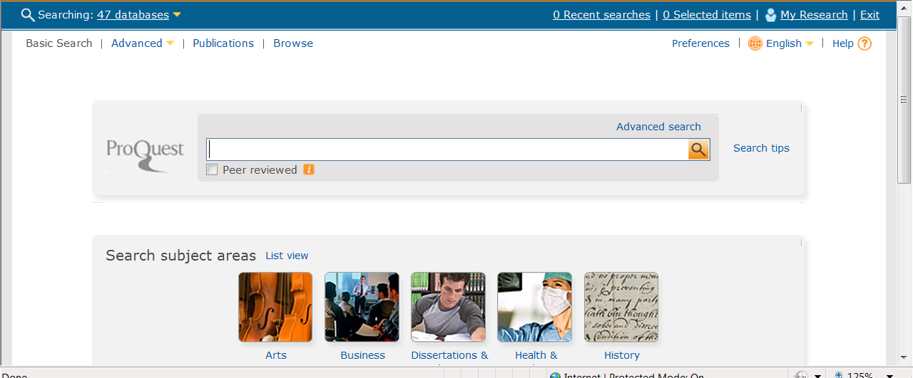
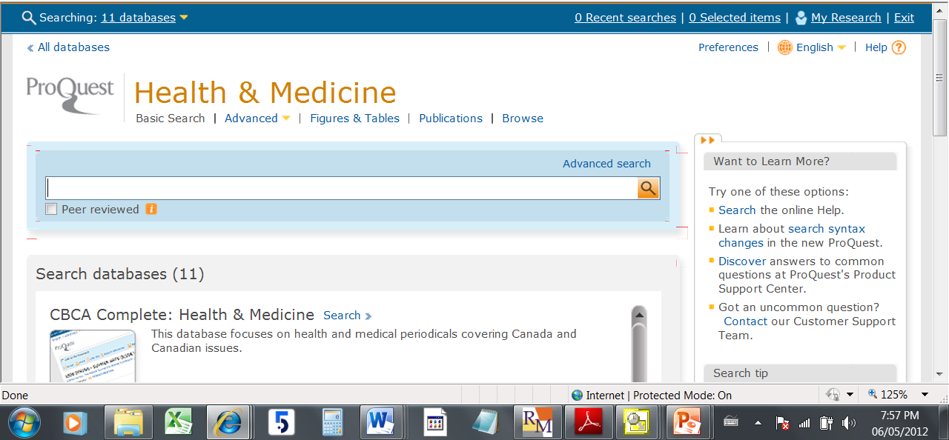
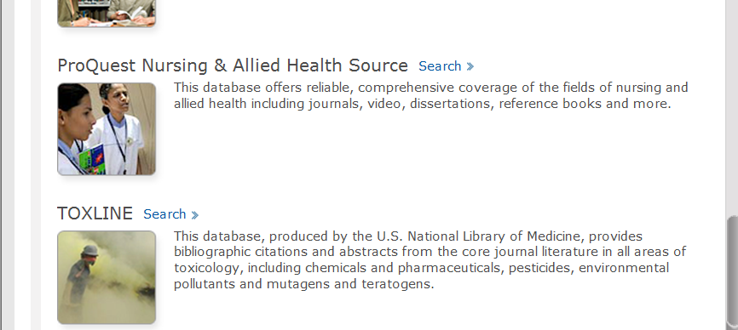
ProQuest= Interface not DB
You may search two databases at once, but be sure to indicate this in search methods. Usually, when searching multiple databases simultaneously, you cannot count on using controlled vocabulary.
Notes:
Another example of a provider (ProQUest) which some people reference as a single database because of entries like the one we saw from the U of O Library

Slide 42
PubMed
No interface name per se…it just is☺
If you are unable to identify an interface name… take a screen shot for the record and check with others.

Slide 43
Database List for a Review
The Cochrane Central Register of Controlled Trials (CENTRAL) YEAR, Issue X, part of the The Cochrane Library. www.thecochranelibrary.com
Medline, OVID [1948-, In-Process]
EMBASE, OVID [1947-]
CINAHL (Cumulative Index to Nursing and Allied Health Literature), EbscoHost [1981-]
PsychInfo, OVID [1806-]

Slide 44
Saving Search Strategies
Reproducibility & Transparency

Slide 45
Search Strategies Must Show
the number of results identified by each line of the strategy
how concepts have been combined
filters applied (usually an RCT Filter, but economic or AE filters, if used must be included
limits applied (if any) –human is a common limit

Slide 46
Search Methods
State date(s) of search(es)
  Searches were run between March 5-12, 2012. Search dates for each database are provided with the strategy in appendices.
Explain choice of terms, briefly:
  Multimorbidity is a relatively new term in the literature and is not necessarily represented in controlled vocabulary such as MeSH. Many studies on multimorbidity use MeSH Comorbidity; thus this term is used in our strategies.
Clearly state, by name, who wrote and ran strategies.
Search strategies entail intellectual effort and results form the evidence base for an SR. Cochrane does not have explicit criteria regarding authorship, but other organisations routinely include authors of search strategies as authors on SRs etc.

Slide 47
Why are these details needed?
Date run: to illustrate timeliness of search.
Number of results per line: provides evidence and illustrates authenticity of search; provides bottom line numbers for gross search results.
Concept combinations: illustrates logic of search
Filters: if a certain type of literature is sought, e.g. RCTs, the method of identifying them should be transparent and, preferably, validated (to contribute to evidence based practices)
Limits: such as date, population, e.g. human, child, etc. Date limits are not encouraged for SRs but if used they must be recorded and justified.

Slide 48
Search Methods Should Describe
Date range of database: informs the scope of the search. E.g. ML In Process or ML 1950- will yield differing results
Reason for any limits applied.
Rationale for combinations of terms and choice of terms. E.g. Multimorbidity =topic; MeSH is comorbidity…not quite the same thing but as close as we’ll get.

Slide 49
Documenting Search “as run”
Method depends on functionality of interface.
OVID allows you to export the strategy with results/line with search results [EASY]
EBSCOHost, Wiley, Proquest, Web of Knowledge are not so easy.
  Strategies may be saved, but to document the strategy as run, users must copy and paste or take screen shots.

Slide 50
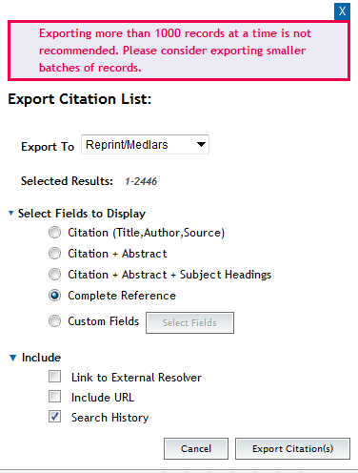
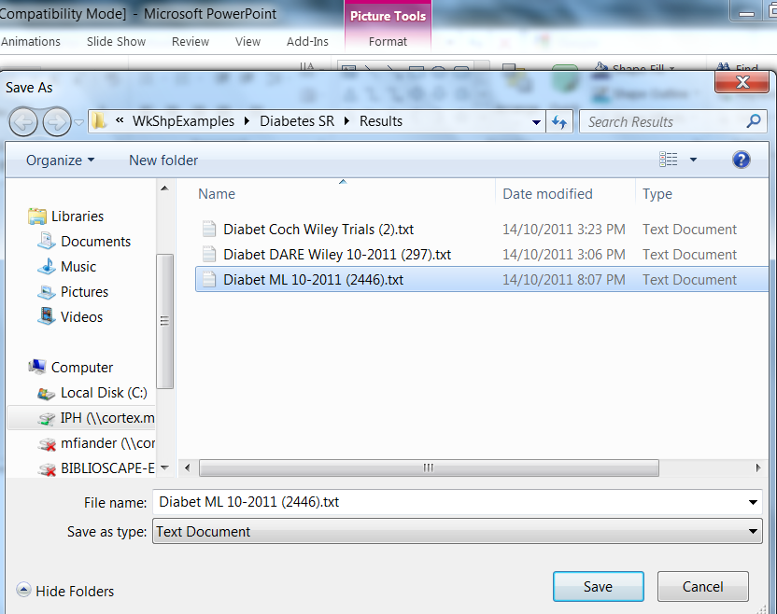
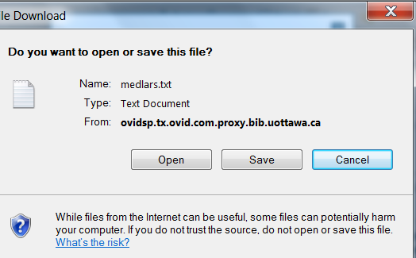
OVID Save Strategy while Exporting Results

Slide 51
Database: Ovid MEDLINE(R) In-Process & Other Non-Indexed Citations and Ovid MEDLINE(R) <1946 to Present>
----------------------------------
1 alcohol drinking/ or alcoholism/ or alcoholic intoxication/ (106577)
2 (alcohol$ or drinking).ti. (109335)
3 or/1-2 [Alcoholism] (153696)
4 Primary Health Care/ (47396)
5 (primary adj4 (care or healthcare or prevention)).ti,ab. (90277)
6 or/4-5 [Primary Care] (107534)
7 Guideline Adherence/ (16335)
8 (guideline? adj3 (adher$ or implement$ or application$ or concord$ or using or introduc$ or treatment? or screening or diagnos$)).ti,ab. (25457)
9 or/7-8 [GL Adherence/Implementation] (38966)
10 (randomized controlled trial or controlled clinical trial).pt. or randomized.ab. or placebo.ab. or clinical trials as topic.sh. or randomly.ab. or trial.ti. (783257)
11 exp animals/ not humans.sh. (3710539)
12 10 not 11 [Cochrane RCT Filter 6.4.d Sens/Precision Maximizing] (724300)
13 3 and 6 and 9 [Alcoholism & Prim Care & GL Adher--Gross] (18)
14 12 and 13 [RCT Results] (2)

Slide 52
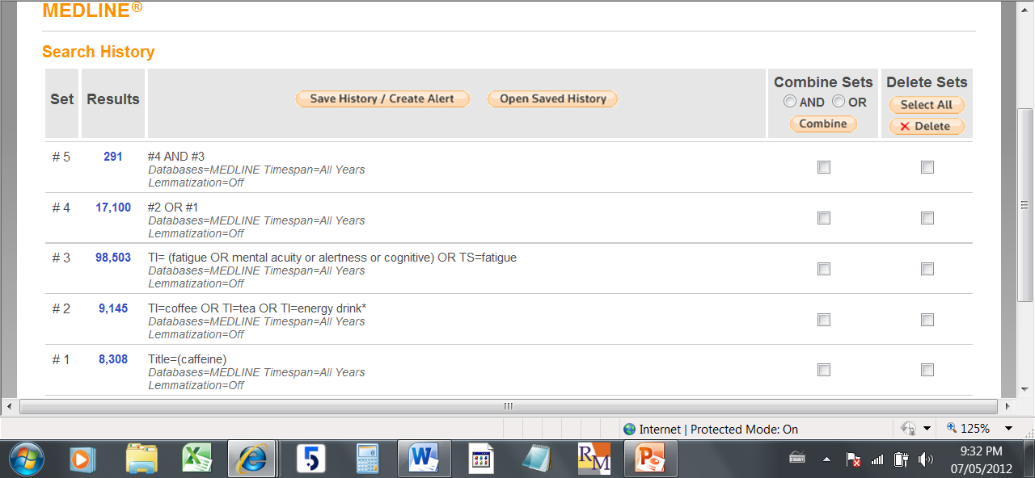
Screen Shot of Strategy

Slide 53
What is missing?
Medline (OVID)
1. alcohol drinking/
2. alcoholism/
3. alcoholic intoxication/
4. (alcohol$ or drinking).ti.
5. ((alcohol adj2 ("use" or abus$ or addiction? or consumption or depende$ or excess$ or misus$ or problem? or withdraw$)) or (alcoholic? or alcoholism)).ab.
6. or/1-5 [Alcoholism etc]
7. Primary Health Care/
8. General Practice/ or Family practice/ or General Practitioners/ or Physicians, Family/ or Physicians, Primary Care/ or General Practice, Dental/ or Primary Care Nursing/
9. (primary adj4 (care or healthcare or prevention)).ti,ab.
10. ((general or family) adj2 (practice? or practitioner? or physician? or doctor?)).ti,ab.
11. (routine adj2 (visit? or health care or healthcare)).ti,ab.
12. (general medical exam$ or health check? or check-up?).ti,ab.
13. or/7-12[Primary care]
How many results per line?
Filters anyone?
How are concepts combined?
What section of Medline was searched?

Slide 54
Hands-on
Go to PubMed pubmed.org
Search a few terms
Export results, save file
Save strategy “as run”

Slide 55
Bottom Line
Reader should be able to take the strategy , copy it into the database it was written for and get the same results.
The numbers shown in each strategy for each database should jive with gross numbers (before dupe removal) in PRISMA

Slide 56
Techniques
Develop a file management system for your SR
Save any search you run; any results you use
Create a database for result
  Import citations so that title, Journal etc appear consistently (use the correct Import Filter)
  Code results in your database (Endnote, Reference Manager, etc.)

Slide 57
File Management
Determine at beginning of a project/systematic review
File naming conventions for
  Search strategies
  Search results
  Screening results
Decide on an abbreviated title to represent your review
  Medication review in hospitals might be abbreviated as MedRev
  Reduction of antibiotic use in primary care—Antibi-PC or RedAntib
Use this abbreviation at the beginning of any and all files you create for your project
Purpose of filename is to clearly define content of file

Slide 58
File & Folder Names
  Diabetes SR [Top Level folder for the project]
    Manuscripts
      Diabet Methods.doc
      Diabet Results.doc
      Int to Improv HbA1c-Diabet.rm5
    Screening
      Diabet-Data Extract 1.0.doc
      Diabet-Data Extract 1.1.doc
      Diabet-Screen Lucy.xls
      Diabet-Screen Mic.xls
    Strategies
      Diabet-ML Strat .txt [strategy for Medline]
      Diabet-EM Strat.txt [Strategy for EMBASE]
      Diabet-Coch Strat.txt
    Results
      Diabet-ML 10-2011 (1256).txt
      Diabet-EM-10-2011 (987).txt
    Ref Man
      DiabetesSR-MASTER.rmd
      DiabetSR-Lucy.rmd
      DiabetSR-Mic.rmd

Slide 59

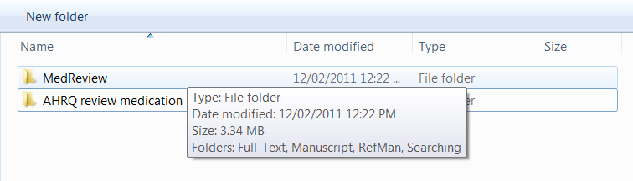
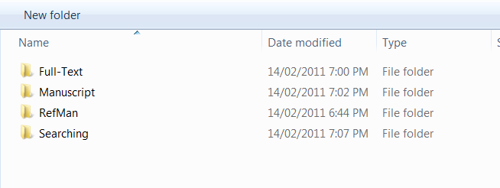
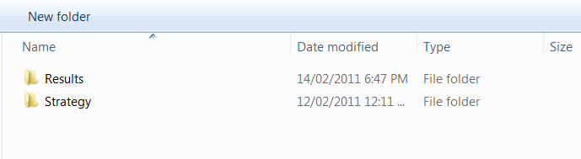

Folder Structure—e.g.

Slide 60
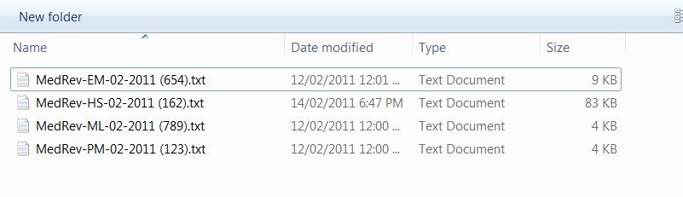
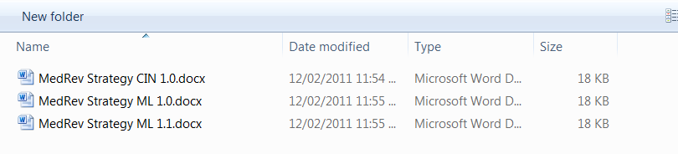
File names—Topic: Medication Review

Slide 61
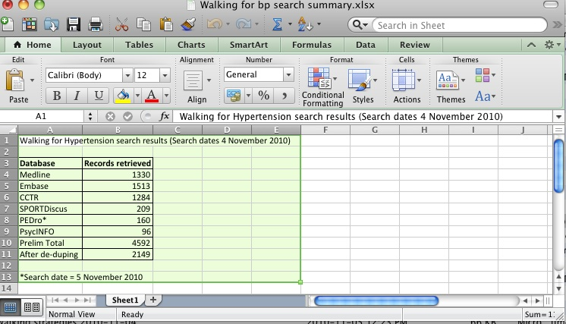
Search Data Sheet e.g 1

Slide 62
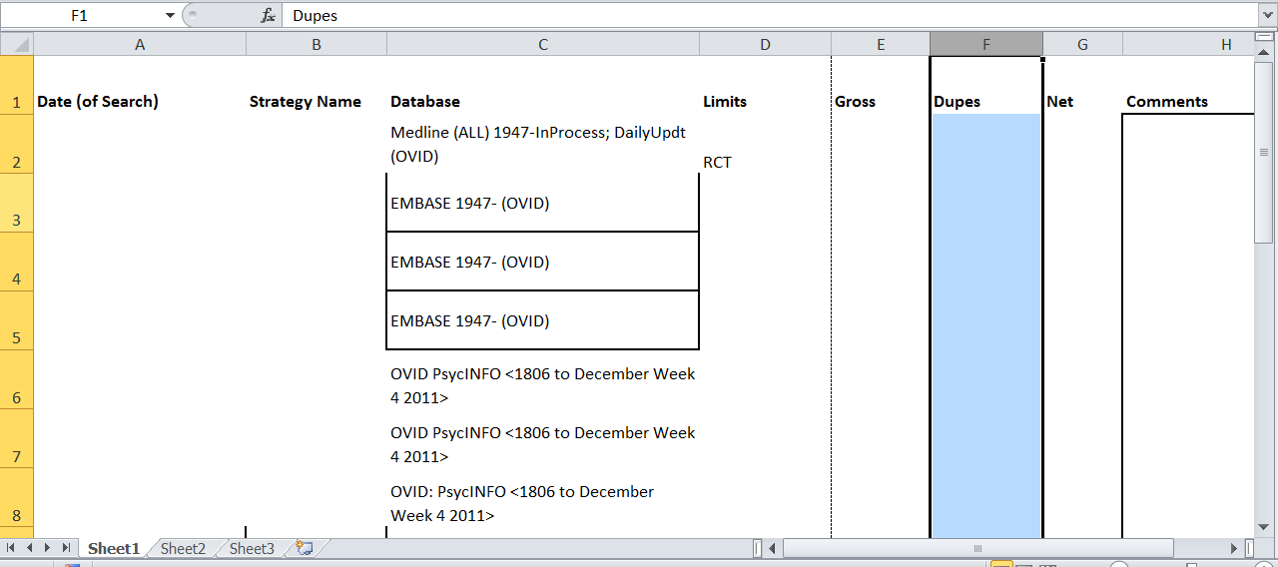
Search Data Sheet e.g. 2
Saving Strats\Edu Printed Material Search Data 1.2.pdf

Slide 63
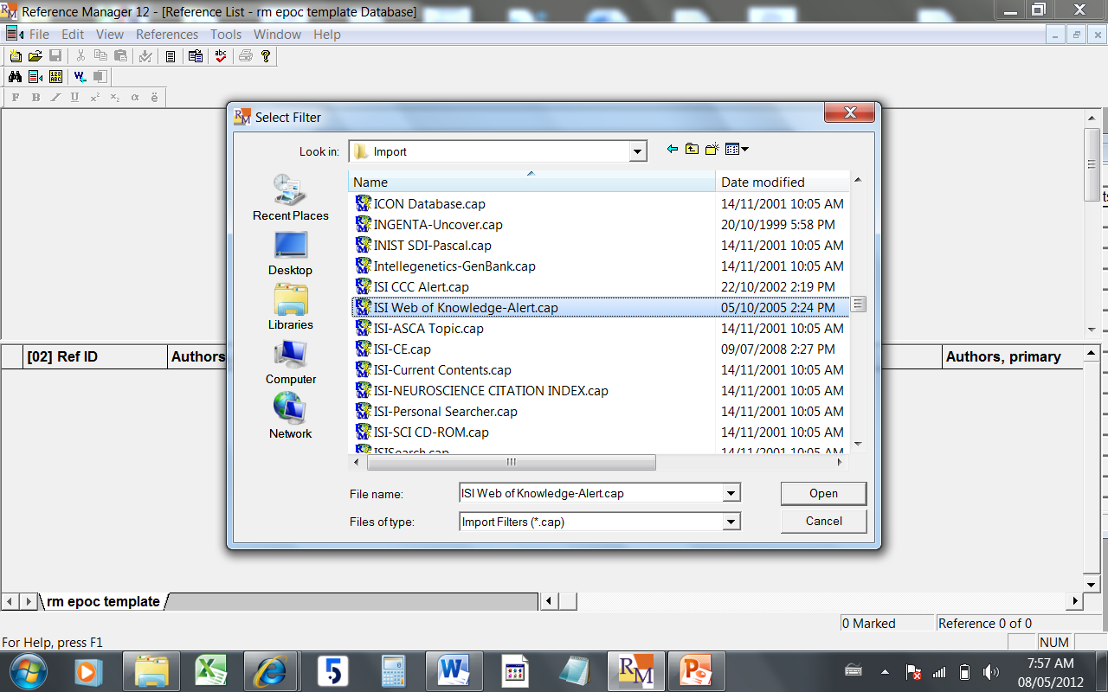
Your Database of Results: Import using an appropriate filter
Notes:
RM, Endnote etc have Import Filters for data exported from Bib databases; use the right ones to ensure the title of an article from Medline is in the same RM field as the title of an article from Cochrane Library. This will make deuping easier.

Slide 64
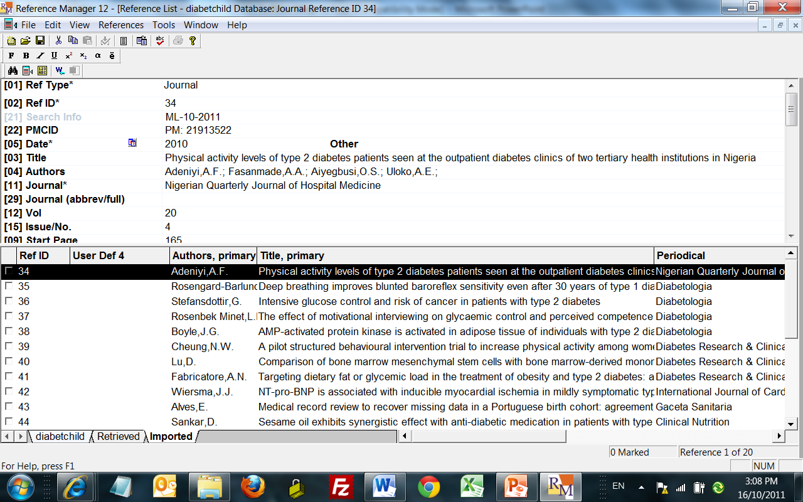
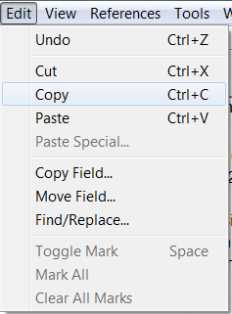
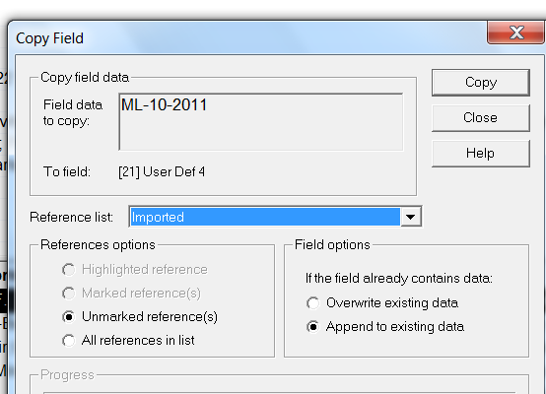
Add Search Info When Importing Search Results
Notes:
THIS WAY< YOU”LL have a database to dedupe against—because there is much duplication among databases, as well as cross over when updating searches. Note IMPORT tab (this is where most recently imported items are); copy field options (all? Or Marked? Usually will be all when coding the source of the results, e.g. Medline)

Slide 65
Grey Literature
Material not aggregated and available through a ‘single’ interface; difficult to find.
Documenting can be a lot of work.
http://cadth.ca/resources/grey-matters Provides sites and suggests method to document the search process used at each site.
Example: Saving Strats\Malaria Nets-Gray Lit ALL-2011.doc

Slide 66
Trial Registers
Current Controlled Trials
http://www.controlled-trials.com/
WHO International Clinical Trials Registry Platform
http://www.who.int/ictrp/en/

Slide 67
Summing up
MECIR describes standards and expectations for methodological aspects of SRs, including searching.
Key : capture searches run and document dates, number of results, in an ongoing basis.
Save documents, screen captures, results files using naming conventions which will keep like materials together. Plan ahead for this.

Slide 68
Thank you!
mfiander@ohri.ca
Cochrane EPOC (Effective Practice & Organisation of Care) Group
Centre for Practice Changing Research
OHRI (Ottawa Hospital Research Institute)
Ottawa, ON

Slide 69
Exporting Examples

Slide 70
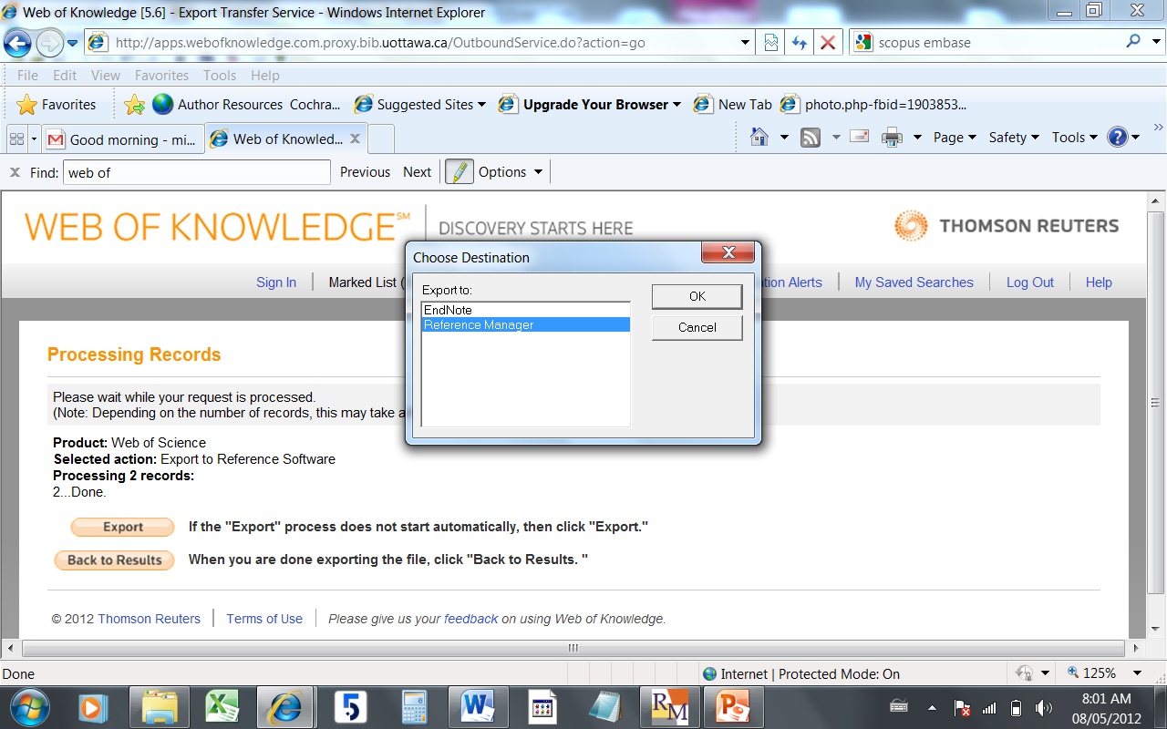
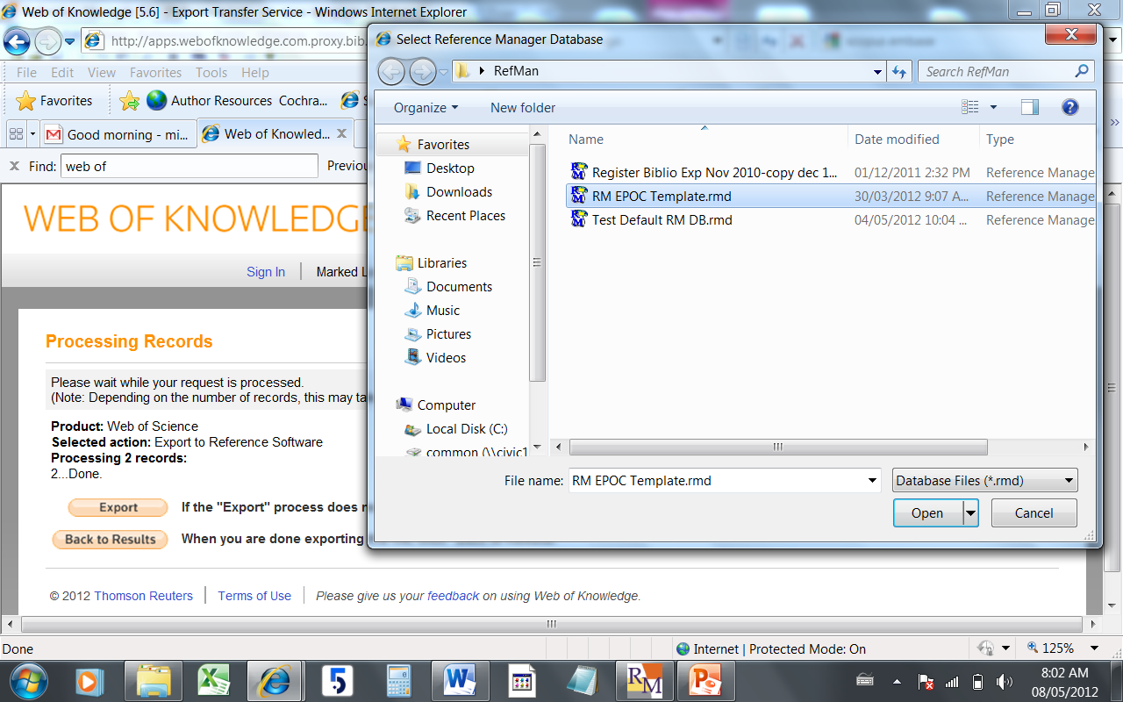

Slide 71
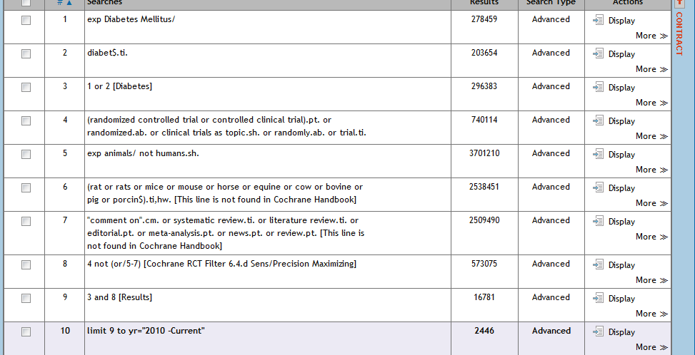
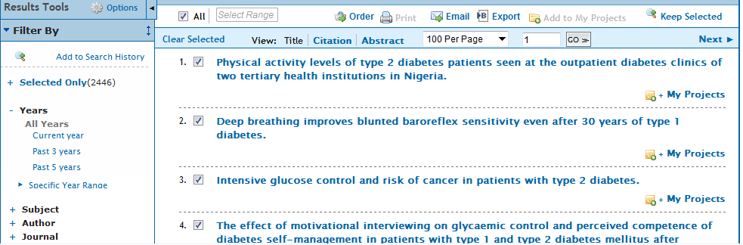
OVID: How To

Slide 72
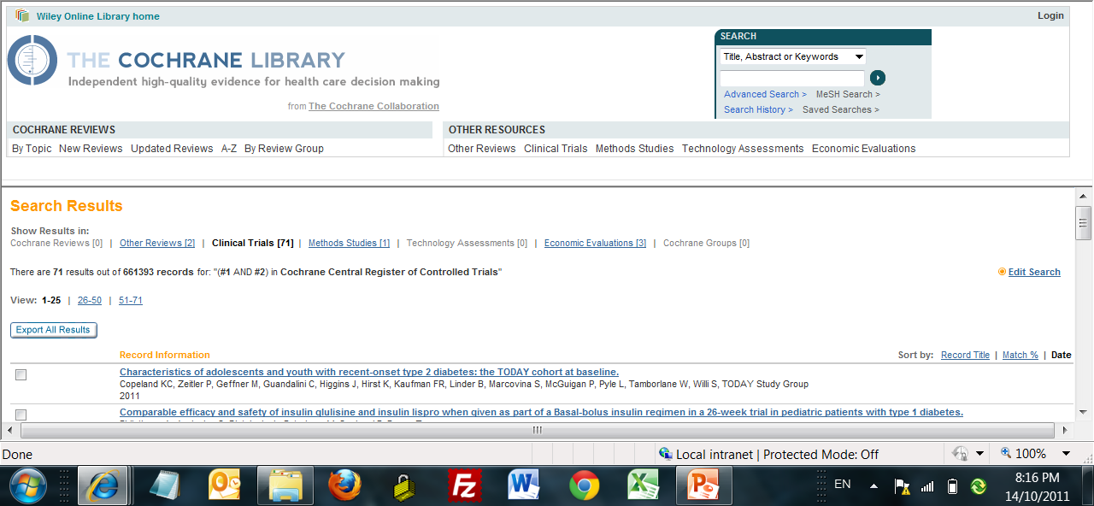
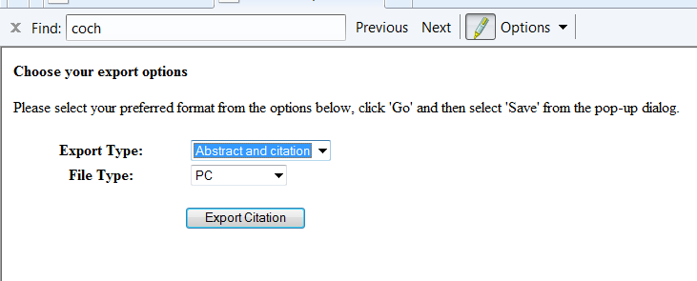
Cochrane (Wiley) Export

Slide 73
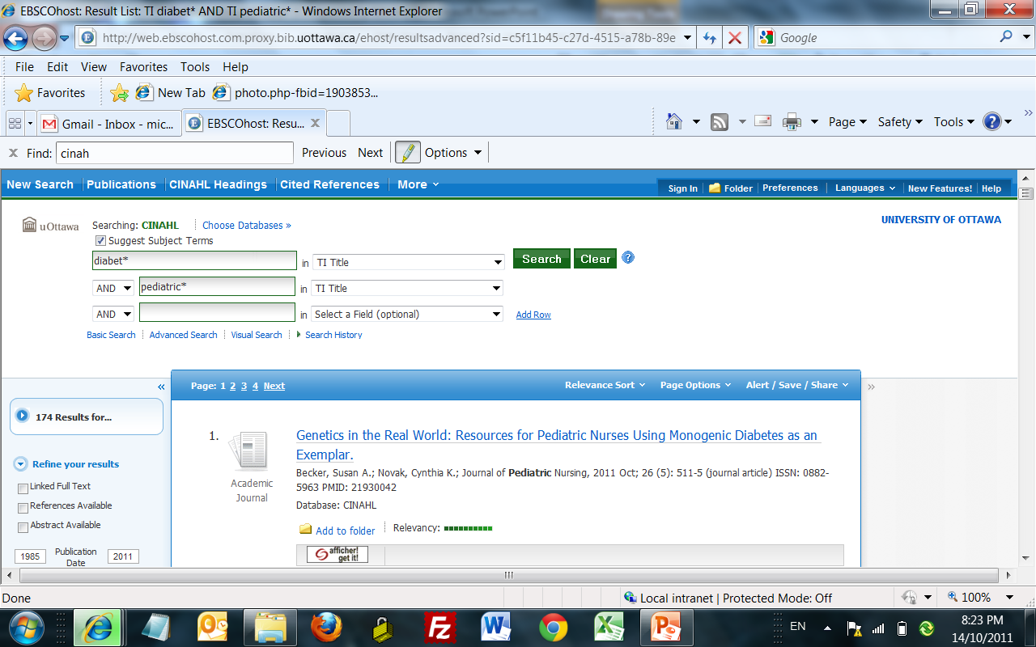
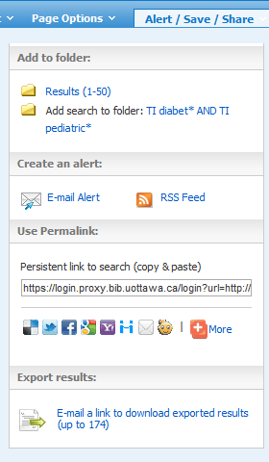
CINAHL (Ebsco) Export

Slide 74
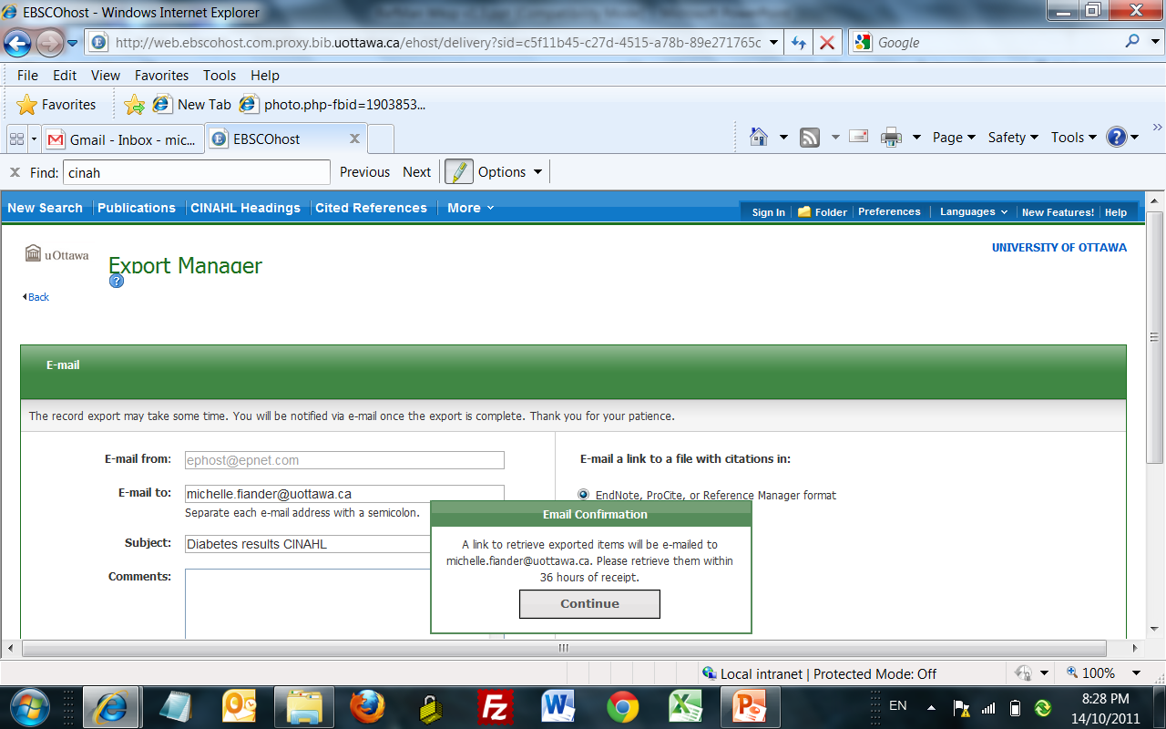

Slide 75
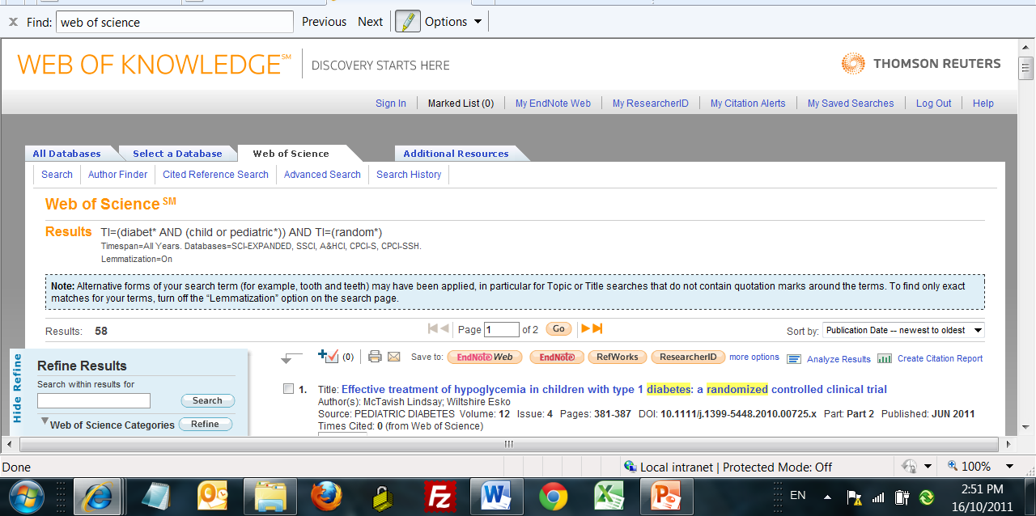
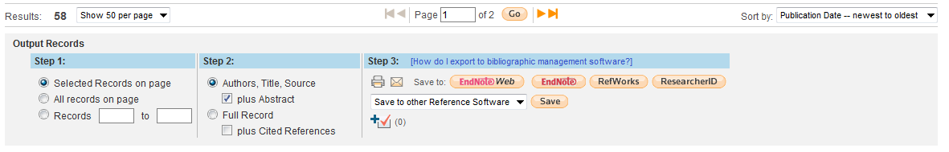
ISI Web of Science Export
Notes:
Scroll down to choose all, otherwise it is necessary to check each item. Choose Export to Other Reference Software for RefMan

