Slide 1
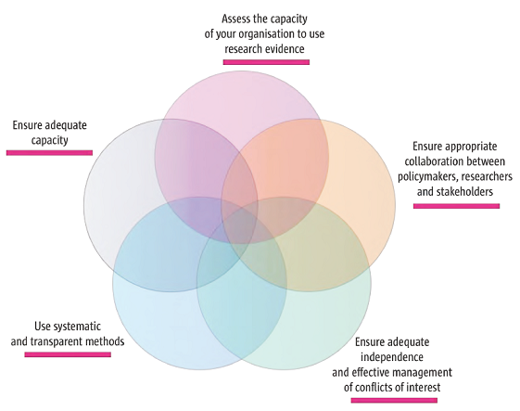
Improving how your organisation supports the use of research evidence to inform policymaking

Slide 2
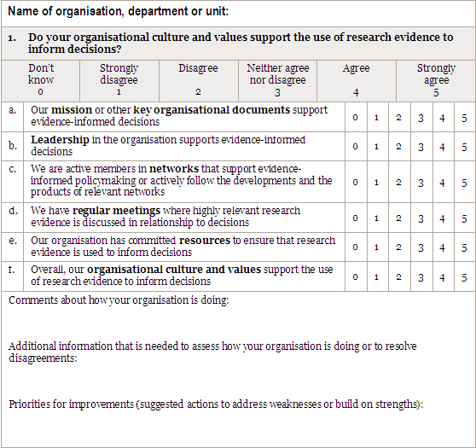
1. Do your organisational culture and values support the use of research evidence to inform decisions?

Slide 3
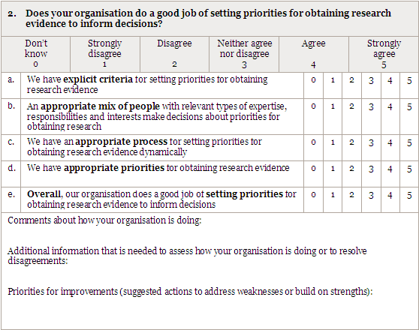
2. Does your organisation do a good job of setting priorities for obtaining research evidence to inform decisions?

Slide 4
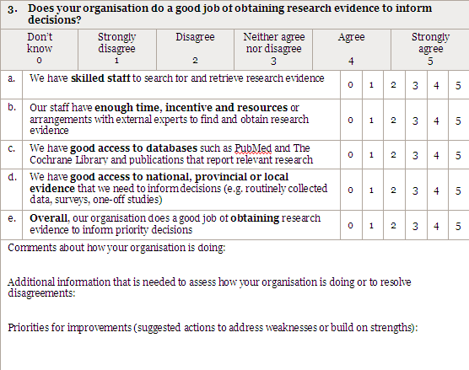
3. Does your organisation do a good job of obtaining research evidence to inform decisions?

Slide 5
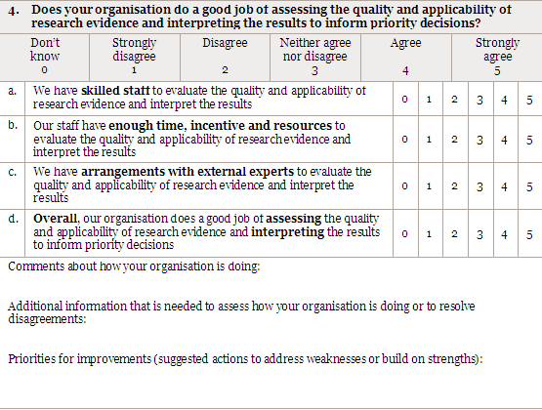
4. Does your organisation do a good job of assessing the quality and applicability of research evidence and interpreting the results to inform priority decisions?

Slide 6
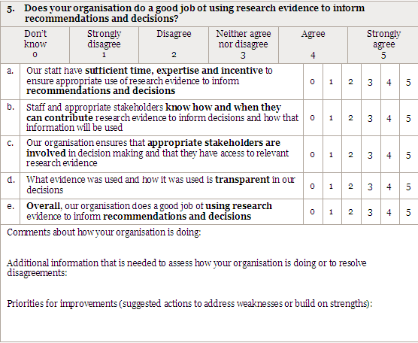
5. Does your organisation do a good job of using research evidence to inform recommendations and decisions?

Slide 7
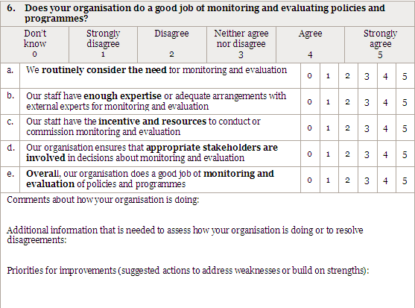
6. Does your organisation do a good job of monitoring and evaluating policies and programmes?

Slide 8
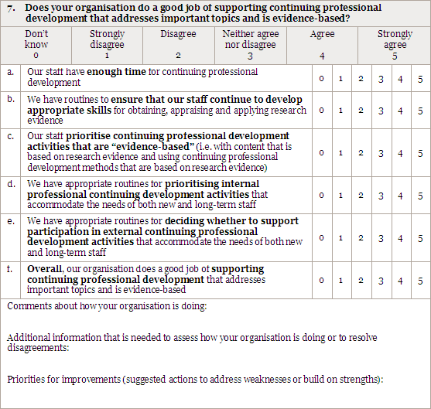
7. Does your organisation do a good job of supporting continuing professional development that addresses important topics and is evidence-based?

Slide 9
Lessons learned from the experience of organisations engaged in activities to support evidence-informed health policymaking
Establish strong links between policymakers and researchers, and involve stakeholders in the work undertaken
Be independent and manage conflicts of interest among those involved in the work
Use appropriate methods and be transparent in the work
Collaborate with other organisations
Start small, have a clear audience and scope, and address important questions
Build capacity among those working in the organisation
Be attentive to implementation considerations even if implementation is not a remit

Slide 10
Strategies that can help to ensure collaboration between policymakers and researchers
Locating those who support the use of research by policymakers within or close to those organisations responsible for policymaking
Involving policymakers on an advisory board or steering committee in instances when organisations are located outside government or policymaking organisations
Formal agreements linking academic organisations to policymaking organisations
Using trusted individuals as ‘knowledge brokers’ to build relationships among researchers and policymakers
Involving policymakers in research processes such as the preparation of policy briefs
Involving researchers in policy-informing processes such as policy dialogues
Skill development programmes for both policymakers and researchers

Slide 11
Options for managing conflicts of interest
Specific, detailed, structured disclosure forms
Explicit criteria to make decisions easier about whether a disclosed interest constitutes a conflict of interest
Range of strategies to manage disclosed conflicts of interest
Public disclosure of conflicts associated with each meeting as a minimum prerequisite, through to
Recusal of conflicted individuals as the most extreme measure
Standard policy requiring all financial ties to be made public
Standing committee to review all financial disclosure statements and to help ensure that conflict of interest policies are enforced

Slide 12
Arrangements to ensure that independence is maintained
Financial arrangements that minimise the risk of inappropriate influence on what evidence is summarised, or how it is summarised
Management arrangements, including the involvement of independent stakeholders in advisory boards or steering groups
Mechanisms for managing disputes such as independent arbitrators or appeal processes, particularly for governmental agencies that fund the work and for industry
Ensuring that decision making is transparent in terms of how evidence is accessed, appraised, summarised and publicly reported

Slide 13
Use of systematic and transparent methods
Methods should be described in easily accessible documents
Although organisational arrangements are likely to vary widely, a great deal of commonality in the methods that are used is likely - no need to reinvent the wheel
Systematic and transparent methods are time-consuming – it may sometimes be helpful to use more rapid methods that are “quick but clean enough”

Slide 14
Ensuring adequate capacity
Collaborate with other organisations, both informally and formally, to learn from their experience in order to avoid the unnecessary duplication of efforts, to draw on their capacity, and to help build capacity
Build capacity among those working in the organisation through training, making the best use of available staff (numbers are often limited), and actions aimed at retaining skilled staff
Start small, have a clear scope, and address important questions in order to ensure that available resources are focused on areas where they are needed most
Use more rapid methods that are rigorous but less resource-intensive

Slide 15
Questions or comments?

