Slide 1
Prioritising topics for policy briefs
Why bother?
What criteria will be used?
Which topics will be considered?
Who will participate?
What process will be used?

Slide 2
Why bother?
Limited resources for producing and using policy briefs
Consequently, only a limited number of policy briefs can be produced
It is necessary to decide which issues to address
Explicit criteria and systematic processes
More likely than implicit criteria and non-systematic processes to ensure well-informed decisions about which issues to prioritise
Challenges to consider when deciding on and applying a priority setting process for policy briefs
Ensuring that the process is both pro-active and reactive
Balancing the need for a rapid and efficient process with the need for a process that is explicit, systematic and fair

Slide 3
Priorities should be both proactive and reactive
Proactive
Focusing on long-term goals and strategic planning
Reactive
Can respond to unanticipated events and opportunities
Two ways of addressing both these needs are
Using criteria that capture both of these needs can help, for example:
A criterion that policy briefs should address important problems can help to focus on long-term goals and strategic planning
A criterion that there should be a window of opportunity for change can help to ensure that policy briefs respond to windows of opportunity
Using a process that allows for priorities to be revised or updated over short intervals of time

Slide 4
Policy briefs take weeks or months to prepare
Unlikely to be useful to set priorities for policy briefs years or even many months in advance
At least not without revising or updating them close to the time that a decision will be made
Yet, priority setting processes should occur far enough in advance that there is adequate time to
Collect the information that is needed to set priorities
Involve policymakers and stakeholders
Developing a list of priority issues that can be revised relatively quickly prior to making a decision to prepare a policy brief can help

Slide 5
Questions or comments about the need for setting priorities or the desirability of using explicit criteria and systematic processes?

Slide 6
Which topics will be considered
Priorities should reflect the views of those who will be involved in and affected by the decisions policy briefs will inform
Useful to consult policymakers and stakeholders widely about which topics should be discussed.
Consultation might include
A call for topics (problems or issues)
An email box or open phone line
Face-to-face or telephone meetings with key informants
An advisory board or a panel
Inviting comments on proposed topics
Interviews, focus groups or surveys

Slide 7
Which criteria will be used to set priorities?
Is the problem/topic important?
Are viable options available that address the problem/topic and/or strategies for implementing options that may have an important impact on the problem?
Is there an opportunity for change?

Slide 8
Is there an opportunity for change?
Have political or other events opened – or could they open – a window of opportunity?
If so, a policy brief is more likely to be useful than if change is unlikely
Is there an identifiable champion for the issue?
It is important that an individual or organisation is available to ensure that the outcomes of the policy brief and dialogue are acted upon
If not, there is a high risk that nothing will happen
Such a champion may be someone in the Ministry of Health or another key stakeholder

Slide 9
Additional considerations
Is there important uncertainty about the problem/topic and potential solutions?
Is relevant research evidence available?
Is there interest in informed deliberation about the problem and potential solutions?

Slide 10
Questions or comments about criteria for setting priorities?

Slide 11
Who will participate in setting priorities?
Likely to be a small group that ideally should include
Policymakers with a broad overview of the health system
Health system researchers with a broad overview of research
Key stakeholders with different perspectives
Others with relevant expertise
May be pragmatic for producers of policy briefs to decide
But having a broader steering group decide may help
Ensure appropriate representation of different perspectives
Protect against the interests of policy brief producers inappropriately influencing decisions
Ensure that policy briefs address important problems and are used to inform decisions

Slide 12
Questions or comments about who should participate in setting priorities?

Slide 13
What process will be used to set priorities?
A systematic and transparent process should be used to ensure that the criteria are appropriately applied
Both the data used and unmeasured factors should be considered explicitly and transparently
Data to inform judgements are often lacking
Unmeasured factors should also be considered
Group processes should ensure full participation
Skilled, knowledgeable and neutral chair or facilitator can help ensure
Participation
Good use of time
Adherence to agreed upon processes
That implicit assumptions and the basis for those assumptions are made explicit

Slide 14
The process should be fair
To ensure this, four criteria should be met
Relevance
Rationales for decisions should rest on reasons (criteria and information) that ‘fair-minded’ people can agree are relevant in the context
Transparency
Decisions and their rationales should be publicly accessible
Revisions
Ideally, draft priorities should be open to comment prior to finalising decisions
Documentation
The process used to set priorities should be documented to ensure adherence to the agreed process and that the first three criteria are met

Slide 15
Worksheet for planning a priority setting process
Who is responsible for the priority-setting process?
What criteria will be used to set priorities?
Who will participate in setting priorities?
What potential priorities have already been identified?
Who will be consulted to generate additional potential priorities?
Who will be consulted about potential priorities after they are identified?
What if any additional information will be collected to inform decisions about priorities and how?
How will potential priorities be ranked?
Who will make the final decision regarding priorities?

Slide 16
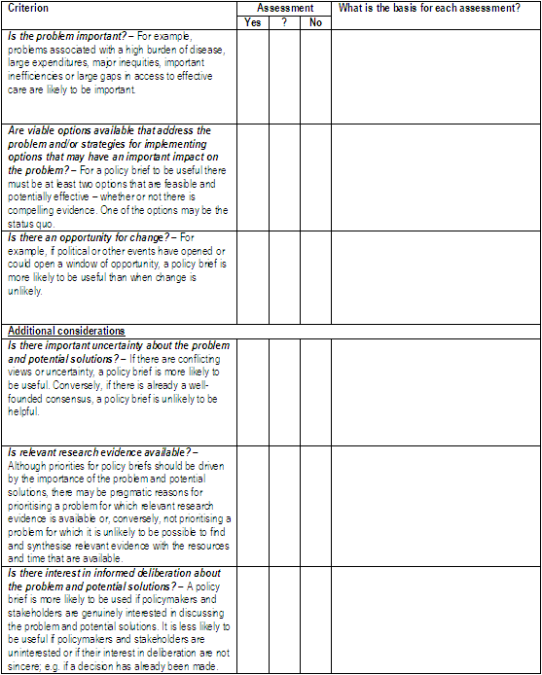
Worksheet for summarising the basis for prioritising a policy brief

Slide 17
Outline for summarising a priority setting process
Who was responsible for the priority-setting process?
What criteria were used to set priorities?
Who participated in setting priorities?
Who was consulted to generate potential priorities?
Who was consulted about potential priorities after they were identified?
What if any additional information was collected to inform decisions about priorities and how?
Who made or will make the final decision regarding priorities?
What potential priorities were considered?
How were they ranked and what was the basis for their ranking?

Slide 18
Questions or comments about how priorities should be set?

