Slide 1
Clarifying the problem
What is the problem and how did it come to attention?
How has the problem been framed (described) and what are the consequences of this?
How big is the problem?
What is the cause of the problem?

Slide 2
Suggested outline for the problem section of a policy brief
The problem
Background (What is the problem and how did it come to attention?)
(Framing of the problem)
Size of the problem
Factors underlying the problem

Slide 3
What is the problem and how did it come to attention?
How was the problem described when the decision to prepare a policy brief was taken?
A description of how the problem came to attention
The motivation for preparing a policy brief on this particular problem
Subsequent iterations and analysis may lead a better way of framing the problem

Slide 4
What is the problem and how did it come to attention?
It is not uncommon for health system problems to be unclear when they first come to attention
A solution or a diagnosis rather than a problem may be brought to attention
Before appropriate options can be identified it is necessary to clarify what the problem is
Interactions with policymakers and other stakeholders may be needed to uncover what the problem is before preceding
Alternatively, it may be helpful simply to flag uncertainty about what the problem is and to facilitate subsequent discussion of this

Slide 5
Knowing how the problem came to attention can both help to clarify what the problem is and the extent to which it warrants attention
Ways in which a problem might come to attention include
A specific event
A change in an indicator
A lack of progress towards established goals
Advocacy
Public dissatisfaction
E.g. brought to attention through polls or the mass media
A political consensus
A political event
Pressure from donors or international agencies
A priority setting process

Slide 6
Sources
A description of the priority setting process that was used (if any)
Key informants
Policy documents
News reports

Slide 7
Questions or comments about clarifying the background of how a problem came to attention?

Slide 8
Describe in a few sentences how your problem came to attention
How did the problem come to attention?
What is the motivation for preparing a policy brief on this particular problem?
What initial considerations arose about how the problem is framed?

Slide 9
How has the problem been framed (described) and what are the consequences of this?
How a problem is framed or described can determine
What sorts of options are considered to address the problem
The extent to which the problem is perceived by stakeholders to warrant attention
It is useful to reflect on different ways of framing the problem in relation to:
How the problem came to attention
Available indicators and comparisons
An analysis of the cause of the problem
Such reflection can help to ensure that the problem is framed in a way that
Resonates with stakeholders
Leads to the identification of appropriate options
This is likely to be an iterative process

Slide 10
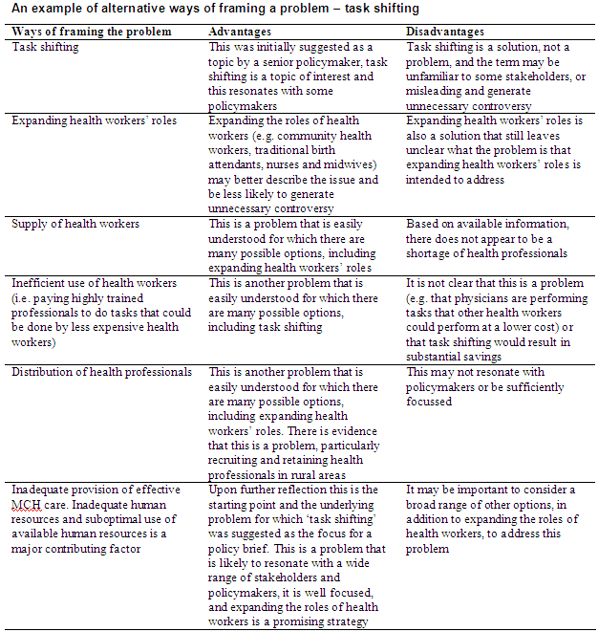
Constructing a table may help clarify how best to frame the problem

Slide 11
Questions or comments about framing the problem?

Slide 12
How big is the problem?
Different indicators may be relevant to estimating the size of a problem, depending on whether the problem is described in terms of
A risk factor or disease
Coverage, quality of care, cost of care, or equitable access to care
Delivery, financial or governance arrangements
Implementation of agreed policies or programmes

Slide 13
Sources of data on the size of a problem
Risk factors and burden of disease
Epidemiological surveys
Routinely collected data
Health services utilisation
Routinely collected data
Studies of
Access to or utilisation of care
Quality of care
Health care expenditures
Inequities
Health system arrangements and the implementation of policies
Highly variable and may be difficult to find
Sources include
Government documents
Data collected by the government or other agencies on their behalf
Studies that describe or analyse health system arrangements or policy implementation

Slide 14
Implicit or explicit comparisons are needed to establish how big a problem is
Explicit comparisons can help clarify the size of the problem. This includes
Comparisons with goals
E.g. the MDGs for maternal or child mortality
Comparisons with other problems
Comparisons over time
E.g. an increase in treatment failures or the prevalence of a disease or risk factor
Comparisons across areas within a country
E.g. variations in access to or utilisation of services
Comparisons with other countries
E.g. differences in mortality or prevalence rates in comparable countries or changes in these over time in those countries

Slide 15
Sources of information for making comparisons
Goals or targets
Government or international documents
Comparisons over time and across areas within a country (same as for indicators)
Epidemiological surveys
Routinely collected data
Studies of access to or utilisation of care, quality of care, health care expenditures, or inequities
Comparisons with other countries
Published studies
International data
E.g. from WHO, the World Bank, GAVI or the Global Fund

Slide 16
Questions or comments about clarifying the size of the problem?

Slide 17
What is the cause of the problem?
Understanding the cause of a problem can help to
Guide the identification and selection of appropriate options
Frame the problem
Causes of health systems problems are complex and uncertain
Clarifying the cause is unlikely to be a simple linear process
It may be important to clarify uncertainty
Strategies include
Using broad or more specific frameworks
Brainstorming
Reviewing relevant research evidence
Interviews with key informants

Slide 18
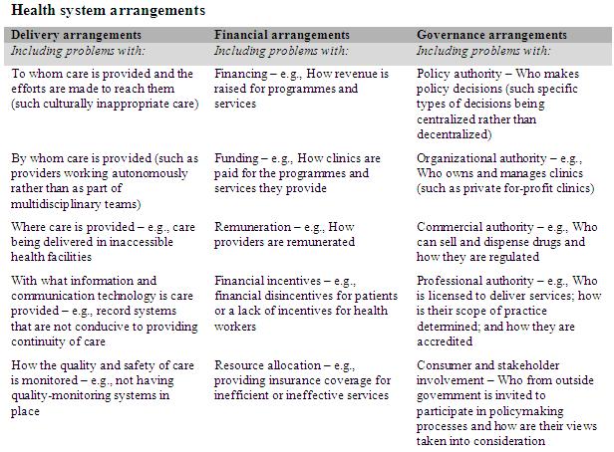
A broad framework for health system problems

Slide 19
For example
Although the problem may initially have been described as a problem with, for example, delivery arrangements
E.g. a shortage of health workers in rural areas
The cause of this shortage may have to do with financial or governance arrangements
E.g. how health workers are remunerated
E.g. licensing of different types of health workers to perform specific tasks

Slide 20
More specific frameworks may facilitate a more detailed consideration of the potential causes of some types of problems
You can easily search for such frameworks using Google Scholar or PubMed. Combine the word ‘framework’ with key words describing the problem
Often the most efficient way of finding these frameworks is to talk with people with expertise in the specific area
Other sources of frameworks include
Other policy briefs on closely related issues
Policy analyses
Systematic reviews
Overviews of systematic reviews

Slide 21
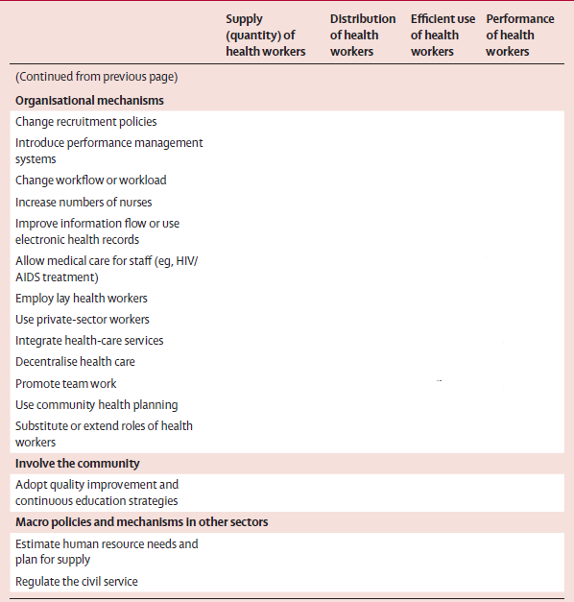
A human resources framework

Slide 22
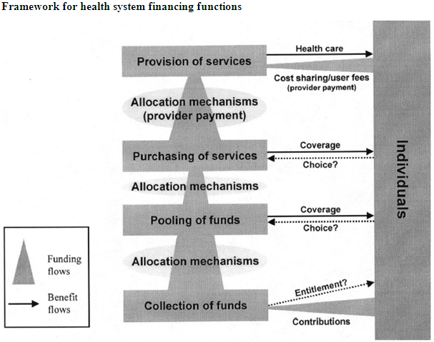
A healthcare financing framework

Slide 23
Brainstorming or creative thinking is likely to be helpful and may be essential
May be done in a
Structured way, using a framework
Unstructured way
Desirable to involve people with
Different perspectives
A broad knowledge of the health system
May be an iterative process, including
Hypothesising about potential causes of the problem
Looking for information to support or refute hypotheses
Discussing the causes of the problem again

Slide 24
Sources of information to support or refute hypotheses
Routine health information systems
Studies that have been undertaken within the country
E.g. of the perceptions and attitudes of patients or health workers
Studies that have been undertaken internationally or in other settings with similar problems
Key informants
Through interviewing or discussing the problem with individuals with relevant experience or knowledge

Slide 25
Problem clarification can be done too rapidly or in too cursory a way
Consequences of this can include
A lack of clarity about what the problem is
Focusing on a problem that is not important or not perceived to be important by key stakeholders
Consideration of inappropriate solutions and failing to consider appropriate solutions
A failure to reconsider the problem iteratively as additional information is found can have the same consequences
Discussing a draft of the problem section with stakeholders before preparing the rest of a policy brief can help to ensure that these undesirable consequences are avoided

Slide 26
Questions or comments about understanding the cause of the problem?

Slide 27
➢ How will you find a suitable framework for your problem? ➢ What key factors underlie your problem? ➢ How will you find evidence regarding those factors? ➢ With whom and how will you consult about whether you have clearly described an important (and solvable) problem in a way that resonates with stakeholders?

Slide 28
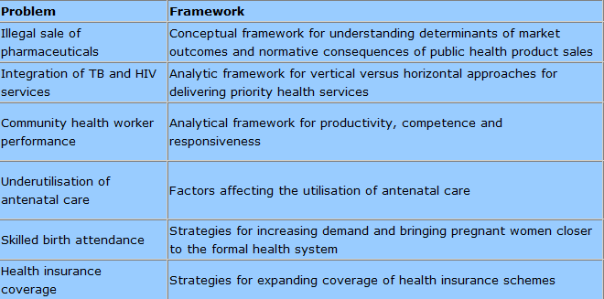
Examples of frameworks

Slide 29
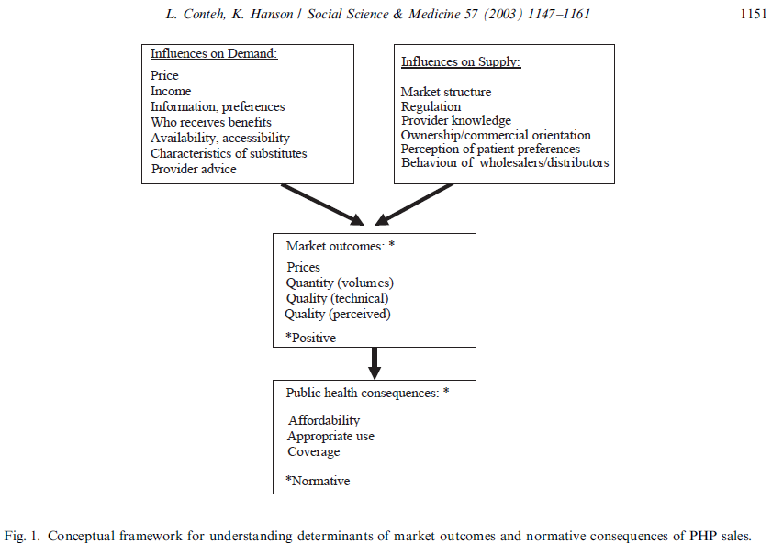
Framework for exploring the problem of the illegal sale of pharmaceuticals

Slide 30
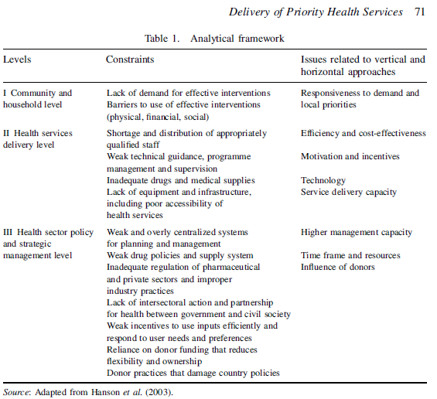
Framework for exploring the problem of the integration of TB and HIV services

Slide 31
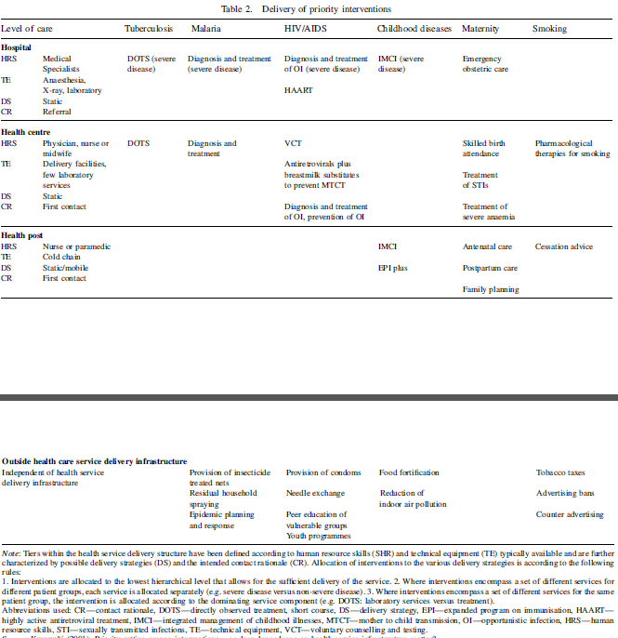
Framework for exploring the problem of the integration of TB and HIV services

Slide 32
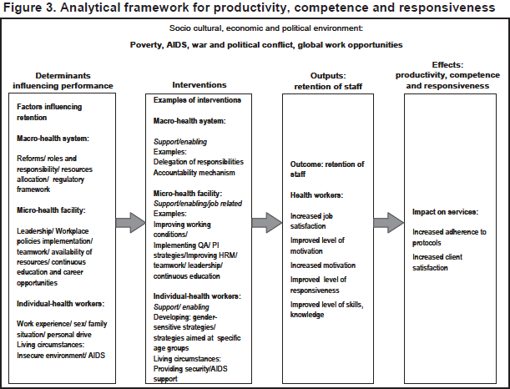
Framework for exploring the problem of community health worker performance
Improving health worker performance: in search of promising practices. Marjolein Dieleman and Jan Willem Harnmeijer. WHO 2007.

Slide 33
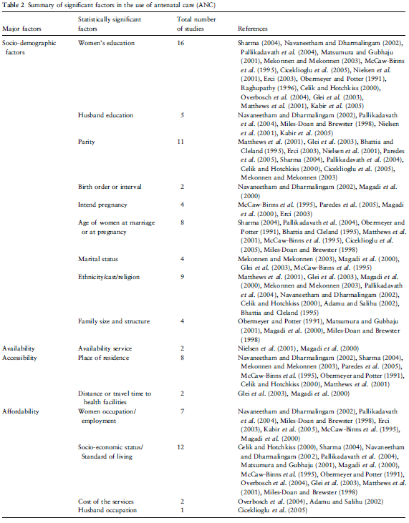
Framework for exploring the problems of the underutilisation of antenatal care and low skilled birth attendance
Simkhadaet al. Factors affecting the utilization of antenatal care in developing countries: systematic review of the literature. Journal of Advanced Nursing 2008;, 61: 244–260.

Slide 34
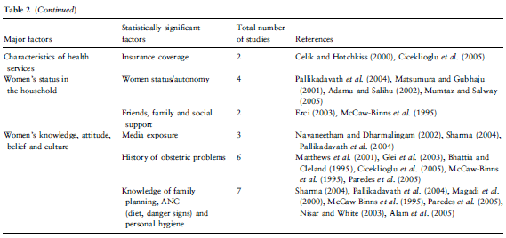
Framework for exploring the problems of the underutilisation of antenatal care and low skilled birth attendance
Simkhadaet al. Factors affecting the utilization of antenatal care in developing countries: systematic review of the literature. Journal of Advanced Nursing 2008;, 61: 244–260.

Slide 35
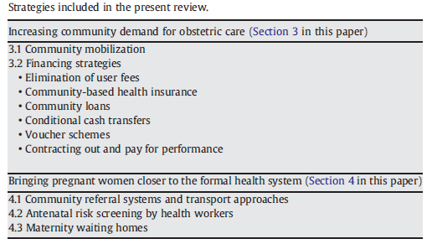
Framework for exploring the problems of the underutilisation of antenatal care and low skilled birth attendance
A.C. Lee et al. / International Journal of Gynecology and Obstetrics 107 (2009) S65–S88

Slide 36
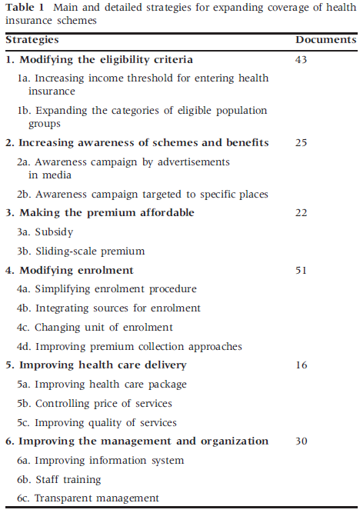
Framework for exploring problems related to health insurance coverage
Q Meng et al. Expanding health insurance coverage in vulnerable groups: a systematic review of options. Health Policy and Planning 2010;1–12.

Slide 37
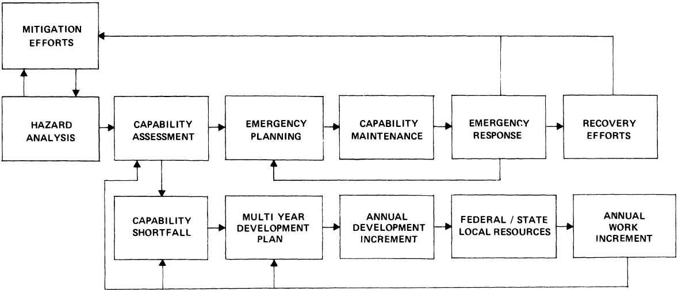
Framework for exploring problems related to the management of emergencies

Slide 38
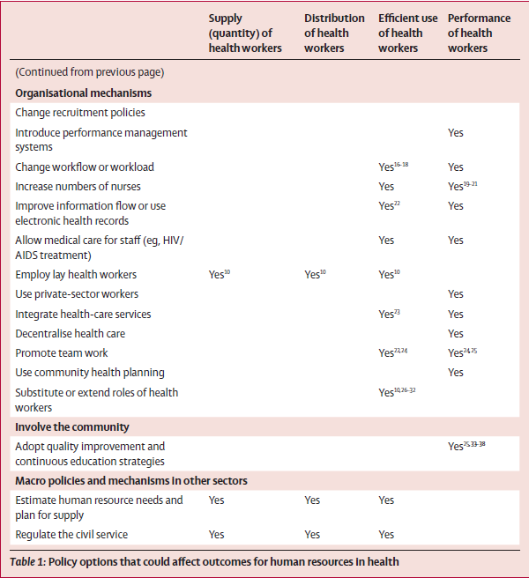
Framework for exploring problems related to human resources for health

Slide 39
STP versus SURE Clarifying the problem
STP
SURE
What is the problem?
How did the problem come to attention and has this process influenced the prospect of it being addressed?
What indicators can be used or collected to establish the magnitude of the problem and to measure progress in addressing it?
What comparisons can be made to establish the magnitude of the problem and to measure progress in addressing it?
How can a problem be framed (or described) in a way that will motivate different groups?
What is the problem and how did it come to attention?
How has the problem been framed (described) and what are the consequences of that?
How big is the problem?
What is the cause of the problem?

