Slide 1
Deciding on and describing policy options
What policy options should be presented?
What is known about their impacts?
How confident can we be about the likely impacts?
How should information about the likely impacts be summarised?

Slide 2
It should be clear why or how policy options were selected
The selection of policy options to be presented in a policy brief often flows logically from the description of the problem
Particularly from the analysis of the cause of the problem or underlying factors
The rationale for deciding which policy options to present in a brief should be provided at the beginning of the section in the brief in which the options are described
When relevant, this should include a statement of why any other options that were considered were excluded
More detailed information about the reasons for excluding or including specific options can be included as an appendix

Slide 3
Which policy options should be presented?
Strategies for identifying potential options include
Considering alternative delivery, financial and governance arrangements that address the problem or its underlying causes
Using frameworks developed to address the specific problem
Considering interventions described in systematic reviews or overviews of reviews
Considering ways in which other jurisdictions have addressed the problem
Consulting key informants
Brainstorming

Slide 4
Creative thinking
Focuses on exploring ideas, generating possibilities and looking for many options
In contrast to critical thinking, which focuses on analysis, figuring out the answer and eliminating incorrect options
Both types of thinking are necessary for identifying and selecting appropriate options
Creative thinking
Critical thinking
Generative
Divergent
Possibility
Suspended judgement
Diffuse
Analytic
Convergent
Probability
Judgement
Focused

Slide 5
Brainstorming
Developed to enhance the ability of work groups to solve problems creatively
No evaluation of the effectiveness of any given alternative is undertaken while the group is generating alternatives
Evaluation of alternatives comes at a later stage in the problem-solving process
The leader of the group places no parameters upon the group regarding what kinds of alternatives or solutions should be suggested
The team leader should encourage the group to come up with novel ideas
The quantity of ideas should initially take precedence over the quality of ideas
The leader should push the group to produce a large number of ideas irrespective of their quality
Participants should feel free to add to or modify previous ideas proposed by others
Marginal ideas that are added upon or altered in some fashion can be transformed into powerful solutions
It should be emphasized that ideas do not belong to the individual who presents them, but to the group

Slide 6
Health system problems are complex
The causes of and solutions to these problems may also be complex
Specific options may be complex
E.g. organising a system to recruit, train, support and retain community health workers to deliver maternal child care
In addition, it may be necessary to consider bundles or packages
Including different delivery, financial and governance arrangements

Slide 7
Deciding on which options should be described in a policy brief
May be straight forward
E.g. if the policy brief is being prepared to describe a specific solution that has already been proposed
Or may require several iterations:
Consider a broad range of options
Narrow the selection down to the most viable ones by appraising each on the basis of evidence and acceptability
Examine what additional changes in delivery, financial, and governance arrangements might be needed in conjunction with these options
Or
Consider potential delivery, financial, and governance arrangements as potential elements of policy options
Appraise the evidence for those elements
Determine whether and how to bundle or package viable elements into policy options

Slide 8
A framework can help to structure consideration of potential options
The same framework used to clarify the causes of a problem may be used to identify potential options
A broad framework for health system problems
May be used both to clarify the causes of a problem and to identify potential solutions
More specific frameworks
May facilitate consideration of the potential options for some types of problems; e.g.
A framework for addressing problems with human resources for health might be used to systematically think through potential solutions, as well as causes for problems such as a shortage of health workers, their distribution, their performance, or their cost
A framework for health care financing may help to systematically think through both problems with health care financing and potential solutions

Slide 9
Finding a framework
Strategies for finding a framework include
Talking to people with expertise in the specific area of interest
.
Searching Google Scholar or PubMed
Combine the word ‘framework’ with key words describing the problem
Looking in other policy briefs on the same or closely related issues, policy analyses, systematic reviews or overviews of systematic reviews

Slide 10
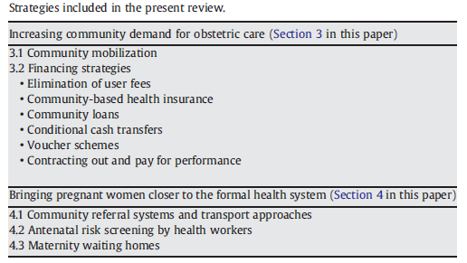
An example of a framework: Skilled birth attendance
Lee ACC, Lawn JE, Cousens S, et al. Linking families and facilities for care at birth: What works to avert intrapartum-related deaths? International J Gyn Obs 2009; 107: S65–S88

Slide 11
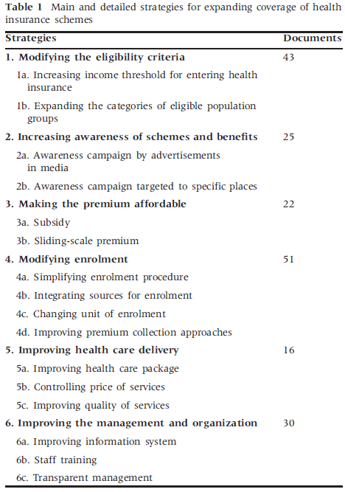
Another example of a framework: Health insurance coverage
Meng Q, Yuan B, Jia L, et al. Expanding health insurance coverage in vulnerable groups: a systematic review of options. Health Policy Planning 2010; 1–12.

Slide 12
Options may or may not be mutually exclusive
If options are mutually exclusive, i.e. it is necessary to make a choice among two or more options
They should be described in a way that facilitates comparison across the options and a well-informed assessment of their pros and cons
If the options are not mutually exclusive
A policy brief should make clear any potential benefits of combining the different options, as well as the pros and cons of each option

Slide 13
Questions or comments about identifying options and deciding which ones to present?

Slide 14
What is known about the impacts of each option?
Finding systematic reviews
Selecting systematic reviews
Judging how much confidence to place in a systematic review

Slide 15
Finding systematic reviews
The ideal starting point for finding out what is known about the impacts of potential options is a systematic review
There are an increasing number of systematic reviews of health system arrangements and implementation strategies
Good places to begin searching for systematic reviews that address the impacts of health systems arrangements include
Health Systems Evidence www.healthsystemsevidence.org
The Cochrane Library www.thecochranelibrary.com
PubMed www.pubmed.gov
EVIPNet VHL (work in progress) www.evipnet.org

Slide 16
Judgements about the applicability of the results of systematic reviews
Judgements about possible differences between where research was done and your setting are necessary
This includes considerations of differences in
Structural elements of health systems
Such that an option could not work in the same way
On-the-ground realities and constraints
That might substantially alter the potential benefits of the option
Perspectives and influences of health system stakeholders
Such that the option may not be accepted or taken up in the same way
Baseline conditions (risks) may result in different absolute effects
Even if the relative effectiveness is the same
This may not lower confidence in the evidence
But it is important to take account of this

Slide 17
Judging how much confidence to place in a systematic review
Judgements are needed about the extent to which a review is likely to provide a reliable summary of the best available evidence of the impacts of an option
Deciding how much confidence to place in a review is a different judgement than deciding how much confidence to place in the evidence
Use of a checklist can help guide these judgements and make them transparent to others

Slide 18
Summary assessments
The criteria in a checklist can be used to determine whether a review has minor, moderate or major limitations
Fatal flaws
Limitations that are important enough to consider the results of the review not reliable. The results should not be used in the policy brief
It may still be possible to draw some key messages or useful information from the review; e.g. a framework for identifying potential options
Important limitations
Limitations that are important enough that it would be worthwhile to search for another systematic review or
To interpret the results of the review cautiously, if a better review cannot be found and
To potentially supplement the information provided in the review with additional searches or information from included studies
Reliable
Only minor limitations – the review can be used as a reliable summary of the best available evidence

Slide 19
When a reliable systematic review cannot be found
It may be necessary to search for individual studies either to supplement the information in a review or in place of a systematic review
If this is done, attention should be paid to the same processes that are used in a systematic review
i.e. so far as possible, systematic and transparent (explicit) methods should be used to
Find, select and critically appraise studies
Synthesize the results of relevant studies
Ideally the methods should be described in an appendix to the policy brief

Slide 20
Questions or comments about using systmatic reviews as a basis for judgements about the likely impacts of options?

Slide 21
How confident can we be about the likely impacts of an option?
Policymakers and stakeholders must trade off the benefits and downsides of different options
They will be influenced not only by the best estimates of the expected advantages and disadvantages, but also by their confidence in those estimates
i.e. the quality of the evidence
GRADE provides a structured and transparent framework for making judgements about the quality of evidence

Slide 22
Using the GRADE framework
Separate ratings of evidence quality should be made for each important outcome
The GRADE framework begins with the study design
Randomised trials provide, in general, stronger evidence than observational studies
Therefore, randomised trials without important limitations constitute high quality evidence
Observational studies without special strengths or with important limitations generally provide low quality evidence
However, there are a number of factors that can reduce or increase our confidence in estimates of effect

Slide 23
Factors that can lower the quality of the evidence
Study limitations
Inconsistent results across studies
Indirectness of the evidence
Imprecision
Publication bias

Slide 24
Study limitations
Our confidence in estimates of effect decreases if studies suffer from major limitations that may bias their estimates of the intervention’s effect
For randomised trials these limitations include, for example
Lack of allocation concealment
Lack of blinding, particularly if outcomes are subjective and their assessment highly susceptible to bias
A large loss to follow-up
Failure to adhere to an intention-­to-treat analysis
Failure to report outcomes

Slide 25
Inconsistent results across studies
Widely differing estimates of effects across studies for which there are no compelling explanations reduce our confidence in knowing what the true effect is
Variability may arise from
Differences in populations
E.g. interventions may have smaller relative effects in disadvantaged populations
Differences in interventions
E.g. smaller effects with smaller financial incentives
Differences in outcome meaasures
E.g. diminishing effects with time
When variability exists but investigators fail to identify a plausible explanation, the quality of evidence decreases

Slide 26
Indirectness of the evidence
Three types of indirectness can lower the quality of evidence
Indirect comparisons
When considering the use of one of two interventions, A and B
Studies may have compared A to no intervention and B to no intervention
This evidence is lower quality than a head-to-head comparison of A and B would provide
Surrogate outcomes
E.g. a process measure that may or may not accurately reflect what can be expected in terms of an important outcome, such as mortality or morbidity
Applicability
Differences between the population, intervention or comparator of interest and those included in studies
Same criteria can be used as those for assessing the extent to which the results of a review of health system arrangements are likely to be applicable in your setting

Slide 27
Imprecision
When studies include relatively few people and few events and thus have wide confidence intervals (or a large p-value), we are less confident in an estimate

Slide 28
Publication bias
The quality of evidence will be reduced if there is a high likelihood that some studies have not been reported (typically those that show no effect)
The risk of such a “publication bias” is greater when published evidence is limited to a small number of studies, all by people with a vested interest in the results

Slide 29
Factors that can increase the quality of evidence
Large estimates of effect
A dose-response gradient
Plausible confounding that would increase confidence in an estimate

Slide 30
Large estimates of effect
The larger the magnitude of effect, the less likely it is that this could be explained by confounders and the evidence is, thus, stronger

Slide 31
A dose-response gradient
The presence of a dose-response gradient can increase our confidence in estimates of effects, for example if larger effects are associated with more intensive variations of an intervention

Slide 32
Plausible confounding that would increase confidence in an estimate
When an effect is found, if all plausible confounding would decrease the magnitude of effect, this increases the quality of the evidence, since we can be more confident that an effect is at least as large as the estimate and may be even larger
Conversely, particularly for questions of safety, if little or no effect is found and all plausible biases would lead towards overestimating an effect, we can be more confident that there is unlikely to be an important effect

Slide 33
GRADE provides a clearly articulated and comprehensive approach for rating and summarising the quality of evidence
Judgements are always required for every step
The systematic and transparent GRADE approach allows scrutiny of and debate about those judgements
Ideally considerations such as these should be systematic and explicit
Even though the details of these judgements are not likely to be reported in a policy brief, keeping an ‘audit trail’ of the judgements that were made can be helpful
Producing the policy brief
Ensuring its reliability and credibility
Protecting against biased judgements
If judgements are subsequently called into question or debated

Slide 34
Questions or comments about judgements about how much confidence to place in estimates of the impacts of options?

Slide 35
How should information about the likely impacts be summarised?
A ”balance sheet” or ”summary of findings table” is a simple but powerful way to present the advantages and disadvantages of different options
Providing text, such as bullet points summarising key messages qualitatively, together with a summary of findings table, can further improve understanding

Slide 36
The aim of a summary of findings is to help decision makers develop an accurate understanding of the important consequences of the options being compared
A summary of findings helps to achieve this in a number of ways
It condenses the most important information, thus enabling efficient consideration
It focuses attention on the most important outcomes, increasing the likelihood that decision makers will gain an accurate perception of what is known about important consequences
The act of constructing it is a helpful mechanism for organising thinking, structuring evidence analysis, and focusing debate
It can help to develop more explicit judgements about
What the most important consequences are
The underlying evidence
Subsequent judgements about the balance between the advantages and disadvantages
It can provide other decision makers with 'raw information', thereby helping them to apply their own judgements about the trade-offs between desirable and undesirable consequences

Slide 37
Limitations of summaries of findings
When there are complicated tradeoffs between multiple outcomes, judgements may require a high level of information processing by policymakers
When weighing up different outcomes, the value judgements employed by policymakers could remain implicit
Formal economic modelling, when it is available or possible to undertake, may help to address these limitations by
Making any underlying assumptions (including value judgements) more explicit
Enabling the use of sensitivity analyses to explore the effects on the results of uncertainties and varying assumptions

Slide 38
No single format for a summary of findings is optimal for all policy briefs or even all options within a single policy brief
There are, however, likely to be some key features, as illustrated in the following examples

Slide 39
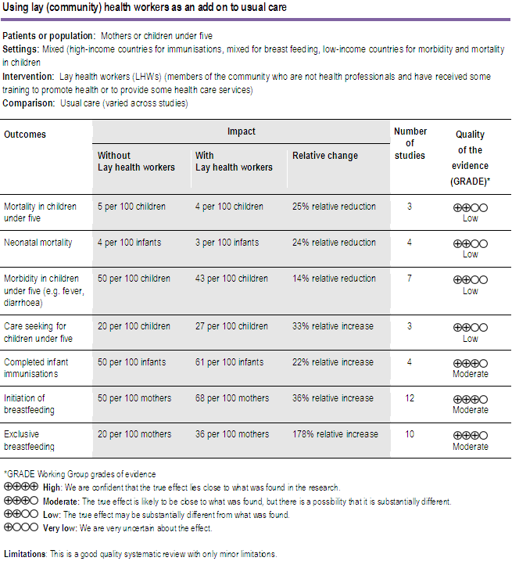

Slide 40
Together with the previous table
Using lay health workers as an add-on to usual care
Probably increases immunisation coverage and breast feeding
May increase care seeking behaviour for children under five and reduce morbidity and mortality in children under five and neonates

Slide 41
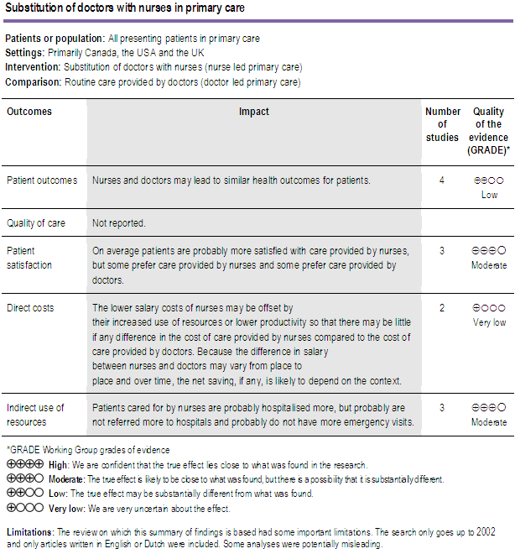

Slide 42
Together with the previous table
Nurses and physicians may lead to similar health outcomes for patients
It is uncertain whether there is any difference in the cost of care provided by nurses compared to the cost of care provided by physicians

Slide 43
Without a table
The impacts of expanding the use of drug dispensers to promote and deliver cost-effective MCH interventions are uncertain

Slide 44
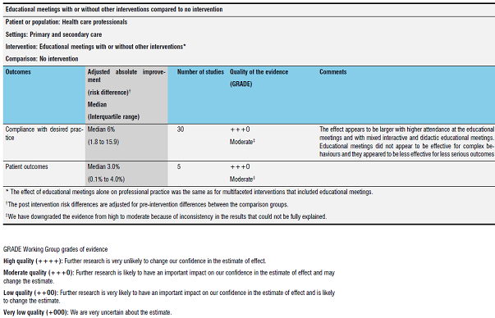

Slide 45
Together with the previous table
Educational meetings for health professionals probably improve compliance with desired practice and patient outcomes

Slide 46
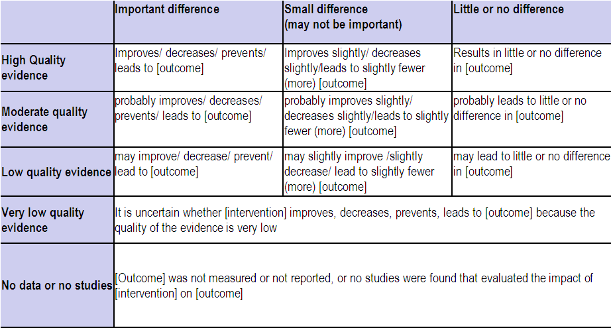
Plain language summaries

Slide 47
Additional considerations
Judgements about impacts on equity
Judgements about resource use and costs
Judgements about the need for monitoring and evaluation

Slide 48
Judgements about impacts on equity
Important to consider potential impacts on equity, as well as the overall impacts of options
By examining the findings of a review and considering possible differential effects of the interventions for disadvantaged populations
The potential for impacts on equity should be considered in relationship to factors likely to be associated with disadvantage in relation to the option being considered, including
Economic status
Employment or occupation
Education
Place of residence
Gender
Ethnicity

Slide 49
Checklist for consideration of potential impacts on equity
Are there plausible reasons for anticipating differences in the relative effectiveness of the option for disadvantaged groups or settings?
Are there likely to be different baseline conditions across groups or settings such that that the absolute effectiveness of the option would be different, and the problem more or less important, for disadvantaged groups or settings?
Are there important considerations that should be made when implementing the option in order to ensure that inequities are reduced if possible, and that they are not increased?

Slide 50
Judgements about resource use and costs
In settings with limited resources, policymakers are deeply concerned about resource use and the costs and savings associated with different options
The term “costs” refers to these considerations broadly, although it is important to be aware that costs include both
Resource use (e.g. the time of health workers) and
Monetary values (or prices) attached to those resources (e.g. wages or fees)

Slide 51
Checklist for consideration of costs
Costs and cost-effectiveness need to be assessed in a specific setting in order to take account of differences in patterns of resource use and prices
What are the most important costs, including the costs of implementing and sustaining the option?
What information is there about those costs, either from systematic reviews or other sources?
Is there important uncertainty about medium to long term costs?
Is there important uncertainty about the applicability of any reported costs?

Slide 52
Judgements about the need for monitoring and evaluation
Uncertainty about the effects and cost-effectiveness of options is common
Therefore policy briefs should routinely consider the need for monitoring and evaluation

Slide 53
Checklist for considering the need for monitoring and evaluation
Is monitoring necessary?
If monitoring is necessary, what should be measured?
Is an impact evaluation necessary?
If an impact evaluation is necessary, what should be evaluated and how?

Slide 54
Questions or comments about summarising the likely impacts of options?

