Slide 1
Finding systematic reviews of health systems research
Which databases to use when
How to use those databases

Slide 2
Databases
Health Systems Evidence
Support Summaries
Rx for Change
The Cochrane Library
PubMed
EVIPNet VHL

Slide 3
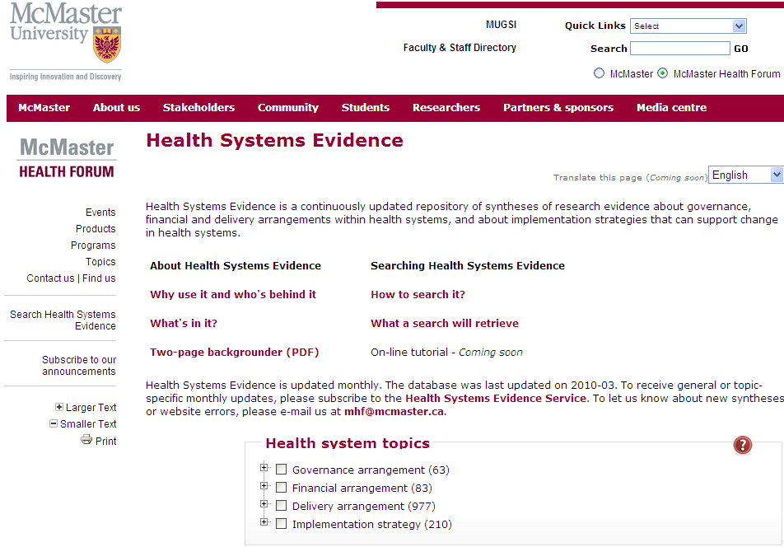
Health Systems Evidence www.healthsystemsevidence.org

Slide 4
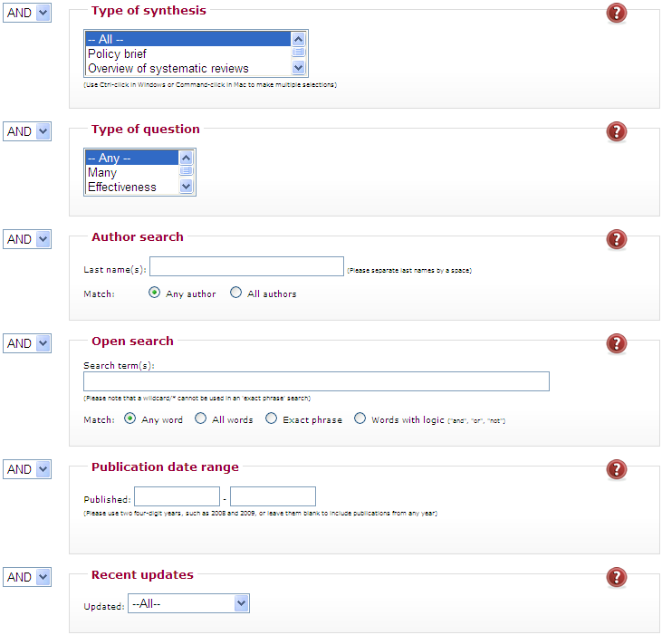
Health Systems Evidence

Slide 5
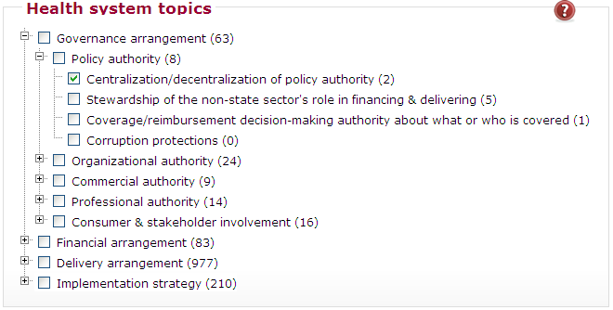
Health Systems Evidence

Slide 6
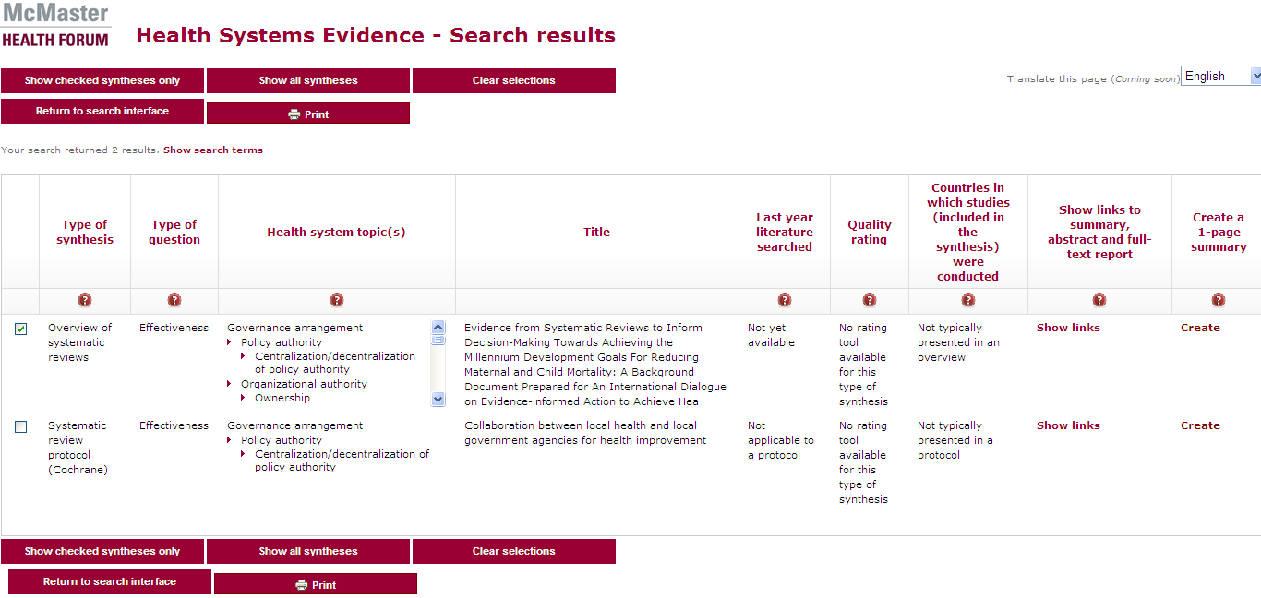
Health Systems Evidence

Slide 7
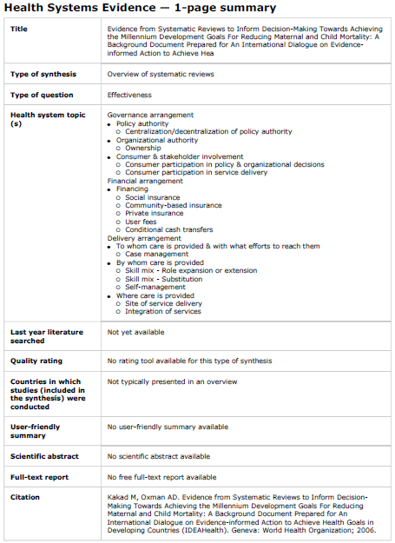
Health Systems Evidence

Slide 8
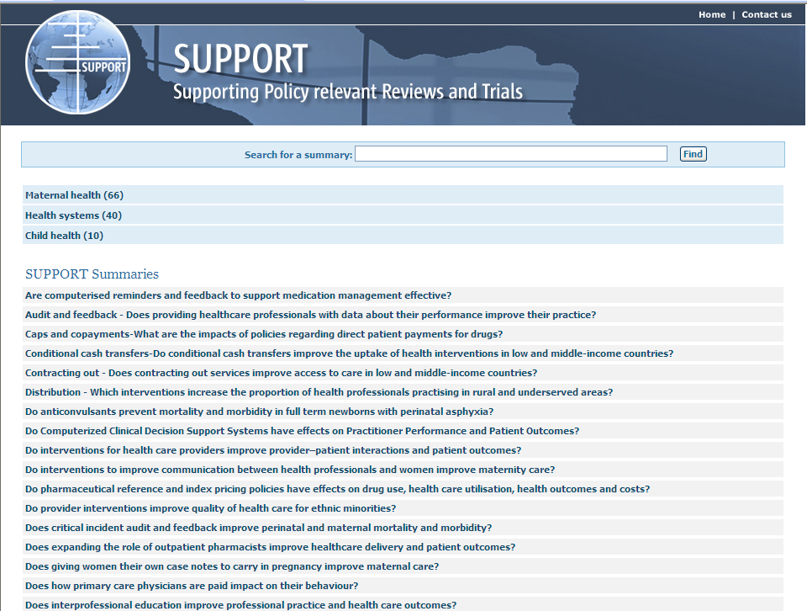
Support Summaries www.support-collaboration.org (www.supportsummaries.org)

Slide 9
Support Summaries

Slide 10
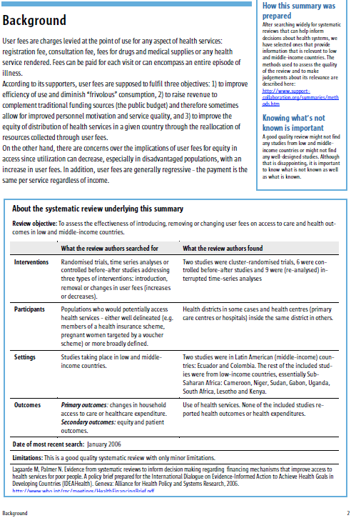
Support Summaries

Slide 11
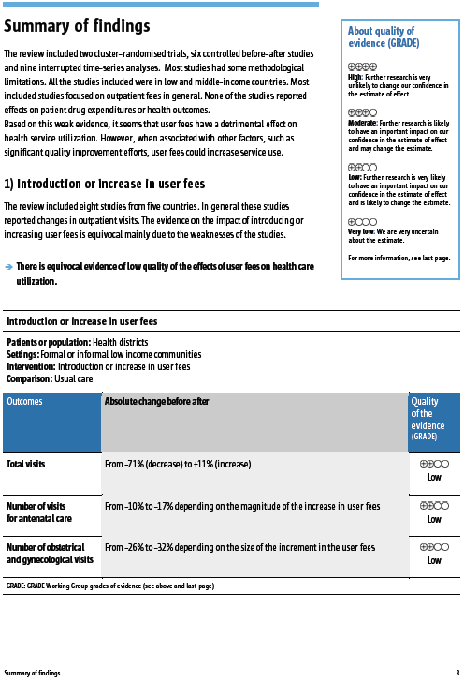
Support Summaries

Slide 12
Support Summaries

Slide 13
Support Summaries

Slide 14
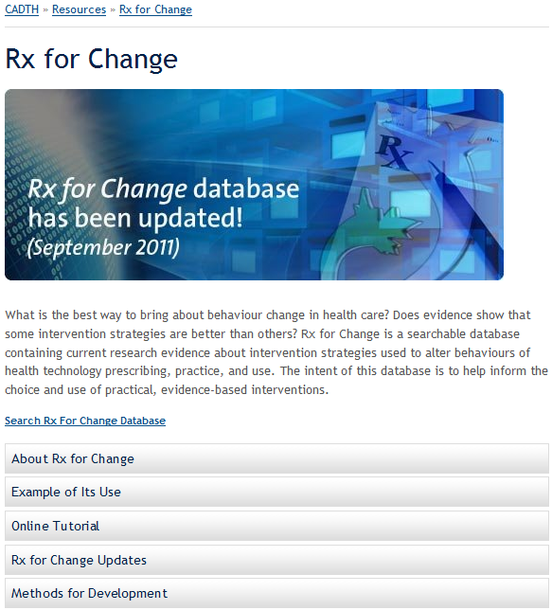
Rx for Change www.cadth.ca/en/resources/rx-for-change/database

Slide 15
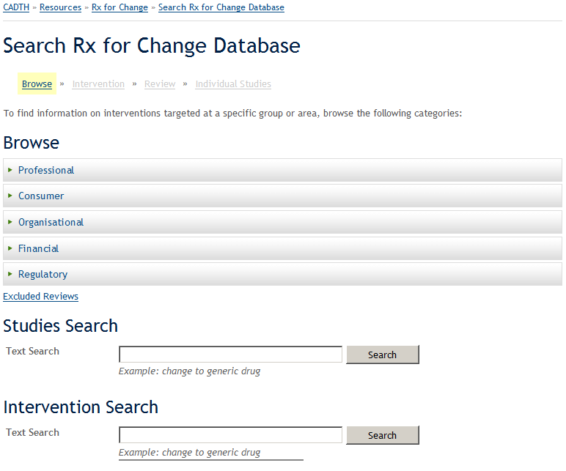
Rx for Change

Slide 16
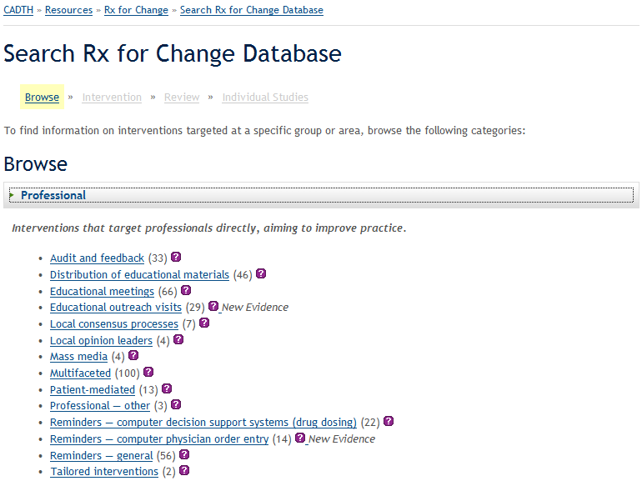
Rx for Change

Slide 17
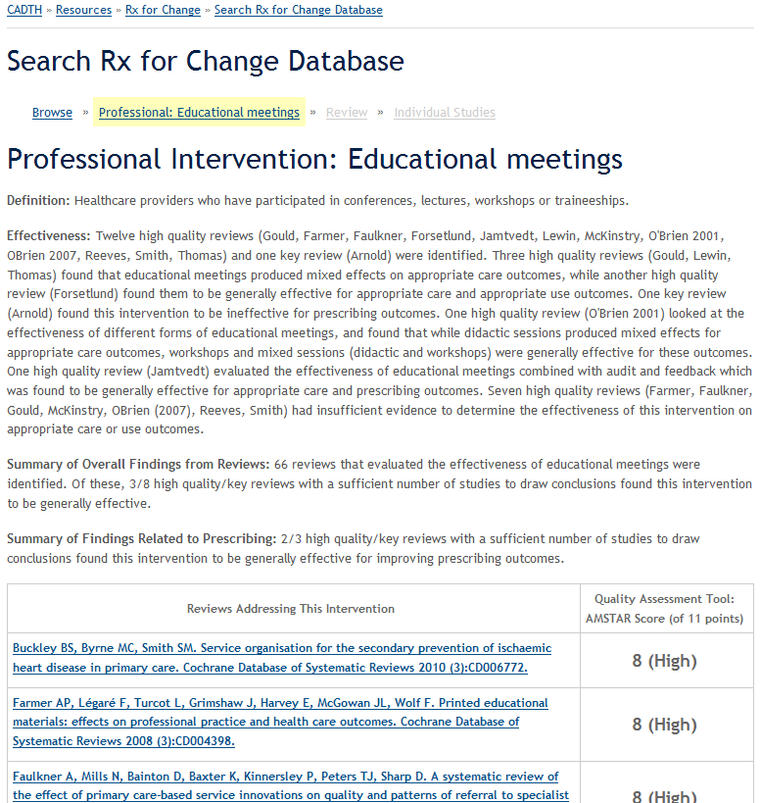
Rx for Change

Slide 18

Rx for Change

Slide 19
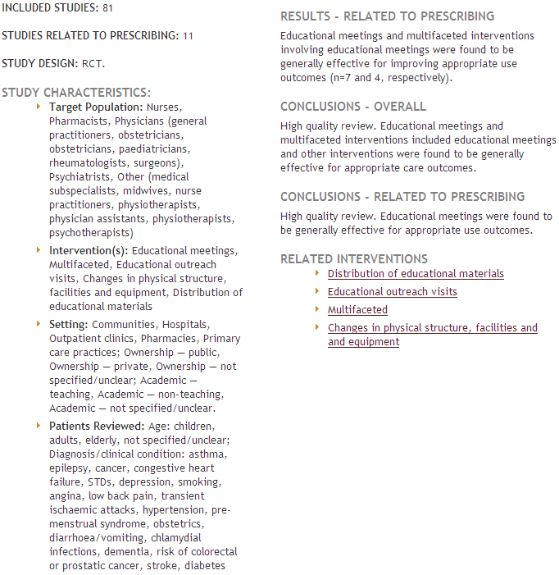
Rx for Change

Slide 20
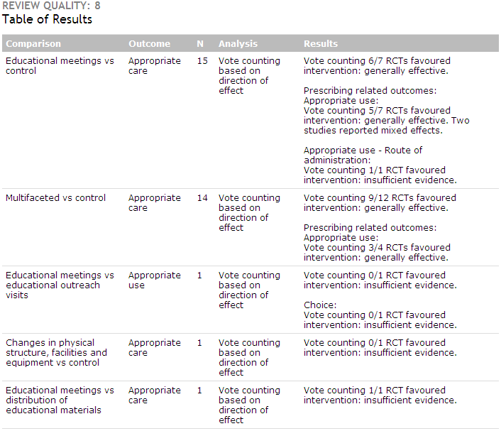
Rx for Change

Slide 21
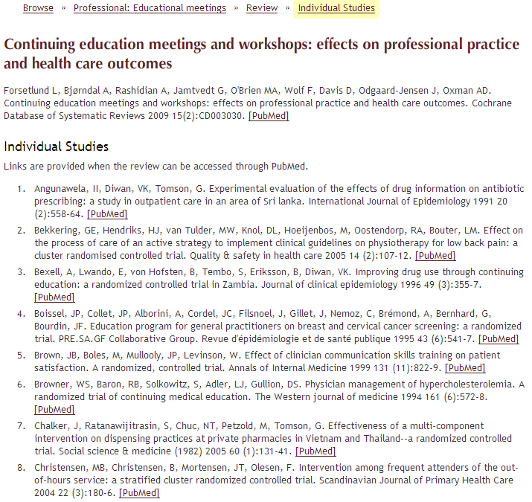
Rx for Change

Slide 22
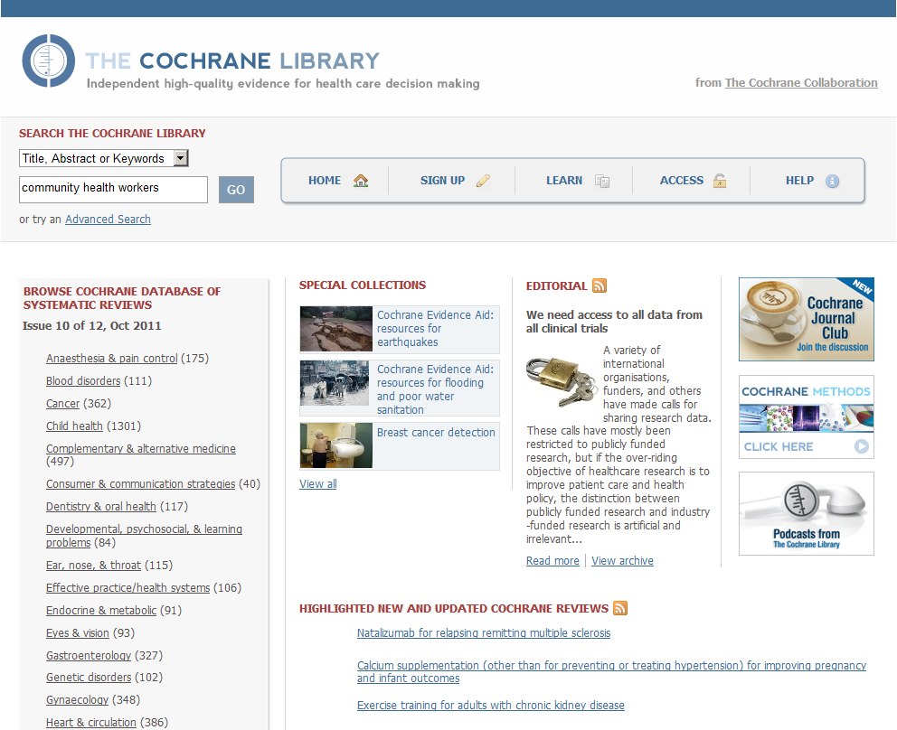
The Cochrane Library www.thecochranelibrary.com

Slide 23
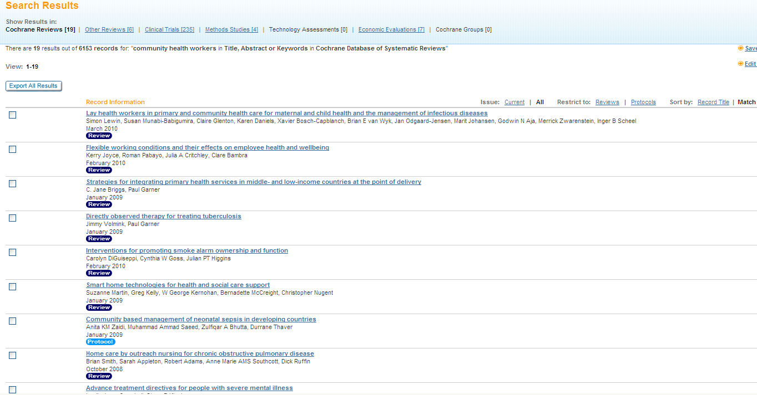
The Cochrane Library

Slide 24
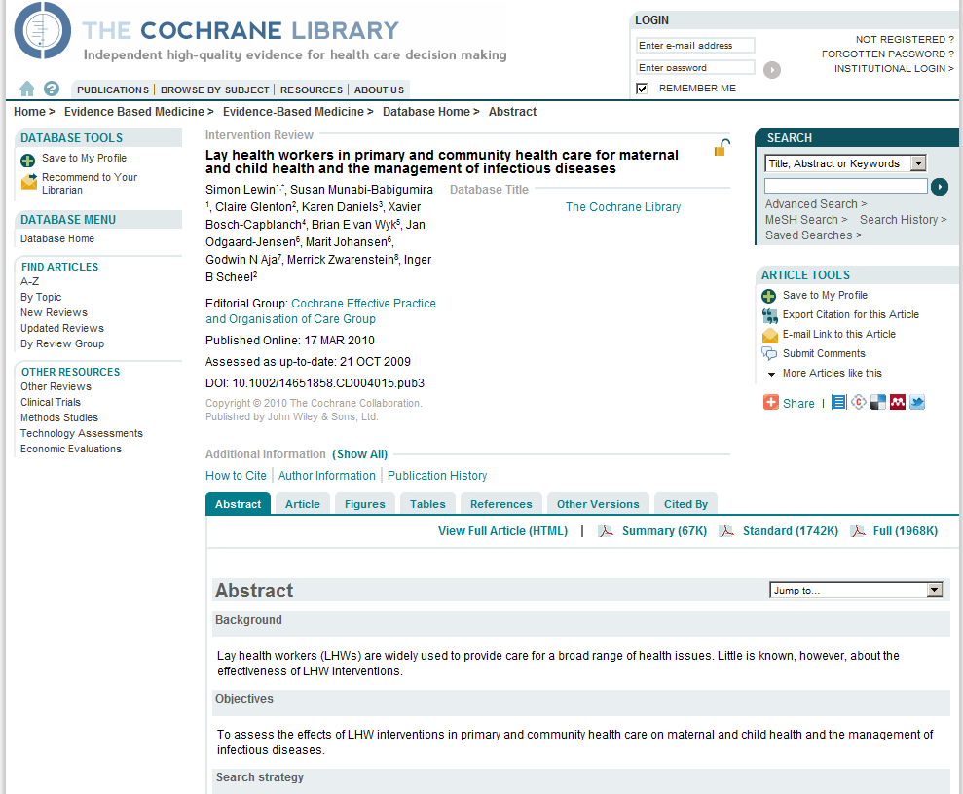
The Cochrane Library

Slide 25
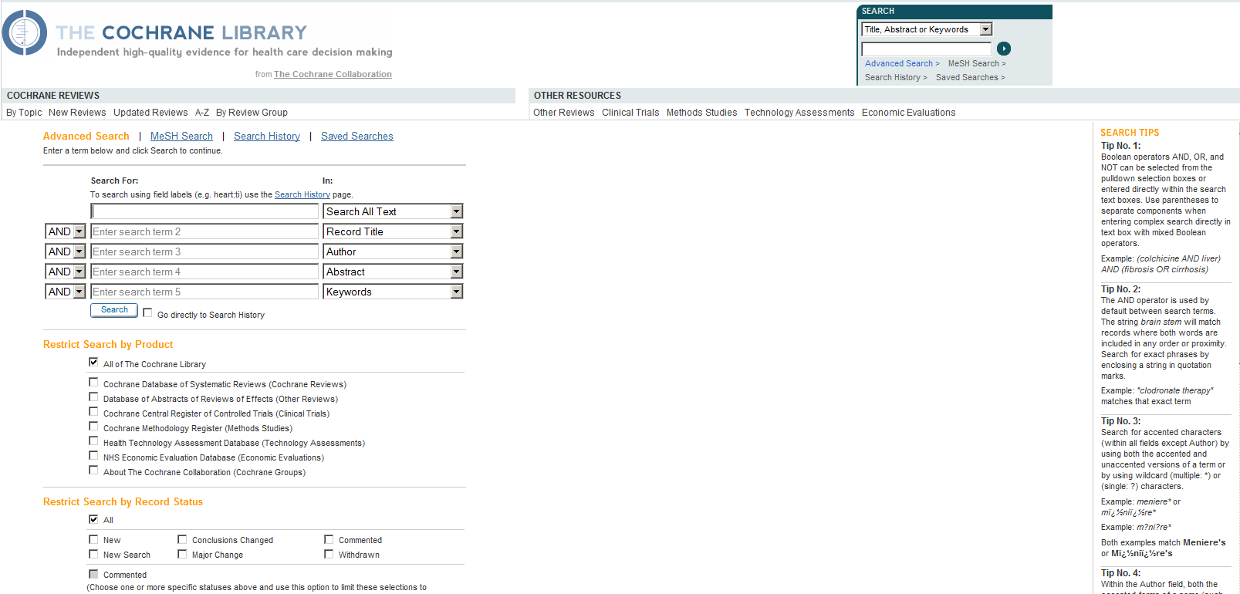
The Cochrane Library

Slide 26
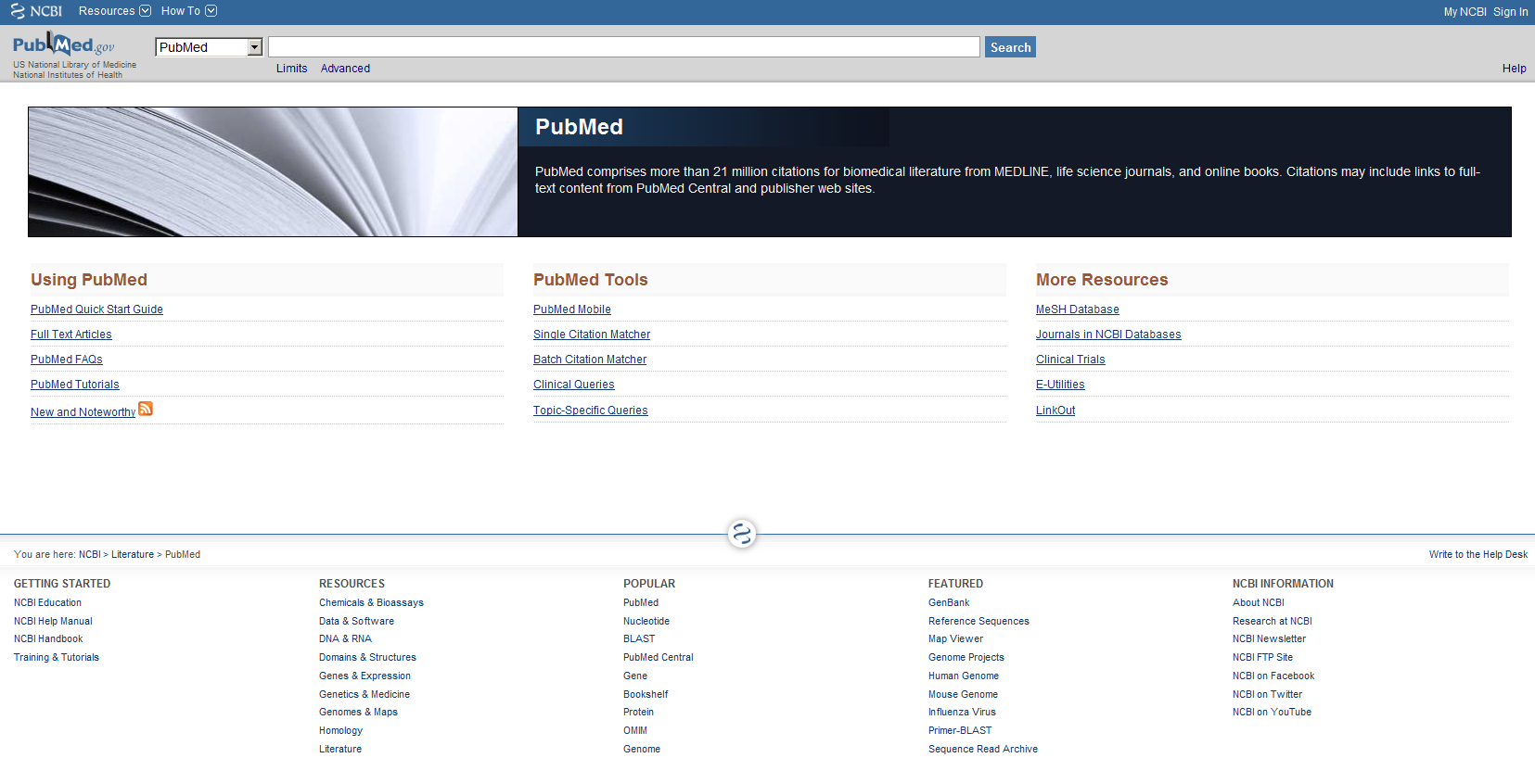
PubMed www.pubmed.gov

Slide 27
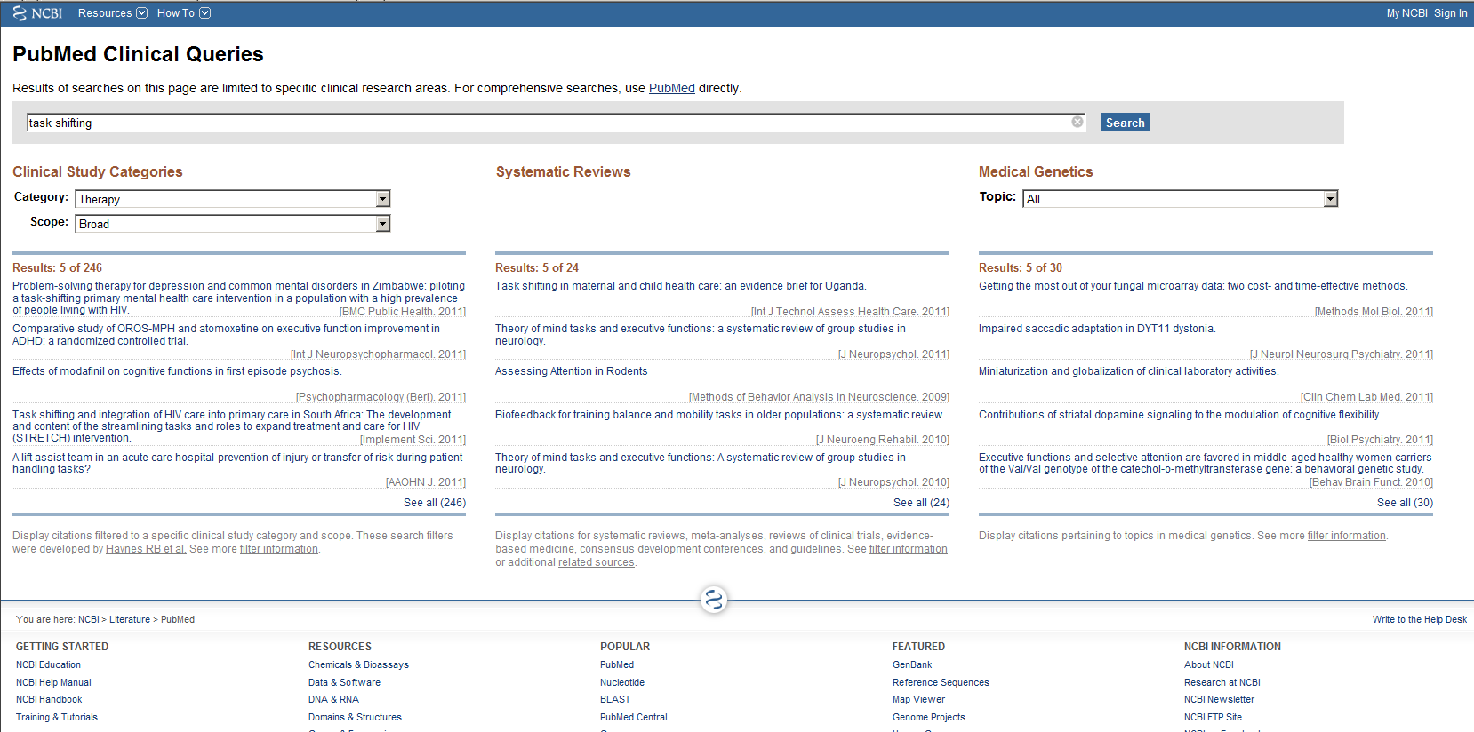
PubMed

Slide 28
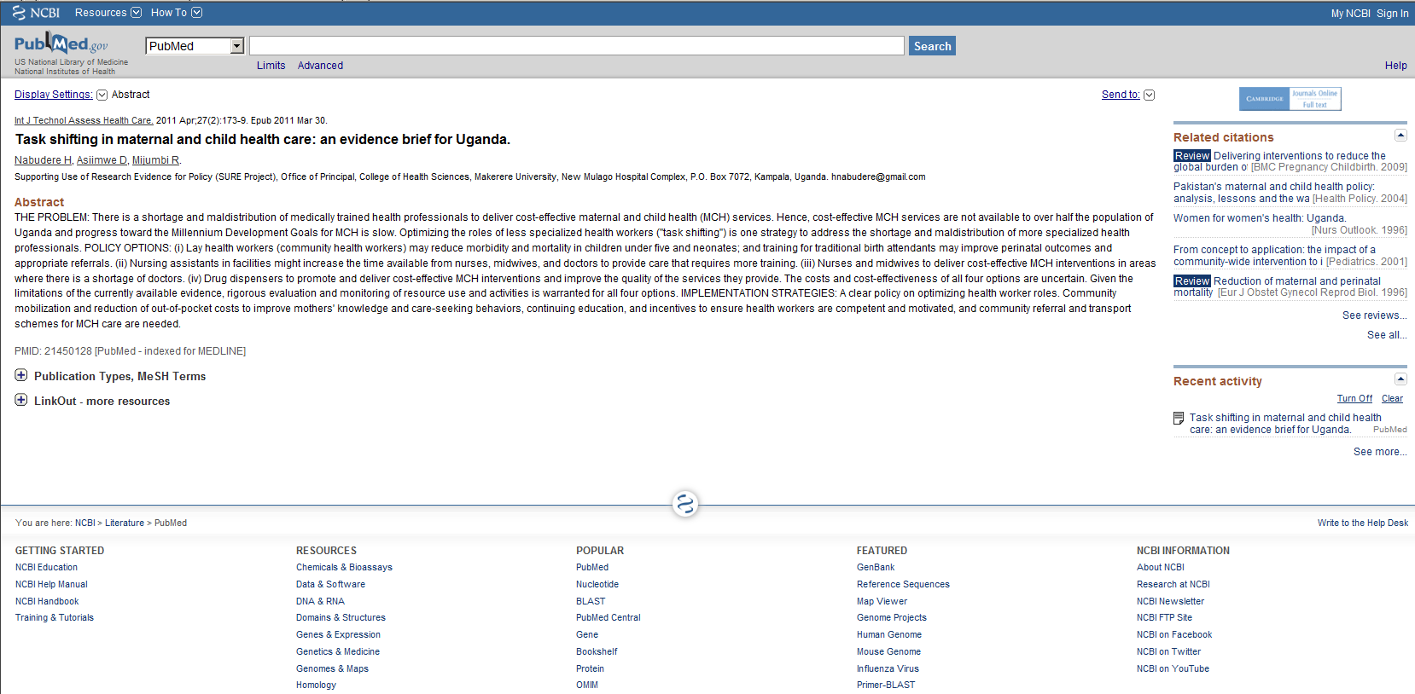
PubMed

Slide 29
Retrieving full-text copies
HINARI
The Cochrane Library
Open access journals
BioMed Central (BMC) journals
Public Library of Sciences journals, including PloS Medicine
SciELO (Scientific Electronic Library Online), including the Bulletin of the World Health Organisation and many journals from Latin America
Directories of open-access or free journals
Directory of Open Access Journals
Free Medical Journals
Open J-Gate
Repositories of full text articles through which journal publishers make available articles (often after a defined time period)
PubMed Central
Bioline International

Slide 30
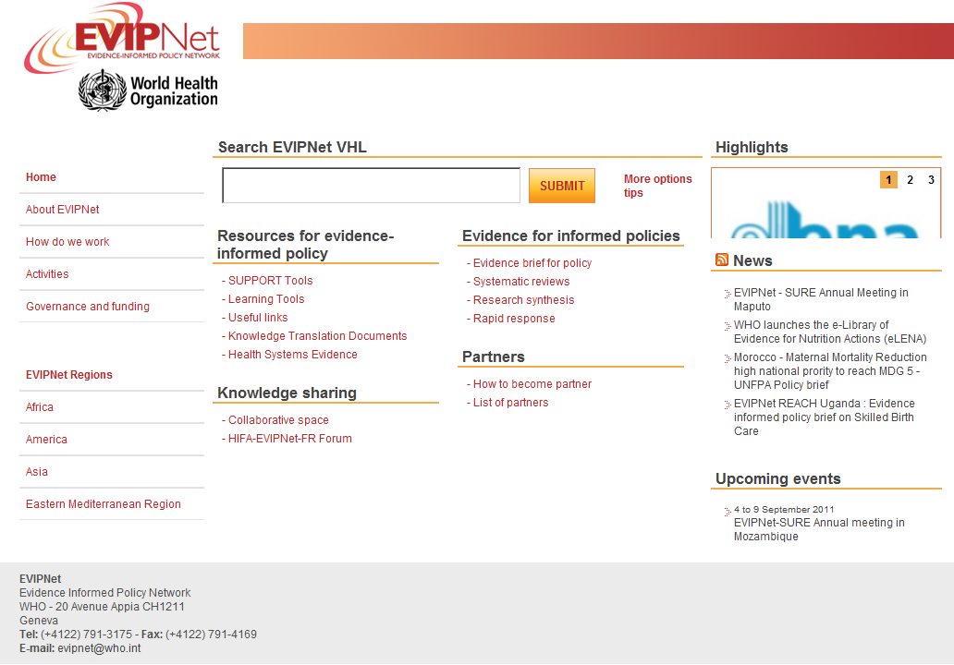
EVIPNet VHL www.global.evipnet.org (under construction)

Slide 31
Questions or comments?

