Slide 1
Deciding how much confidence to place in a systematic review
What do we mean by confidence in a systematic review and in an estimate of effect?
How should we assess how much confidence to place in a systematic review of health systems research?

Slide 2
What do we mean by confidence in a systematic review?

Slide 3
What do we mean by confidence in a systematic review?
The extent to which we can be sure that the review provides a complete and accurate summary of the best available evidence
Based on methods used to
Identify, include and critically appraise studies
Analyse the findings

Slide 4
What do we mean by confidence in an estimate of effect?

Slide 5
What do we mean by confidence in an estimate of effect?
The extent to which we can be confident that an estimate of effect is correct (or adequate to support a particular decision)
Based on judgements about, for example:
Risk of bias
Imprecision
Consistency
Directness

Slide 6
Being confident in a systematic review is not the same as being confident in an estimate of effect derived from the review
For example, a reliable systematic review may find
Only studies with a high risk of bias
Imprecise results
Inconsistent results
Only indirect evidence

Slide 7
Some jargon
Risk of bias
Extent to which bias may be responsible for the findings of a study
Bias
Systematic error or deviation from the truth in results or inferences
Systematic differences in
Groups that are compared (selection bias)
Intervention that is provided, or exposure to other factors apart from the intervention of interest (performance bias)
Withdrawals or exclusions of people entered into a study (attrition bias)
How outcomes are assessed (detection bias)
Reporting of outcomes (reporting bias)
Assessments of the risk of bias are sometimes referred to as assessments of the validity or quality of a study
Validity
Extent to which a result (of a measurement or study) is likely to be true
Quality
Vague notion of the strength or validity of a study

Slide 8
SURE checklist for making judgements about how much confidence to place in a systematic review
A number of checklists are available to guide assessments of the reliability of systematic reviews
SURE checklist is based on other similar checklists
Developed based on experience applying a widely used check list to systematic reviews of health system arrangements and implementation strategies
Tailored to guide judgements of the extent to which a review is likely to provide a reliable summary of the best available evidence of the impacts of these complex interventions
Divided into two parts
Methods used to identify, select and critically appraise studies
Methods used to analyse the results of included studies
Summary assessments based on the questions
Minor, moderate or major limitations
Can guide the use of reviews in policy briefs

Slide 9
Summary assessments
Fatal flaws
Limitations that are sufficiently important to render the results of the review unreliable. As such, the results should not be used in the policy brief (although it may still be possible to draw some key messages or useful information from the review, such as a framework for identifying potential options)
Important limitations
Limitations important enough to make searching for another systematic review worthwhile. The results of this review should be interpreted cautiously if a better review cannot be found (however, the information provided in the review could potentially be supplemented with additional searches, or information from included studies may be included in the policy brief)
Reliable
Only minor limitations and the review can be used as a reliable summary of the best available evidence

Slide 10
If a systematic review without important limitations cannot be found
May be necessary to search for individual studies either to supplement the information in a review or in place of a systematic review
Attention should be paid to the same processes that are used in a systematic review
i.e. so far as possible, systematic and transparent (explicit) methods should be used to find, select and critically appraise studies; and to synthesize the results of relevant studies
Ideally the methods used to do this should be described in an appendix to the policy brief

Slide 11
Identification, selection and appraisal of studies
5 criteria

Slide 12
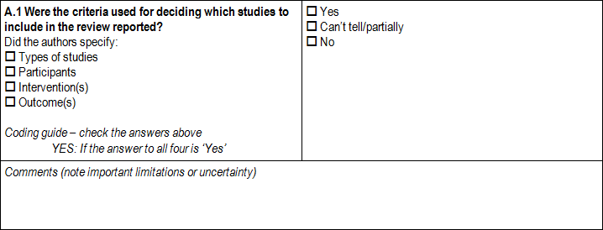
Were selection criteria reported?

Slide 13
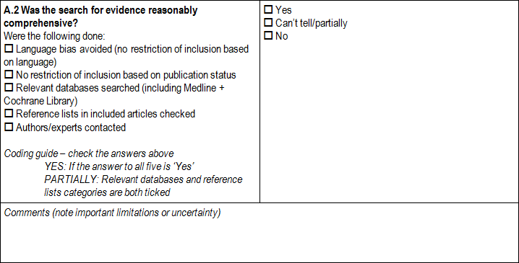
Was the search comprehensive?

Slide 14
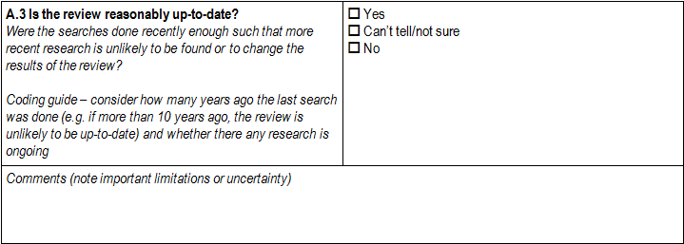
Is the review up-to-date?

Slide 15
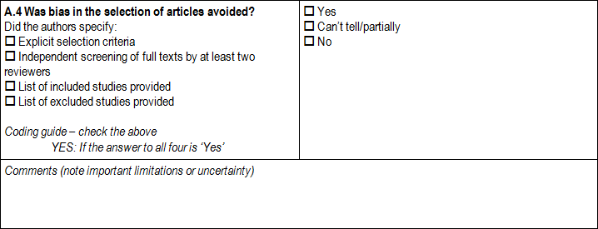
Was biased selectionof articles avoided?

Slide 16
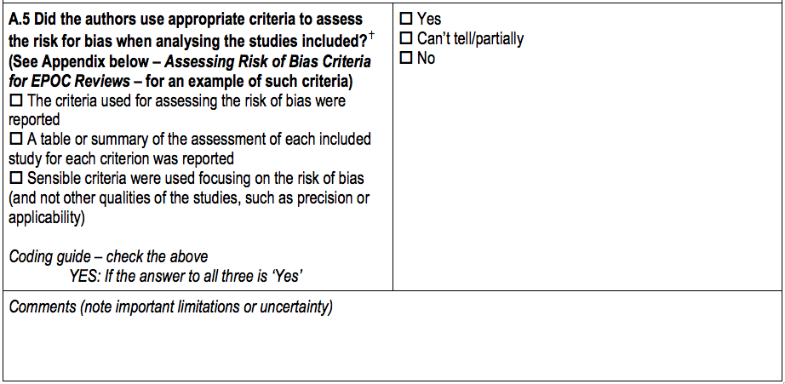
Were appropriate criteria used to assess the risk of bias?

Slide 17
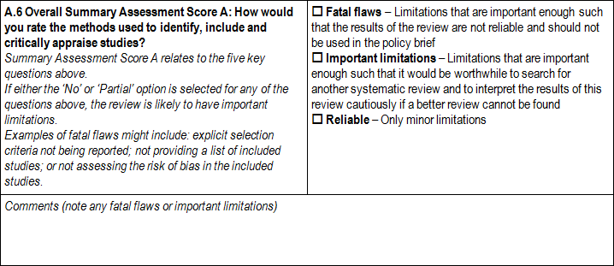
Overall identification, selection and appraisal of studies

Slide 18
Analysis of the findings
5 criteria

Slide 19
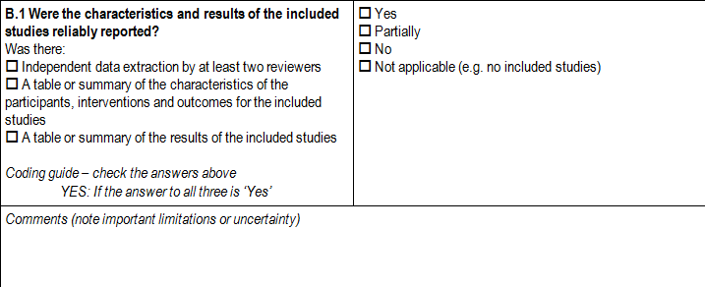
Were characteristics and results of included studies reliably reported?

Slide 20
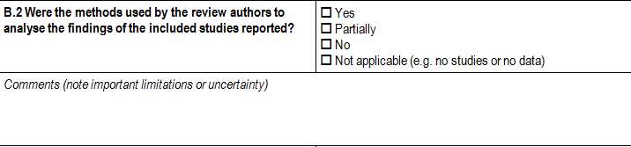
Were methods used to analyse the findings reported?

Slide 21
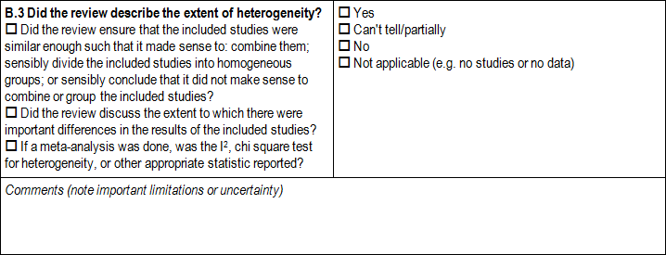
Was the extent of heterogeneity described

Slide 22
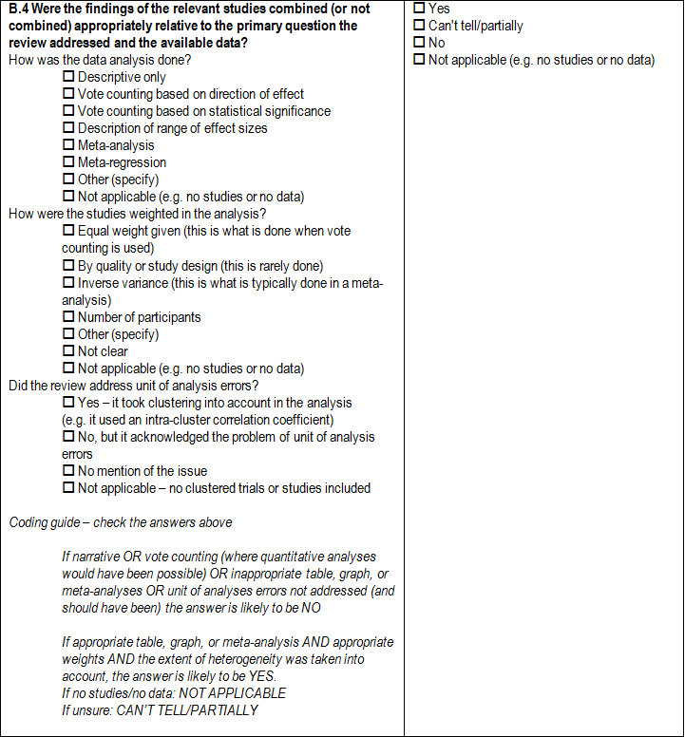
Were the findings combined (or not combined) appropriately?

Slide 23
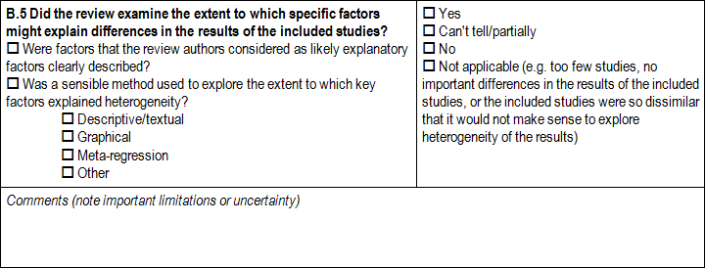
Were factors that could explain heterogeneity explored?

Slide 24
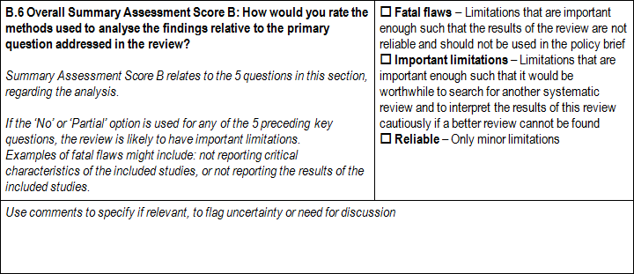
Overall analysis of findings

Slide 25
Overall assessment of the reliability of the review
Identification, selection and appraisal of studies
Analysis of findings
Other considerations

Slide 26
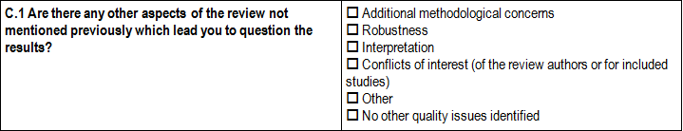
Other considerations

Slide 27
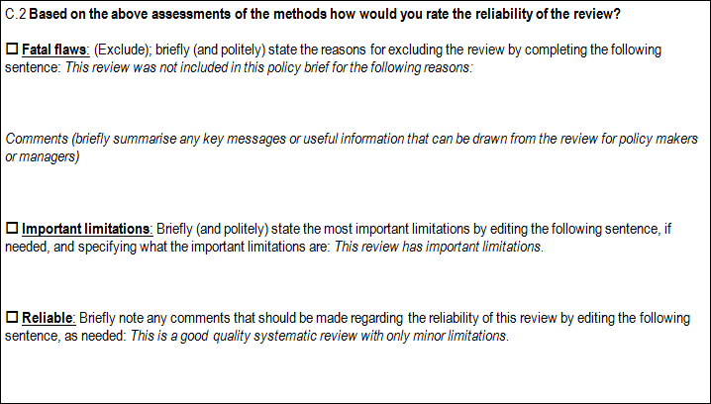
Overall reliability of the review

Slide 28
Questions or comments?

