Slide 1
Identifying and addressing barriers to implementing policy options
What barriers are there to implementing each policy option?
What strategies are available to address important barriers?
What is known about the effects of relevant implementation strategies?
How should information about barriers and the likely effects of strategies for addressing them be summarised?

Slide 2
Implementing options often is not straightforward
It may require changes at various levels, including
Behavioural changes of healthcare recipients and providers
Organisational changes
Strategies for bringing about these changes are most likely to be successful if they address important barriers to implementation
But little is known about the effectiveness of different methods for identifying barriers and tailoring interventions to address those barriers

Slide 3
What barriers are there to implementing each policy option?
A structured approach to identifying barriers can help ensure that important barriers are not overlooked and that undue attention is not paid to unimportant barriers
This requires a framework for systematically considering potential barriers and the identification and appraisal of evidence of the extent of potentially important barriers

Slide 4
Barriers and enablers are often the mirror image of each other
Barriers to change and enablers of change are sometimes called “moderators and mediators”, “problems and incentives” or “barriers and facilitators”
To avoid redundancy, ‘barriers’ is sometimes used as shorthand for both barriers and enablers
However, it is important to consider enablers as well as barriers when implementing policy options

Slide 5
A checklist for identifying factors affecting the implementation of a policy option
Levels at which barriers may occur include
Recipients of care
Providers of care
Other stakeholders
Health system constraints
Social and political constraints

Slide 6
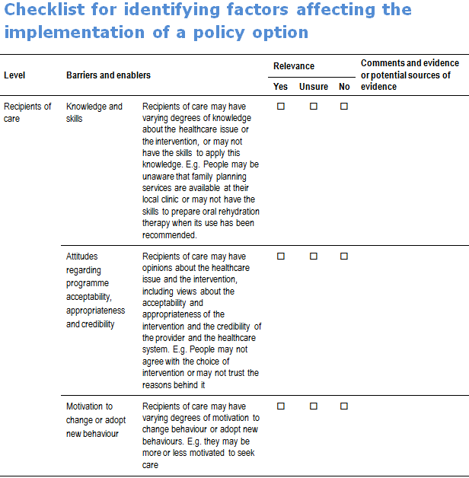
Recipients of care

Slide 7
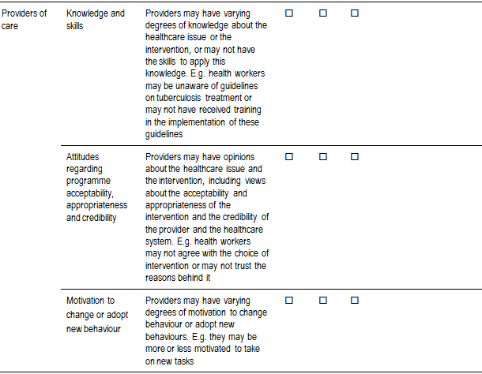
Providers of care

Slide 8
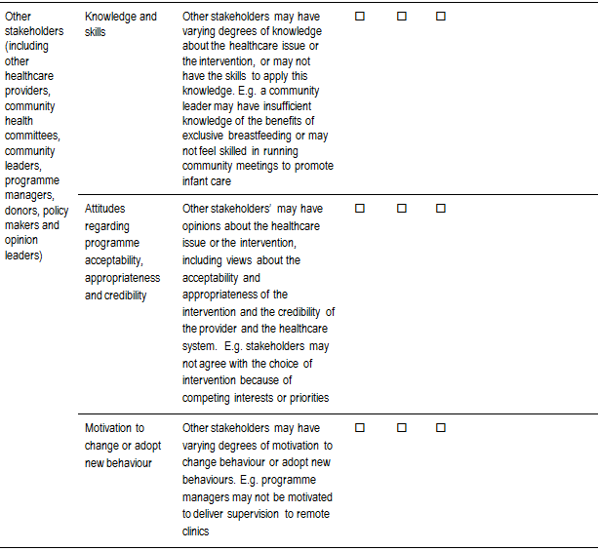
Other stakeholders

Slide 9
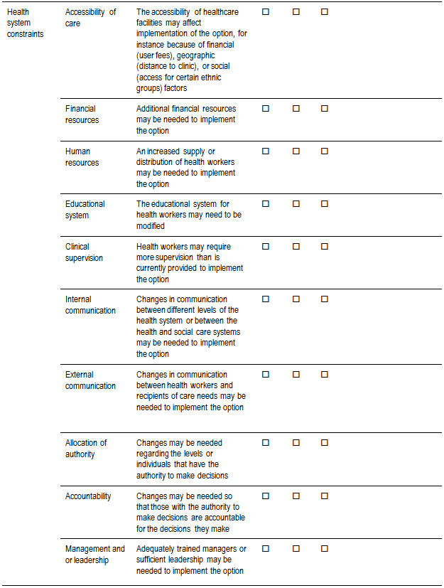
Health system constraints

Slide 10
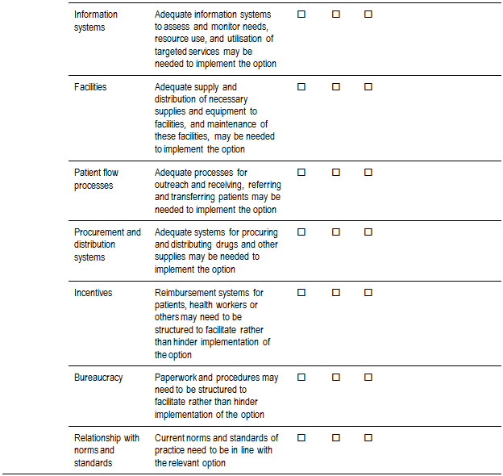
Health system constraints

Slide 11
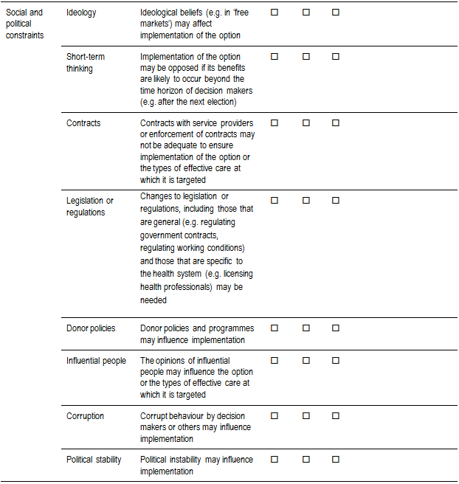
Social and political constraints

Slide 12
Methods for identifying and clarifying the importance of potential barriers
Brainstorming
Contacting key informants
Searching for published or unpublished studies, including
Case studies
Interview studies
Focus group studies
Direct observations
Surveys

Slide 13
Strategies for finding relevant studies
PubMed
Hedge for finding qualitative research http://www.nlm.nih.gov/nichsr/hedges/search.html
Google Scholar
http://scholar.google.com/schhp?hl=en&tab=ws
WHO Library Information System
http://dosei.who.int/uhtbin/cgisirsi/Mon+May++4+21:00:46+MEST+2009/0/49
Personal contact with researchers

Slide 14
Questions or comments about identifying barriers to implementing options?

Slide 15
What strategies are available to address important barriers?
Methods for matching implementation strategies to important barriers and enablers rely to a large extent on brainstorming
Either a structured or an unstructured approach
Typically face-to-face
Participants respond to each other’s suggestions without criticising ideas
Evaluation of ideas is explicitly forbidden until after the generation process is done
Can also be done by exchanging ideas over the Internet

Slide 16
Advantages of brainstorming
Bringing together a group of people with different types of expertise and perspectives to generate as many potential solutions as possible may increase the chance of finding a good one among them
Subsequently, discussing the merits of the solutions that are generated can help to focus attention on those that are most promising

Slide 17
Theories can be used to inform the selection of interventions
Still relies to a large extent on logic and judgments
There is a paucity of research evidence that supports the use of specific interventions for specific barriers
A common sense use of theories helps primarily by providing a framework and an approach to identifying interventions
Theory-based approaches can also be used in a group as a structured approach to brainstorming

Slide 18
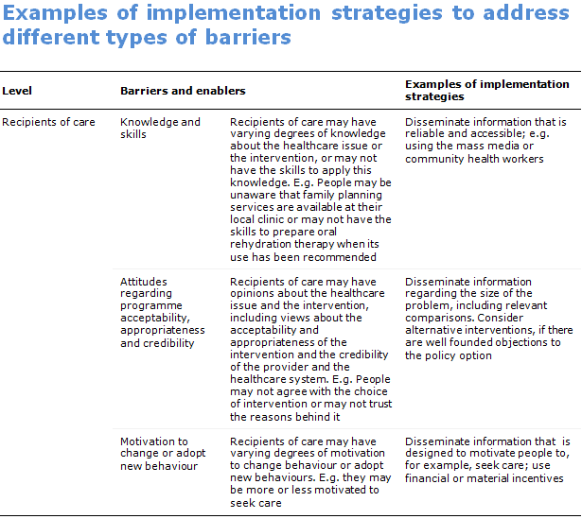
Recipients of care

Slide 19
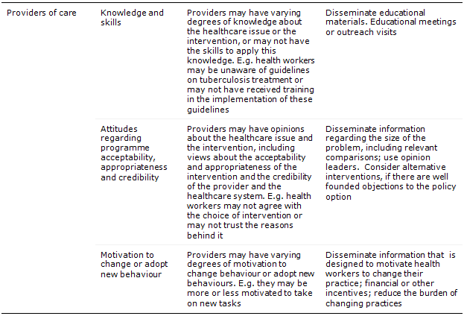
Providers of care

Slide 20
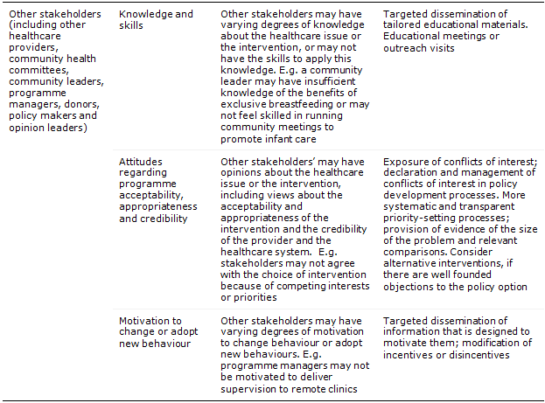
Other stakeholders

Slide 21
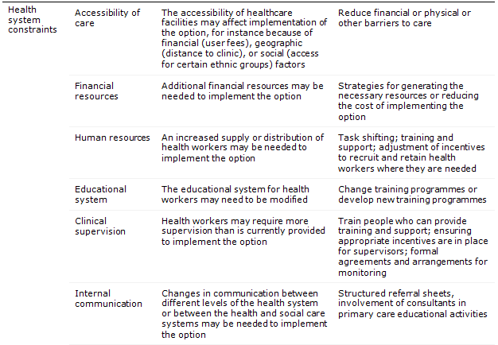
Health system constraints

Slide 22
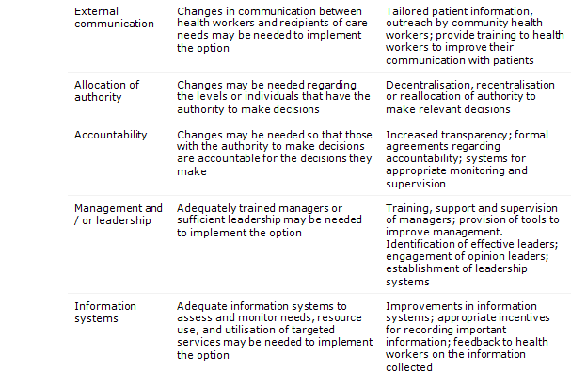
Health system constraints

Slide 23
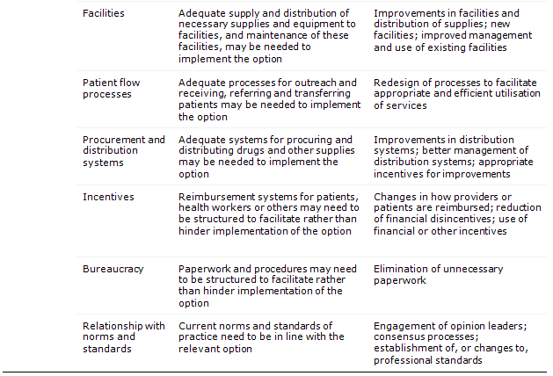
Health system constraints

Slide 24
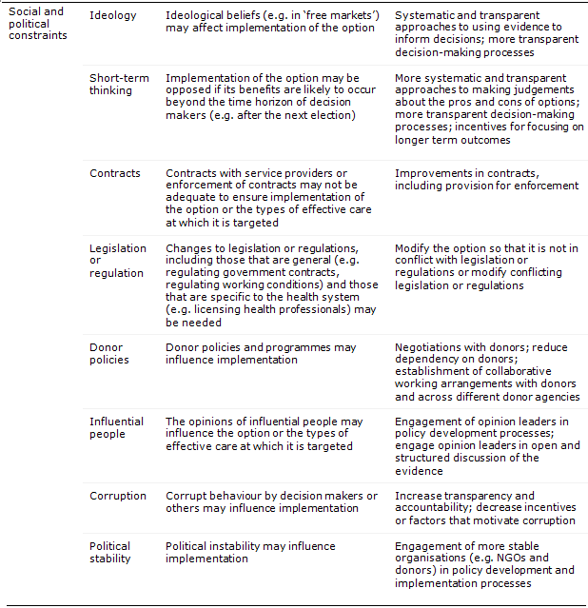
Social and political constraints

Slide 25
Questions or comments about identifying strategies to address important barriers?

Slide 26
What is known about the effects of relevant implementation strategies?
Finding and appraising evidence of the effects of implementation strategies is similar to finding and appraising evidence of the impacts of the policy options
Entails finding, selecting and assessing the reliability of systematic reviews, and
Based on that evidence making judgements about the effects of implementation strategies and how much confidence can be placed in those estimates

Slide 27
The ideal starting point for finding out what is known about the effects of implementation strategies is a systematic review
There are many systematic reviews of strategies for changing behaviours of recipients and providers of care
There are fewer reviews of strategies for addressing health system, social and political constraints
Sources for finding systematic reviews include
Health Systems Evidence
www.healthsystemsevidence.org
CADTH Rx for Change
www.cadth.ca/index.php/en/compus/optimal-ther-resources/interventions
The Cochrane Library
www.thecochranelibrary.com
PubMed
www.pubmed.gov

Slide 28
Health Systems Evidence
www.healthsystemsevidence.org
Formally the PPD/CCNC database
Can be used to find syntheses of research evidence about governance, financial and delivery arrangements within health systems, and about implementation strategies
Contains details about policy briefs, overviews of systematic reviews, systematic reviews, and protocols of systematic reviews relevant to health systems
Links to user-friendly summaries, scientific abstracts, and full-text reports (when freely available)
Updated monthly
Includes around 200 systematic reviews of implementation strategies targeted at consumers (68), providers (141) and organisations

Slide 29
Support Summaries
www.support-collaboration.org
Summaries of systematic reviews that examine the effects of interventions on maternal and child health, and health systems, including implementation strategies
Prepared using an approach similar to the one described in the SURE guide for deciding on and describing options
Including the preparation of summaries of findings using the GRADE approach and assessments of relevance to low and middle-income countries
Last updated in December 2009

Slide 30
Rx for Change
www.cadth.ca/index.php/en/compus/optimal-ther-resources/interventions
Summaries of key findings from systematic reviews that evaluate the effects of strategies targeting professionals, the organization of health care, and consumers
Focus is on prescribing, but not restricted to implementation strategies that are specifically targeted at prescribing
Organized into easy-to-browse categories of interventions
For each intervention, there is an overall summary of its effects
From each intervention summary, summaries of the individual reviews are available
Each review is quality-assessed and summarized to highlight key characteristics and relevant evidence
From each review summary, there are links to the individual studies
Last updated in October 2009

Slide 31
The Cochrane Library www.thecochranelibrary.com

Slide 32
The Cochrane Library
www.thecochranelibrary.com
Most Cochrane reviews of implementation strategies are prepared by the Effective Practice and Organisation of Care (EPOC) group
These reviews can be browsed by clicking on “By Topic and scrolling down to EPOC
Structured abstracts of other (non-Cochrane) systematic reviews of effects, including reviews of implementation strategies can be found in the Database of Abstracts of Reviews of Effects (DARE)
www.crd.york.ac.uk/crdweb/

Slide 33
PubMed
www.pubmed.gov
Contains bibliographic information, index terms and abstracts for over 20 million articles, updated daily
Only a small proportion are systematic reviews of implementation strategies
Hedge to restrict searches to systematic reviews
http://www.ncbi.nlm.nih.gov/sites/pubmedutils/clinical
Also possible to search for “related articles” to ones that have identified

Slide 34
Google scholar
http://scholar.google.com/schhp?hl=en&tab=ws
Can be used for citation searching
May sometimes be helpful for identifying published reviews and reviews in the grey literature by using advanced features and precise terms (e.g. putting terms like “systematic review” in quotations so that the exact phrase is searched for)

Slide 35
Personal contact and other databases
Personal contact with people who have health systems and/or systematic review expertise may be helpful, particularly for finding unpublished, more recent and otherwise hard to find systematic reviews
Other databases, such as ISI Web of Science (for citation searching) and EMBASE may require a subscription and may require the assistance of a research librarian
A list of databases relevant to low and middle-income countries can be found on the Norwegian Cochrane Effective Practice and Organisation of Care (EPOC) Satellite’s website
http://www.epocoslo.cochrane.org/en/newPage2.html

Slide 36
Retrieving full-text copies
HINARI www.who.int/hinari/en
The Cochrane Library
Open access journals
BioMed Central (BMC) journals www.biomedcentral.com/browse/journals
Public Library of Sciences journals, including PloS Medicine www.plos.org
SciELO (Scientific Electronic Library Online), including the Bulletin of the World Health Organisation and many journals from Latin America www.scielo.org
Directories of open-access or free journals
Directory of Open Access Journals www.doaj.org
Free Medical Journals www.freemedicaljournals.com
Open J-Gate www.openj-gate.com
Repositories of full text articles
PubMed Central www.ncbi.nlm.nih.gov/pmc
Bioline International (includes journals from Bangladesh, Brazil, Chile, China, Colombia, Egypt, Ghana, India, Iran, Kenya, Malaysia, Nigeria, Turkey, Tanzania, Uganda, Venezuela) www.bioline.org.br/journals

Slide 37
It is prudent to search for broadly focused reviews
Reviews of implementation strategies commonly address broad overlapping questions from different perspectives
For example, reviews of strategies for improving professional practice may address the effects of
A type of intervention across different practices (e.g. educational meetings)
Different types of interventions to address a single problem or condition (e.g. diabetes)
A type of behaviour or practice across different conditions (e.g. prescribing)
Reviews with an overly narrow focus may be misleading

Slide 38
Once a relevant systematic review is found, it is necessary to decide how much confidence to place in the review
The checklist appended to the SURE guide for deciding on and describing options can also be used to guide judgements about the reliability of reviews of implementation strategies

Slide 39
If a systematic review without important limitations cannot be found, it may be necessary to search for individual studies
Either to supplement the information in a review or in place of a systematic review
If this is done, attention should be paid to the same processes that are used in a systematic review
I.e. so far as possible, systematic and transparent (explicit) methods should be used to find, select and critically appraise studies; and to synthesize the results of relevant studies
Ideally the methods used to do this should be described in an appendix to the policy brief

Slide 40
Judgements about the likely effects of implementation strategies are similar to the judgements about the likely impacts of the policy options that are being implemented
The GRADE framework provides a structured and transparent approach to making these judgements, including judgements about how much confidence to place in estimates of the likely effects
The SURE worksheets for preparing a summary of findings using GRADE, appended to the guide for deciding on and describing options can also be used to guide judgements about estimates of the effects of implementation strategies

Slide 41
Questions or comments about finding and assessing evidence about implementation strategies?

Slide 42
How should information about barriers and the likely effects of strategies for addressing them be summarised?
The section of a policy brief describing implementaiton considerations should include descriptions of
Important barriers to implementing each option, including
the evidence and judgements used to characterise the barriers
Strategies for addressing the barriers, including
A concise summary of the advantages and disadvantages (including costs) of the implementation strategies
The quality of the evidence
Any important limitations of systematic reviews or processes used to summarise the evidence of the likely effects of implementation strategies
Important gaps in the evidence

Slide 43
Additional considerations
The same as described in the SURE guide for deciding on and describing options
These include judgements about
Impacts on equity
Resource use and costs
Need for monitoring and evaluation
See SUPPORT Summaries for examples
www.support-collaboration.org

Slide 44
Questions or comments about how to summarise and present information about barriers and implementation strategies in policy briefs?

Slide 45
Conclusion
Evidence of the effects of implementation strategies is often limited
But a cursory review of the evidence entails risks
Unreliable descriptions of implementation strategies
Loss of credibility
Introducing biased assessments
Overstating or understating the degree of confidence
A more systematic and transparent process is likely to take more time than a cursory one
The additional investment is likely to be warranted
For the specific policy brief and
To improve over time the extent to which decisions about how to implement policy options are well-informed by the best available research evidence

Slide 46
Questions or comments?

