Slide 1
Clarifying uncertainties and needs for monitoring and evaluation
Are there important uncertainties that should be addressed prior to making a decision?
What should potentially be monitored and how?
What should potentially be evaluated and how?

Slide 2
It is unrealistic to assume that we can predict the impacts of a health policy with certainty
Rigorous evaluation is often lacking
Policymakers must still make decisions
Consequently, some degree of monitoring and evaluation is almost always warranted
Providing data will be used to
Reduce important uncertainties about implementing an option
Identify the need for corrective actions, if things are not going as planned
Support continuation of the option, if things are going as planned

Slide 3
“Both politically, in terms of being accountable to those who fund the system, and also ethically, in terms of making sure that you make the best use possible of available resources, evaluation is absolutely critical.” Julio Frenk (former Minister of Health of Mexico )
Dr Julio Frenk, Minister of Health, Mexico

Slide 4
Are there uncertainties that should be addressed prior to making a decision?
It may be prudent to undertake an evaluation before full implementation for options that are promising, but
Entail large investments or
Important risks of adverse effects
Undertaking a rigorous evaluation, for example as a pilot study, can potentially
Prevent wasting resources
Reduce the risk of unintended impacts
Ensure that desired impacts will be achieved

Slide 5
Caution is warranted
Whenever judgments about the impacts of an option are based on
Theories
Surrogate outcomes
Limited observational studies or
Inadequate randomized impact evaluations
The advantages of undertaking an evaluation prior to fully implementing an option are likely to outweigh the disadvantages when there is a substantial risk of
The benefits not outweighing the harms and costs or
A potential need to make important modifications
However, this depends on an evaluation being
Possible to complete within an acceptable timeframe
Feasible
Affordable

Slide 6
Advantages and disadvantages of undertaking an evaluation prior to fully implementing an option
 | Findings of the evaluation The balance between the benefits, harms and costs
 | Favour the policy | Do not favour the policy
Advantages | Potential for improvements prior to implementation | Possible to stop implementation and to reconsider options
Disadvantages | Delay in implementation

Slide 7
Describing uncertainties that potentially should be addressed prior to full implementation in a policy brief
Depending on how compelling the arguments are for undertaking an evaluation, such options can be described by
Flagging the uncertainties and ensuring that consideration is given to undertaking a prior evaluation
Describing full implementation and undertaking a prior evaluation as two different options
Describing the option as undertaking an evaluation
Indicating that it should not be fully implemented without first undertaking an evaluation

Slide 8
Questions or comments about addressing uncertainties before making a decision?

Slide 9
What should potentially be monitored and how?
In describing options in a policy brief, consideration should be given to the need for monitoring
The extent to which monitoring is necessary and what should be monitored depends on how much uncertainty there is regarding the inputs, activities, outputs and impacts for an option
The extent to which specific types of uncertainty should be described in a policy brief depends on the
Degree of uncertainty
Potential for monitoring to reduce important uncertainties
Feasibility of monitoring
Ability and preparedness to act on the results of monitoring

Slide 10
Types of indicators, reasons for monitoring them, and potential actions
Indicators | Definitions | Reasons for monitoring | Potential actions
Inputs | Financial, human and material resources | Uncertainty about the magnitude of the resources that are required | Adjustments to the budget
Activities | Ways in which inputs are used | Uncertainty about how resources will be used or to ensure that they are used as intended | Changes in how resources are allocated or used
Outputs | Services provided, changes or short-term effects of activities | Uncertainty about the immediate effects of activities | Changes in the budget, how resources are used, the activities that are undertaken, or a decision to continue or discontinue implementing the option
Impacts | Desirable and undesirable effects that are important to those affected | Uncertainty about the extent to which outputs accurately and completely reflect the likely impacts of the option | Changes in the services that are provided or how they are provided, or a decision to continue or discontinue implementing the option or to undertake an impact evaluation

Slide 11
For uncertainties for which there are compelling reasons for monitoring
Consideration should be given to which specific indicators to use
I.e. specific types of data that could potentially be collected to provide a reliable means to measure inputs, activities, outputs or impacts
This may be
Simple counts of events
E.g. the number of vaccinations conducted within a set period of time
Constructs based on various data sources
E.g. the proportion of all children being fully immunised before their first birthday
The choice of indicators for monitoring should be based on their characteristics, including the extent to which
They are acceptable
Valid, reliable and consistent data are available
They are affordable

Slide 12
Why consider the choice of indicators in a policy brief?
To ensure that due consideration is given to important uncertainties and how to address these
To inform discussions about the need for monitoring an option during the policy development process
The amount of detail that can be included in a policy brief regarding monitoring is limited
It may be desirable to include key considerations in the text and more detailed considerations, when relevant, as an appendix
The risk of not incorporating these considerations is that monitoring will be considered as an afterthought, rather than as an integral component of the option

Slide 13
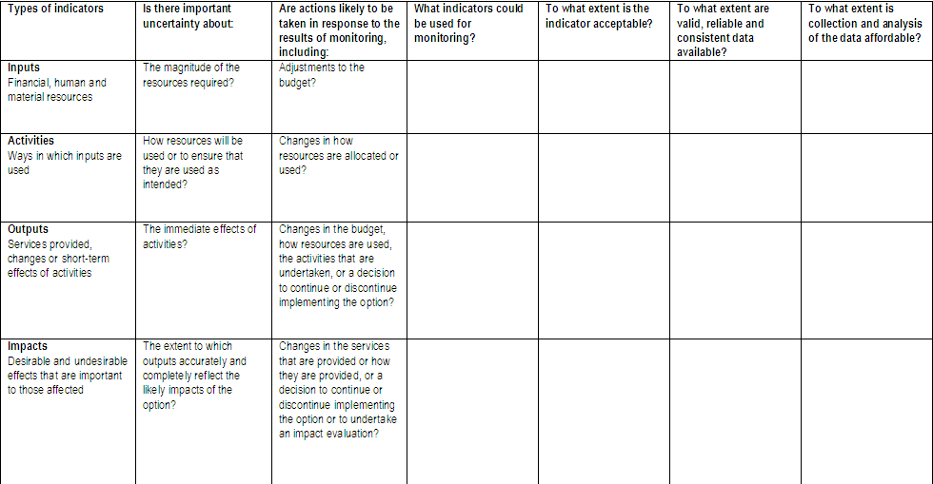
Worksheet for considering needs and alternatives for monitoring implementation of an option

Slide 14
Questions or comments about monitoring?

Slide 15
What should potentially be evaluated and how?
Although monitoring can sometimes be used to reduce uncertainties about the impacts of an option, often this will not be adequate
“Evaluation” is sometimes used interchangeably with “monitoring”
But evaluation, or more specifically ‘impact evaluation’, usually suggests an assessment of whether observed changes in the impacts that are measured can be attributed to the implementation of the option

Slide 16
Monitoring does not necessarily indicate whether an option has had an impact on the indicators that have been measured
Indicators will almost always be influenced by factors other than the option being implemented
This makes it extremely difficult to determine what caused any observed changes
If monitoring reveals, for example, that performance improved over time, implementation of the option may not be the only causal factor and may, in fact, not have caused the change at all

Slide 17
Impact evaluations should, so far as possible, measure all desirable and undesirable outcomes that are important to those affected for which there is substantial uncertainty
I.e. where the results of the evaluation could conceivably affect a decision about whether implementation of the option is worthwhile

Slide 18
An impact evaluation must estimate what would occur in the absence of implementing an option and compare this to an estimate of what happens with implementing the option
Ideally an evaluation should be built into an option as it is designed
Which means that the evaluation should be planned as early as possible
Policy briefs can help to ensure that appropriate consideration is given to the need for impact evaluations
And when and how they should be conducted

Slide 19
Evaluation methods and findings should be as reliable as possible
Attributing a change to the implementation of an option requires a comparison
The compared groups should be as similar as possible in order to rule out influences other than the option being evaluated
The most effective way of doing this is by random allocation
Randomised trials can be conducted
As pilot projects before a programme is introduced at a national level or
In parallel with full scale implementation
For example by randomly allocating the districts in which the option will be implemented first and using districts where implementation is delayed as the comparison

Slide 20
Randomised trials are not always feasible
Alternative approaches include
Interupted time series analyses
Controlled before-after studies

Slide 21
Interupted time series analyses
Can be used when data are collected from multiple time points before and after implementation of the option
Advantages
May be feasible and relatively easy to conduct if the necessary data are available
A control group is not needed
Controls for trends over time and variability in indicators over time
Disadvantages
Influences other than the option being evaluated may affect the observed changes

Slide 22
Controlled before-after studies
Changes before and after implementation of an option are compared with observed changes during the same time period in areas where the option was not implemented
E.g. in neighbouring districts or countries
Advantages
May sometimes be the only practical option
E.g. for options where randomisation is not feasible for practical or political reasons and where it is not feasible to collect data at multiple time points
Disadvantages
Rarely provide reliable estimates of impacts
Known or unknown differences between the groups that are compared may exert more influence on the outcomes that are measured than the option that is being evaluated
Consequently, it is generally difficult, if not impossible to confidently attribute observed changes (or a lack of change) to the implementation of an option

Slide 23
Other study designs may sometimes be used to assess the impacts of health policy options
However, some designs are typically not feasible for assessing the impacts of health policies
E.g. cohort studies and case-control studies
Other designs rarely provide compelling evidence
Before-after studies
Historically controlled studies
Cross-sectional studies
Qualitative studies (as well as other quantitative designs such as surveys) can provide valuable evidence to explain how an option worked or why it did or did not work
But they do not generate data that can be used to estimate the effect of an option beyond the perceptions of those who were interviewed or surveyed

Slide 24
Rigorous evaluations can be expensive to conduct
Budget, time or data constraints limit the ability to undertake rigorous impact evaluations
These constraints can impact on the reliability of impact evaluations in a number of ways, including:
Threats to the overall validity of the results; e.g. due to
Insufficient planning or follow-up
A lack of baseline data
Reliance on inadequate data sources
Selection of an inappropriate comparison
Inadequate samples; e.g. due to
Selection of a convenience sample that is not representative
A sample size that is too small
Inadequate attention to contextual factors

Slide 25
It may be possible to address budget, time and data constraints
For example, by starting planning early and reducing the cost of data collection
However, for it to be worthwhile to undertake an impact evaluation, it is important to ensure that the evaluation will provide reliable information
Thus, before implementing an evaluation, an assessment should be made as to whether an adequate evaluation is possible
If it is not, an assessment needs to be made as to whether to implement the option without evaluating it, given the nature of the uncertainty about its potential impacts

Slide 26
Evaluability assessment
Several models have been described for assessing the extent to which an adequate evaluation is possible, which is sometimes referred to as “evaluability assessment”
One purpose of an evaluability assessment is to determine whether the intended objectives of an evaluation can be achieved with the available resources and data and within the specified evaluation time horizon
The focus is on whether the particular level or levels of government (or non-governmental organisations) are in a position to begin collecting, analyzing, and reporting evaluation data so as to inform the decision-making process

Slide 27
A policy option is evaluable to the extent that
Goals and priority information needs are well defined
Goals are plausible
Relevant data can be obtained at a reasonable cost
The intended users of the evaluation results are able to agree on how they will use the information

Slide 28
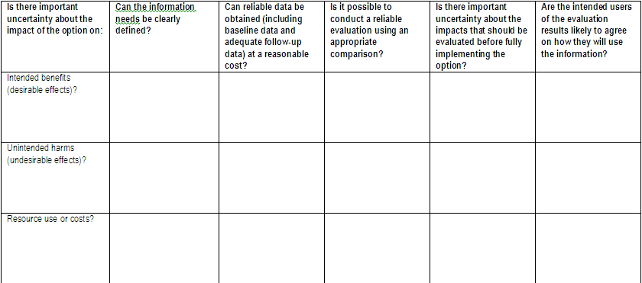
Worksheet for considering needs and alternatives for evaluating the impacts of an option

Slide 29
Decisions about proceeding with an option when there are important uncertainties about its impacts and it is not evaluable
Depend on judgements about
The size of the problem
What the alternatives are
The expected impacts of the programme
The extent of uncertainty about those impacts
Values
Costs
Feasibility
Acceptability

Slide 30
“We will serve the public more responsibly and ethically when research designed to reduce the likelihood that we will be misled by bias and the play of chance has become an expected element of professional and policy making practice, not an optional add-on.”
Iain Chalmers

Slide 31
“If you are poor, actually you need more evidence before you invest, rather than if you are rich.”

Slide 32
Questions or comments about evaluation?

