Slide 1
Informing and engaging stakeholders
Which stakeholder groups should be informed and engaged in the preparation and use of a policy brief?
What contextual factors might affect efforts to engage stakeholders?
How will different stakeholder groups be engaged in the preparation and use of a policy brief?
What difference will be made by informing and engaging stakeholders and how will this difference be evaluated?

Slide 2
Engaging people, groups or organisations with an interest (stakeholders) in deliberations about health policies can help to ensure
Their concerns are addressed
Problems are analysed, described and perceived correctly
Appropriate solutions are identified
Important barriers to implementing solutions are considered
Effective implementation strategies are identified
Appropriate values are used when balancing the pros and cons of options
Policy decisions are appropriate, understood and acceptable

Slide 3
Effectively informing and engaging stakeholders can result in better policy decisions, improved implementation of policies, better healthcare and better outcomes
Stakeholder involvement can also be viewed as a goal in itself by encouraging
Participative democracy
Public accountability
Transparency
For example, the World Health Organization’s Declaration of Alma Ata states that
The people have the right and duty to participate individually and collectively in the planning and implementation of their health care.

Slide 4
Engaging stakeholders is not always helpful
Poorly planned and implemented efforts to engage stakeholders can
Create mistrust
Waste people’s time
Undermine future attempts to engage stakeholders
Simply trying out a method of engaging stakeholders without having a clear objective for engaging them can result in angry participants without any benefit to the policymaking process or outcomes
Stakeholders are also sometimes engaged for inappropriate reasons; e.g stakeholdrs should not be engaged to
Legitimise a decision that has already been taken behind closed doors and misled into thinking they can affect the decision
Avoid responsibility for difficult decisions

Slide 5
Efforts to engage stakeholders should be based on respect for their time and their potential contributions
This requires ensuring that
Efforts to engage stakeholders have a clear purpose
Stakeholders’ input is considered
Their ability to influence decisions is clear

Slide 6
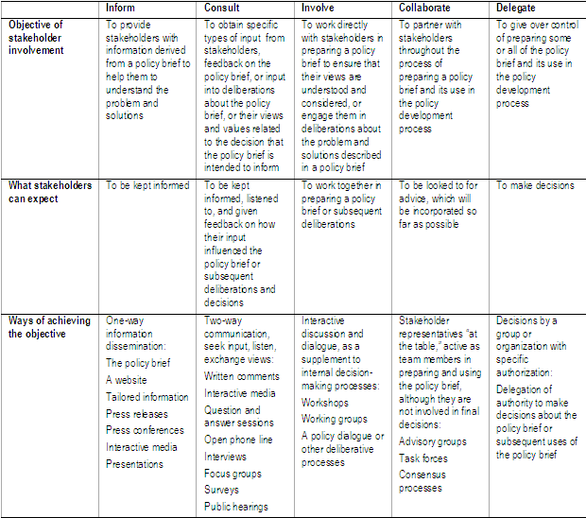
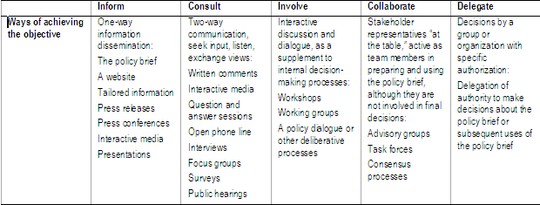
Different levels of engagement are appropriate in different circumstances

Slide 7
There is little rigorous evaluation of the effects of different strategies for engaging stakeholders in health policy development
There is a vast amount of experience and anecdotal evidence that can inform decisions about how to involve stakeholders in policymaking
Systematic consideration can help to ensure that stakeholders are well informed and effectively engaged
Which stakeholders have an interest in a policy brief
The degree to which they should be engaged in preparing and using the brief
How to inform and engage them
How their input will be used

Slide 8
Which stakeholder groups should be informed and engaged in the preparation and use of a policy brief?
Careful consideration of which stakeholder groups should be informed and engaged in preparing and using a policy brief is necessary to
Target efforts
Decide on appropriate strategies
Use resources efficiently
Before considering who to engage, it may help to consider how much effort is warranted

Slide 9
How much effort should you put into identifying and engaging stakeholders?
Can anything change as a result of engaging stakeholders?
If nothing can change as a result of informing or engaging participants it is likely to be better to limit efforts to simple, passive dissemination strategies
Do you have time and resources to effectively engage stakeholders?
While it may be possible to set up and run good processes for engaging stakeholders in a very short period of time this is challenging and should be avoided
Are there important risks that need to be managed?
Risks with engaging stakeholders include:
Wasted resources
Diminished credibility
Risks to the reputations of those who are engaged
Damaged relationships among those who are engaged
What are the risks of not engaging stakeholders?
Not informing or engaging stakeholders also entails risks
Not informing or engaging key stakeholders may impede implementation of appropriate options
Not obtaining their input may result in poorly informed decisions.

Slide 10
Categories of stakeholders and reasons for engaging them
Considering different categories of stakeholders and the reasons for engaging them can help to identify which stakeholders should be informed and engaged in preparing and using a policy brief
Public officials
Elected officials, political staff and civil servants in different government departments (e.g. health, finance, education, labour) and agencies in the national government and sub-national governments
Managers
In districts or regions, healthcare institutions (e.g. hospitals), non-governmental organisations (NGOs), and other relevant types of organisations
The public at large
Sections of the public
That are particularly affected by the problem and policy options
Health workers
Professionals, professional organisations, and non-professionals
Unions
Professional organisations that represent the interest of their members and other trade unions
Special interest groups
Groups or organisations formed for the purpose of putting forward the shared views and interests of its members
NGOs
National and international
Donors and international agencies
Individuals, groups or organisations with particular expertise and experience
E.g. researchers, technical experts, people with relevant practical experience

Slide 11
For each category of stakeholder
It may be helpful to consider potential reasons for engaging organisations, groups or individuals in preparing and using a policy brief, including
Inform them
Obtain specific types of input
Engage them in deliberations about the problem and solutions
Reach a consensus or make a decision
In addition, there may be reasons that are external to the specific policy issue, including to
Improve governance, social cohesion and social justice
Build capacity and learn

Slide 12
Reasons for engagement and the degree of engagement that is desirable will vary across different stakeholders
While it may be desirable to inform a wide range of stakeholders, the amount and type of information that is needed will vary
Similarly, the types of input and the importance of engaging people in deliberations will vary
Consequently, how best to engage different stakeholders will also vary

Slide 13
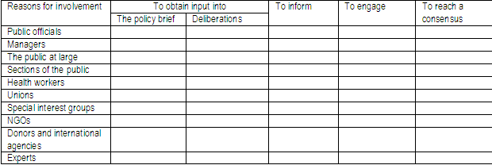
Categories of stakeholders and reasons for engaging them

Slide 14
Clarifying which organisations, groups or individuals to engage
Who has access to the types of information and evidence that are needed to clarify the problem, options for addressing the problem, barriers to implementing those options and implementation strategies?
Who has practical experience related to the problem and possible solutions?
Who has been engaged in efforts to address the problem in the past?
Who has not been engaged, but should have been?
Who will be affected?
Who is influential?
Who can obstruct a decision if not engaged?
Who runs organisations with relevant interests?
Who is directly responsible for decisions regarding the options and their implementation?

Slide 15
How should stakeholders be selected?
Some strategies require little or no selectivity
E.g. disseminating information to the public at large
But because time and resources are always limited, it is generally necessary to establish priorities
Even broad dissemination may require setting priorities such as how much effort to put into informing people who
Are illiterate
Speak different languages
Live in different parts of the country
Because information may need to be tailored to specific audiences to be effective, it may be important to determine which groups are most in need of tailored information
It is better to consider priorities such as these explicitly to ensure that time and resources are used efficiently

Slide 16
Most deliberative processes require deciding who will participate
Finding the right participants is important to ensure that deliberative processes work well

Slide 17
For some types of input a representative sample may be desirable
For example, representativeness is essential for opinion polls and other types of surveys
It may also be important for deliberative processes to ensure legitimacy and perceptions of legitimacy

Slide 18
Aims of selecting participants in deliberative processes
To involve those that are appropriate to the particular process, including those who themselves feel they have a stake
To ensure that people are not excluded because they are outside familiar networks
Special efforts may be needed to avoid excluding people by accident or lack of sufficient care
This can undermine the legitimacy and credibility of deliberative processes
It can also reinforce existing inequalities of power and access to resources

Slide 19
Issues to consider with respect to deciding which stakeholders to include in deliberative processes
Who decides who is included and how
When the selection of participants can be politically charged it may be useful to make the selection process as transparent as possible
The usual people
Being someone who is usually engaged is not grounds to include or exclude someone
People should be included because they are the right people
The range of opinions
By including people with conflicting opinions they may gain some ownership and be less inclined to undermine the process or outcomes by having been excluded
Conflicting interests
Competing interests are common and cannot be completely avoided
For some deliberative processes conflicts of interest should be disclosed
E.g. if an objective is to reach a consensus or make a decision
It may be appropriate to exclude or restrict involvement of some organisations or individuals
What’s in it for them?
It is important to consider what stakeholders want to get out of a deliberative process and what could prevent them from participating
If everyone’s motivations are clear, there will be less confusion and everyone is more likely to be satisfied with the outcomes

Slide 20
Questions or comments about deciding which stakeholders to inform and engage?

Slide 21
What contextual factors might affect efforts to engage stakeholders?
To be effective the methods used to engage stakeholders should be appropriate for the context in which they will be used as well as for the reasons for engaging people
Understanding the wider context is important to ensure that efforts to inform and engage stakeholders
Link with other relevant activities
Do not duplicate other activities
Build on previous experience
Are responsive to stakeholders’ needs and sensitivities
Are relevant

Slide 22
Knowing about and considering the context can help to guide decisions about how best to engage different stakeholders
Key decision-makers’ interest in and commitment to engaging stakeholders
How engaging stakeholders fits in with the relevant decision-making system
Past efforts to address the same problem
Other relevant past activities that may affect how information is perceived or discussions
E.g. previous experience with an option for addressing the problem
Sections of the public that are unlikely to be engaged but should be
E.g. disadvantaged populations
Existing relationships between key stakeholders, including relationships with potential facilitators and relevant decision-makers
E.g. antagonisms or close alliances

Slide 23
Knowing about and considering the context can help to guide decisions about how best to engage different stakeholders
Experiences of key stakeholders with deliberative processes
E.g. those with more experience, skills and confidence could dominate processes, so that a process may need to be designed to deal with important differences, for example by
Having different processes for different stakeholders
Separating stakeholders with more and less experience in breakout sessions
Providing training and support to stakeholders with less experience
The cultural diversity of stakeholders, which may affect people’s willingness to meet together or affect the way they participate in discussions
E.g. those with formal committee experience may expect a chair and formal debating procedures
Language
E.g. it may be important to prepare information in different languages or to ensure that deliberative processes accomodate different languages
Any barriers to people working together
E.g. gender barriers
Other relevant recent, current or planned activities to address the same or related problems, that might affect the feasibility or acceptability of solutions, or that might engage the same participants
Knowing about these can help to ensure that
Information is shared
Undesirable duplication is avoided
Activities and outputs are coordinated, if appropriate

Slide 24
Questions or comments about assessing contextual factors that might affect efforts to engage stakeholders?

Slide 25
How will different stakeholder groups be engaged in the preparation and use of a policy brief?
Different ways of engaging stakeholders are appropriate for different objectives
Different approaches will also likely need to be adapted to the specific context in which they will be used
It may help to consider a menu of different approaches when deciding how to engage key stakeholders

Slide 26
Ways of informing stakeholders
Disseminating the policy brief
A website
Tailored information
Press releases
Press conferences
Presentations

Slide 27
Ways of consulting stakeholders
Written comments
Interactive media
Question and answer sessions
Open phone line
Interviews, focus groups and surveys
Public hearings

Slide 28
Ways of involving stakeholders
Working groups
Advisory groups and task forces
Consensus processes

Slide 29
Questions or comments about deciding how different stakeholder groups will be engaged in preparing and using the policy brief?

Slide 30
What difference will be made by informing and engaging stakeholders and how will this difference be evaluated?
Evaluation is an integral part of involving stakeholders
Planning the evaluation in advance is important to ensure that necessary data are collected and evaluations can inform decisions about adjustments to the approaches that are being used, if needed

Slide 31
Measurable success criteria should be developed that reflect the objectives of informing and engaging stakeholders
Evaluation should address whether the
Intended outputs were delivered and were appropriate
Intended outcomes were achieved
Level of involvement was appropriate
Aproaches that were used were appropriate and worked as expected
Extent to which stakeholders were informed and engaged
Input was appropriate and was used appropriately
Efforts were worthwhile in relationship to what was achieved

Slide 32
Evaluation
The evaluation should include a basic description of what was done
The objectives
Targeted stakeholders
The approaches that were used
It is likely to be important to collect feedback from a range of stakeholders, since their assessments of the efforts and the extent to which they succeeded may vary
The evaluation can also help with risk management by raising awareness of and monitoring challenges

Slide 33
Questions or comments?

