Slide 1
Introduction to policy briefs
What is a policy brief?
What should be included in a policy brief?
How can policy briefs be used?
Getting started

Slide 2
What is a policy brief?
Evidence-based policy briefs
Bring together
  Global research evidence (from systematic reviews)
  Local evidence
To inform deliberations about health policies
They include
  A policy problem and summarise the best available evidence to clarify the size and nature of the problem
  A description of the likely impacts of key options for addressing the problem
  Considerations about potential barriers to implementing the options and strategies for addressing those

Slide 3
Questions or comments about what a policy brief is?

Slide 4
What should be included in a policy brief?
Key messages
  1 page of bullet points summarising the most important take home messages
Executive summary
  Synopsis of the problem, policy options, and implementation considerations
Full report
  The problem
    How it came to attention
    How the problem has been framed
    The size of the problem
    Factors underlying the problem
  Policy options
    The likely impacts
    Equity, cost and cost effectiveness considerations
    Need for monitoring and evaluation
  Implementation considerations
    Barriers to implementing the options
    Implementation strategies

Slide 5
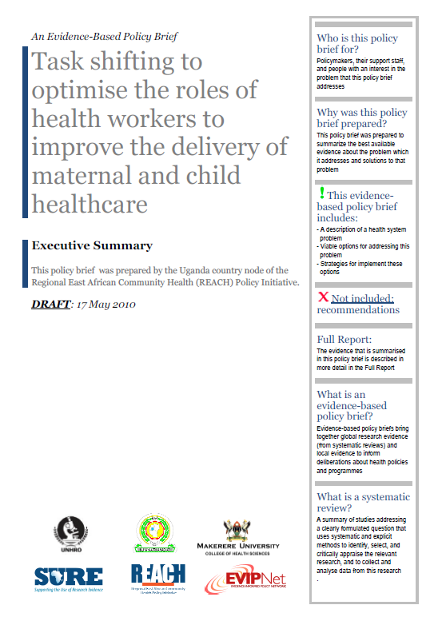
User friendly format

Slide 8


Slide 12


Slide 13
Questions or comments about what should be included in a policy brief?

Slide 14
How can policy briefs be used?
Informing stakeholders
  Disseminating the policy brief
  Tailored information derived from the policy brief
  Mass media
  Face-to-face presentations
Consulting stakeholders
  Written comments
  Question and answer sessions
  Interviews, focus groups, surveys
  Public hearings
Involving stakeholders
  Policy dialogues
  Targeted briefings or dialogues designed to reach specific audiences
  Bilateral meetings where public officials meet with a key stakeholder
  Electronic process to engage a large or widely dispersed group of participants
  Working or advisory groups
  Consensus processes
Can occur during the preparation of a policy brief or after it is completed
How the policy brief will be used should be considered early on

Slide 15
Questions or comments about how policy briefs can be used?

Slide 16
First steps
First step in preparing a policy brief is to agree on the problem
  Explicit criteria and systematic processes are more likely than implicit criteria and non-systematic processes to ensure well-informed decisions about which issues to prioritise
Next step is to decide on a timeline and a work plan
  Often determined by external factors
  Typically must be prepared in weeks or months

Slide 17
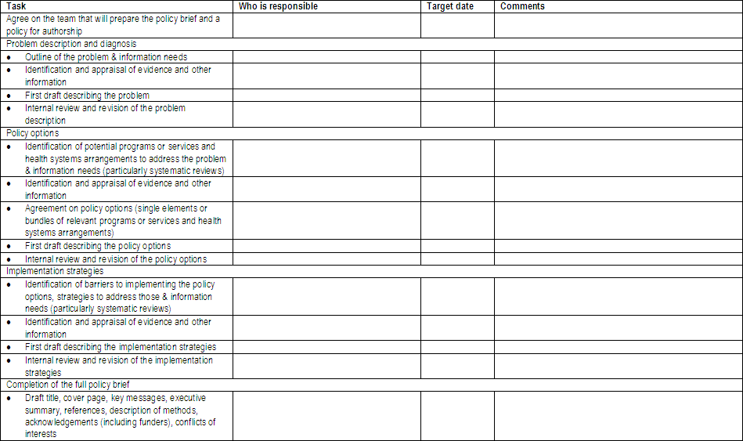
Work plan for a policy brief

Slide 18
SURE Guides for preparing and using policy briefs
Background
Getting started
Prioritising topics for policy briefs
Preparing policy briefs
Clarifying the problem
Deciding on and describing policy options to address the problem
Identifying and addressing barriers to implementing policy options
Clarifying uncertainties and needs for monitoring and evaluation
Using policy briefs
Organising and running policy dialogues
Informing and engaging stakeholders

Slide 19
Questions or comments about getting started?

