Slide 1
Finding and assessing research evidence about the costs and cost-effectiveness of options
What resources are needed?
What evidence is there regarding resource use?
How much confidence can be placed in that evidence?
How much will the necessary resources cost?
Is the option cost-effective?

Slide 2
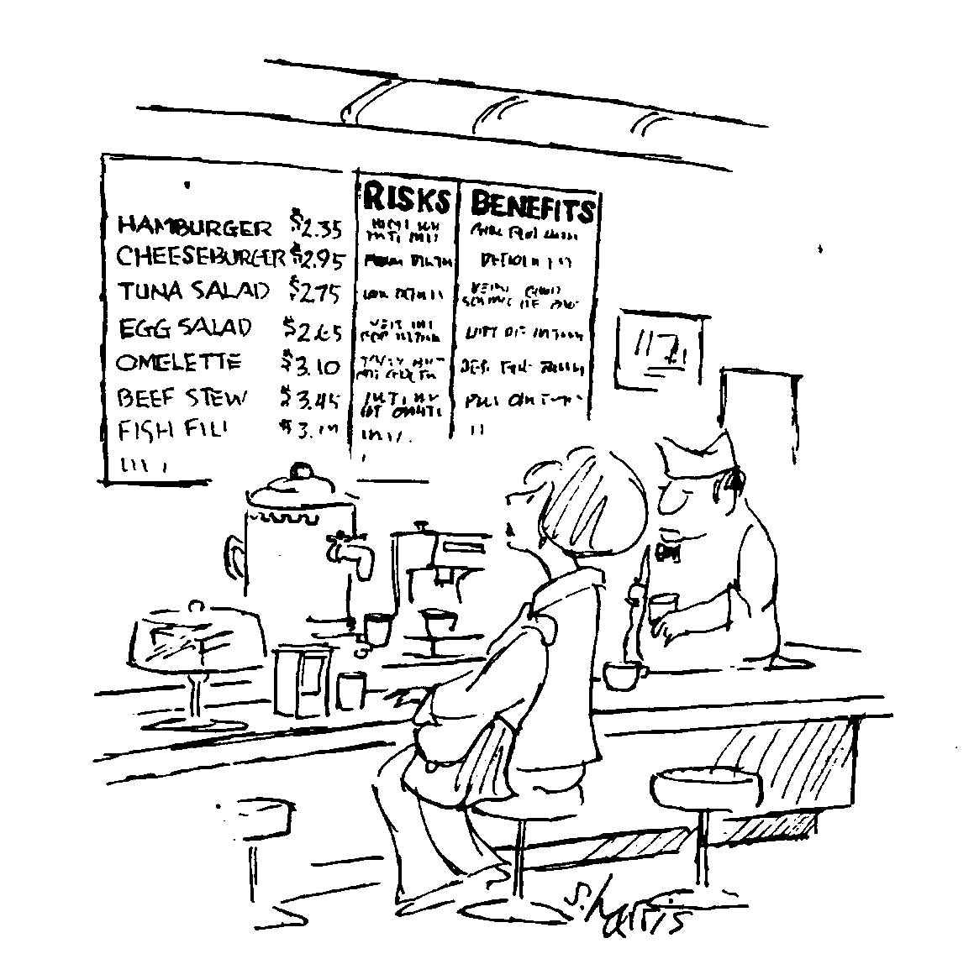
Policy briefs should inform judgements about whether the net benefits are worth the incremental costs

Slide 3
Costs differ from benefits and harms
Healthcare costs are typically shared
Unit costs tend to vary widely
Resource use is likely to vary
Resource implications vary widely
Stakeholders have different perspectives
Conflicting interests are common

Slide 4
What resources are needed?
Consider both
Resources used to implement the option
  E.g. drugs, equipment and human resources
Subsequent resource use from the impacts of the option
  E.g. increases or decreases in healthcare utilisation
For example, incentives to patients to improve adherence to tuberculosis treatment
Require substantial resource inputs
But these may be offset by subsequent savings
  Due to a reduction in failed treatment and less spread of the disease
  And therefore less subsequent resource use for retreatment and treatment of others who become infected

Slide 5
It is necessary to specify the viewpoint
A societal perspective
  Is a broad viewpoint that includes all important healthcare and non-healthcare resources
  Has the advantage of ensuring that the issue of who pays does not determine whether resource use is included
A healthcare system perspective
  Costs or savings outside of the healthcare system would not be included
  This would not preclude a consideration of the impacts of an option on issues such as social services or crime
  But any costs or savings associated with those impacts would not be relevant to the healthcare budget

Slide 6
It is also necessary to specify the time horizon
The period of time for which resource use, as well as health outcomes and other impacts, will be considered

Slide 7
Potentially important resource consequences
Changes in use of healthcare resources
Policy or programme delivery
  Human resources/time
  Consumable supplies
  Land, buildings, equipment
Additional (or fewer) hospitalisations, outpatient visits or home visits
Additional (or less) use of laboratory tests or examinations
Paid transportation (e.g. emergency transportation)
Changes in use of non-healthcare resources
Transportation to healthcare facilities
Social services (e.g. housing, home assistance, occupational training)
Changes in use of patient and informal caregiver time
Outpatient visits
Hospital admissions
Time of family or other informal caregivers
Changes in productivity
Should be captured in terms of the value or importance attached to health outcomes and should not be included as resource consequences

Slide 8
Questions or comments regarding identifying potentially important impacts on resource use?

Slide 9
Finding evidence regarding resource use
Systematic reviews
Impact evaluations
National, sub-national or international databases; e.g.
  Drug use from prescription databases
  Hospitalizations from hospital databases

Slide 10
Focus on evidence about resource use, not costs
Costs = resources expended x cost per unit
  Wide variability in unit costs
  Not possible to judge applicability with just costs
Advantages of focusing on resources
  Possible to judge whether the resource use reflects practice patterns in your setting
  Possible to focus on the items of most relevance
  Possible to ascertain whether the unit costs apply in your setting, if monetary values are subsequently assigned to the resources used

Slide 11
Evidence of resource consequences is often lacking
Published economic analyses might help
Consideration should be given to undertaking costing studies, if this is critical to making a decision
In the absence of available evidence it is likely to be important to flag that the costs of an option are uncertain

Slide 12
Questions or comments regarding finding evidence regarding resource use?

Slide 13
How much confidence can be placed in evidence of resource use?
Criteria for assessing the quality of evidence for resource use are largely the same as those for health outcomes, including study design and
Risk of bias
Precision
Consistency of results
Directness of the evidence
Publication bias

Slide 14
Factors that commonly lower the quality of resource evidence
Unavailability of data due to resource use not having been measured or reported, or reported only as cost estimates
Weak (observational) study designs
Indirectness due to uncertainty about the transferability of resource evidence from one setting to another
Indirectness due to inadequate follow-up periods

Slide 15
Checklists for economic analyses
More than 20 instruments for assessing the quality of economic analyses in the healthcare literature
These instruments focus on the development and reporting of economic models
They are not constructed to assess the quality of evidence upon which analyses are based

Slide 16
The quality of the evidence used in published economic models is rarely explicitly assessed
Sensitivity analyses are used to test assumptions, but rarely directly take into account the quality of the evidence
Tables that present the data used to build an economic model rarely include assessments of the quality of evidence for each estimate that is used

Slide 17
Questions or comments on making judgements about how much confidence to place in evidence of resource use?

Slide 18
How much will the necessary resources cost?
Requires attaching appropriate monetary values (unit costs) to resource use

Slide 19
Attaching appropriate monetary values to resource use has several advantages
Monetary values are more easily understood by decision makers
Attaching monetary values makes it possible to aggregate different types of resource use
The use of appropriate monetary values can help to ensure that resource use is valued consistently and appropriately by decision makers

Slide 20
Monetary valuations of resource use should be made with data specific to the context where a policy decision must be made
Reliable databases or data sources from the same setting are the most reliable sources of data for unit costs
If not possible, interpretation of valuations from other settingscan be assisted by
  Purchasing power parity
  Exchange rates
  Inflation factors
CCEMG - EPPI-Centre Cost Converter can be used to adjust an estimate of cost expressed in one currency and price year to a target currency and/or price year http://eppi.ioe.ac.uk/costconversion/default.aspx

Slide 21
Discounting
Used to adjust for social or individual references over the timing of costs and health benefits
Less weight given to costs or benefits occurring further in the future
Recommended discount rates differ between countries
Often varied in sensitivity analyses in economic analyses

Slide 22
Questions or comments on making judgements about attaching monetary values to resource use?

Slide 23
Economic models have advantages
They allow for more explicit and complex sensitivity analyses
Can be helpful when
  Decisions are complex and involve multiple important outcomes and resource consequences over long periods of time
  Large capital investments, such as building new facilities or purchasing new, expensive equipment

Slide 24
Finding economic analyses
NHS Economic Evaluation Database (NHS EED) www.crd.york.ac.uk
Contains 12,000 abstracts of health economics papers
  Over 3000 quality-assessed economic evaluations
Aims to assist decision makers by systematically identifying and describing economic evaluations, appraising their quality, and highlighting their relative strengths and weaknesses
PubMed www.pubmed.gov

Slide 25
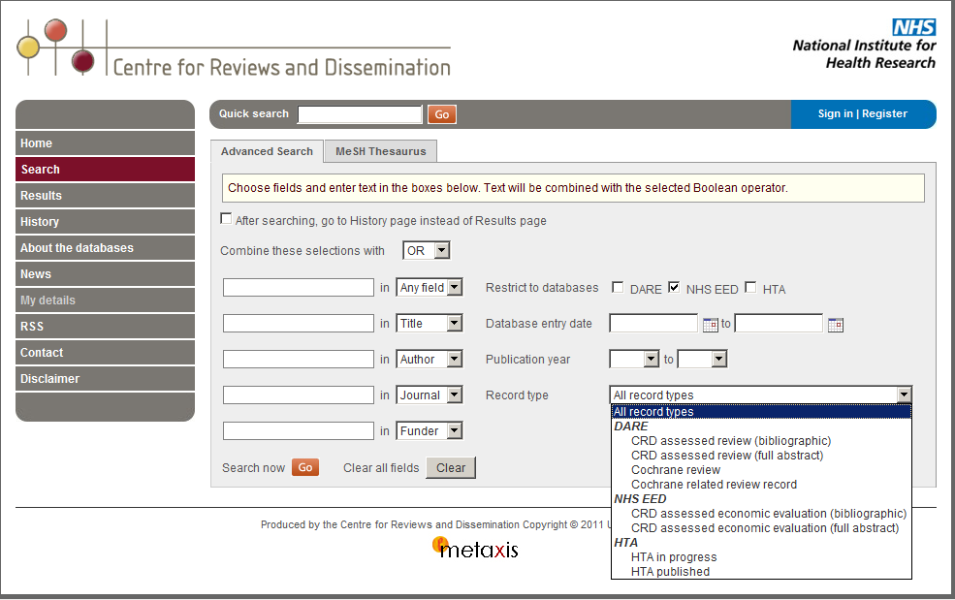
NHS Economic Evaluation Database

Slide 26
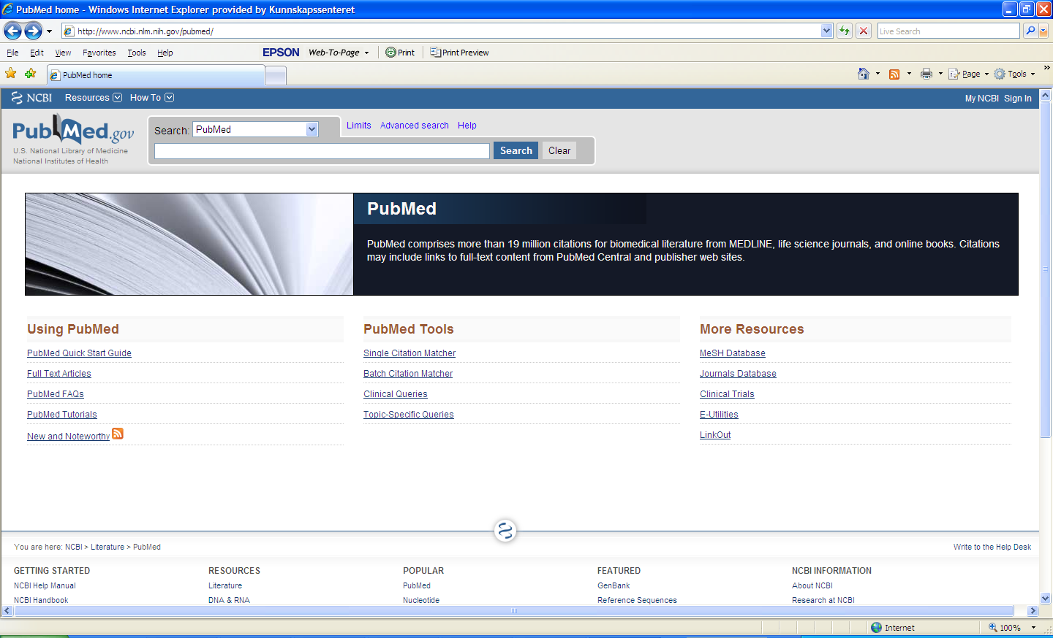
PubMed

Slide 27
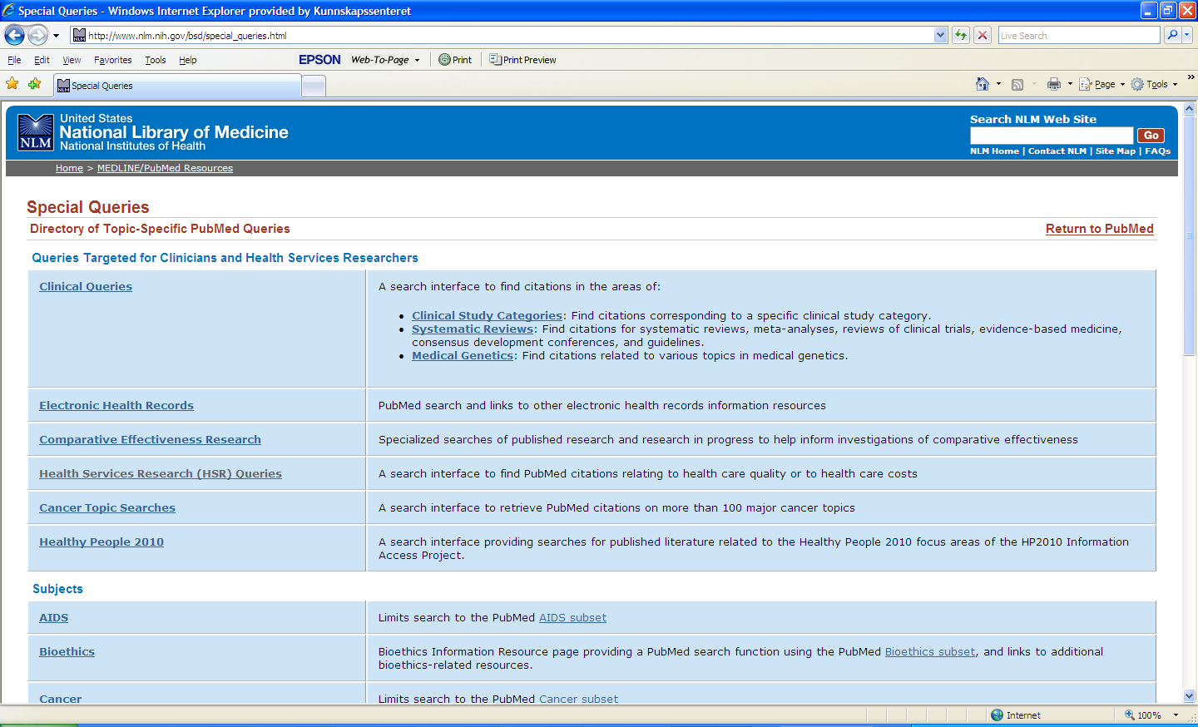
PubMed

Slide 28
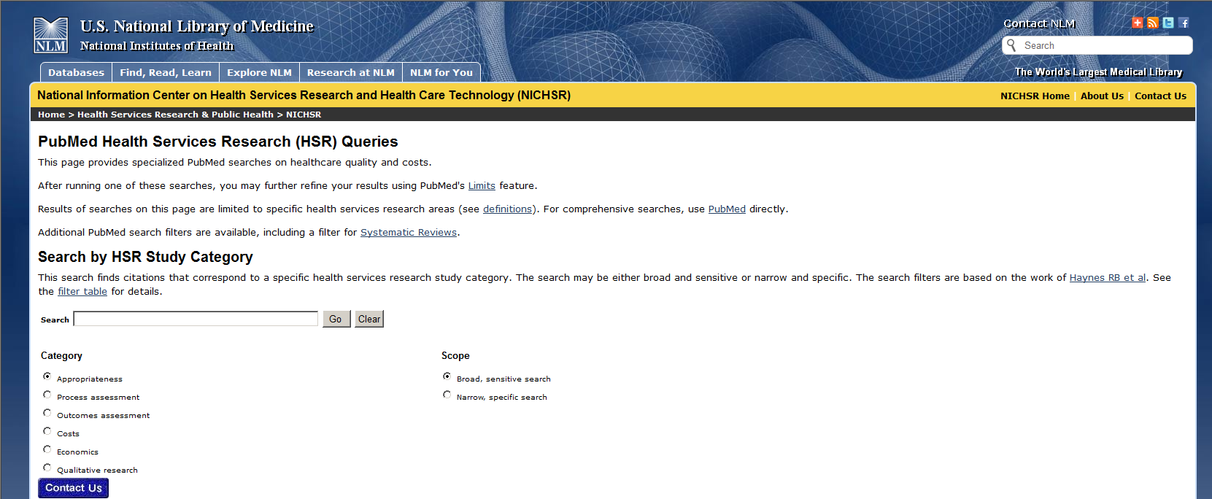
PubMed

Slide 29
Published cost-effectiveness analyses are often of limited value
Can be helpful, particularly for developing a model
But often of limited value when not from the same setting
  Assumptions made and the unit costs that were used may not be transferable
In addition, as with any research, cost-effectiveness analyses can be flawed
Without the complete model it is difficult to make informed judgements about either the quality of the evidence or its applicability

Slide 30
Given the complexity of economic models & limited resources for constructing these, it often is not feasible to undertake full economic models
Even when economic models are used, a balance sheet can help
  Ensure decision-makers’ understanding key outcomes and resource consequences
  Focus attention on the quality of the evidence used in an economic model

Slide 31
Questions or comments about economic analyses?

Slide 32
Resource consequences need to be considered along with health and other impacts when making judgements about the balance between the pros and cons of options

Slide 33
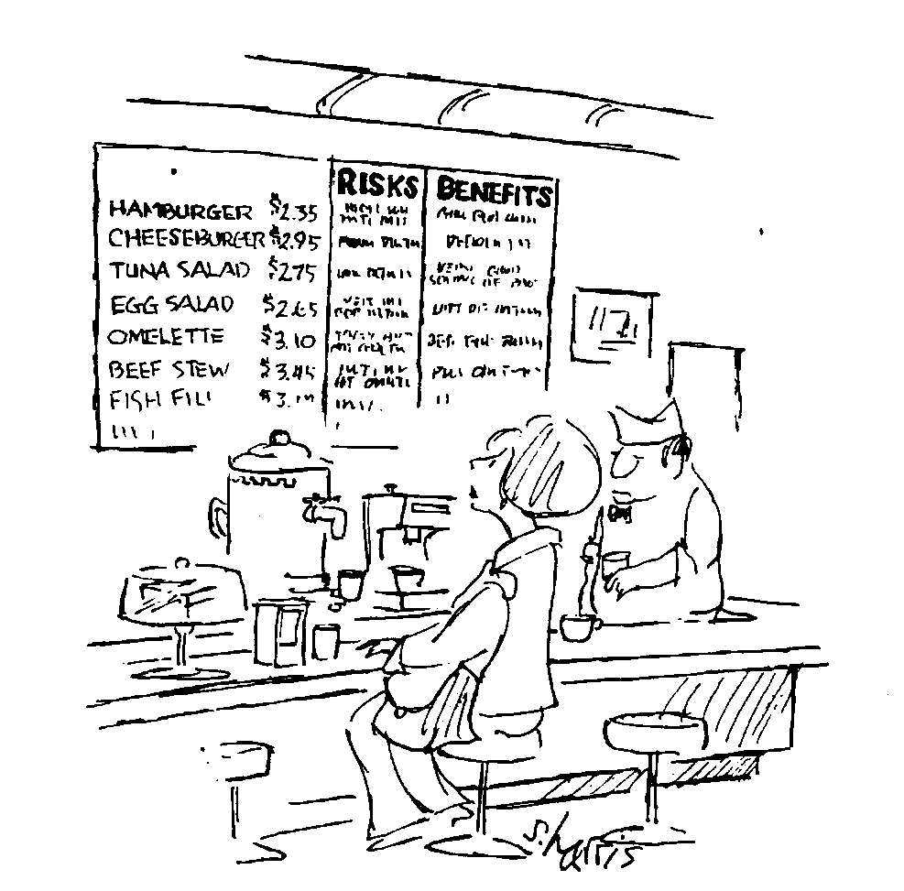
Policy briefs should inform judgements about whether the net benefits are worth the incremental costs
?
?
?
?
And clarify important uncertainties

Slide 34
Equity considerations
In addition to considering the overall costs (and cost-effectiveness) of optons, policymakers need to consider
Who will bear particular costs and
The impact that this will have on inequities

Slide 35
Questions or comments?

