Slide 1
Summarising findings about the likely impacts of options
Judgements about the quality of evidence
Preparing summary of findings tables
Plain language summaries

Slide 2
Introduction to Summary of Findings (SoF) Tables

Slide 3
Why bother?
SURE policy briefs are intended to help people make decisions.
A well-informed decision requires comparison between expected benefits and harms.
A balance sheet that summarises this information can facilitate decisions.

Slide 4
Examples of SoF tables

Slide 5
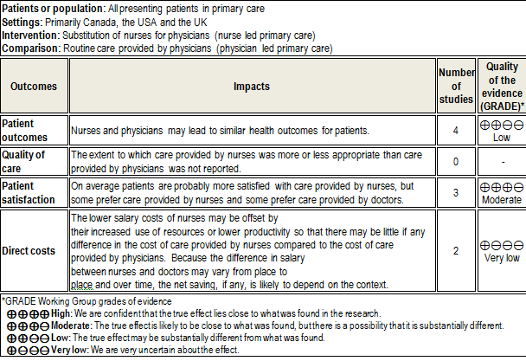
Substitution of nurses for physicians in primary care

Slide 6
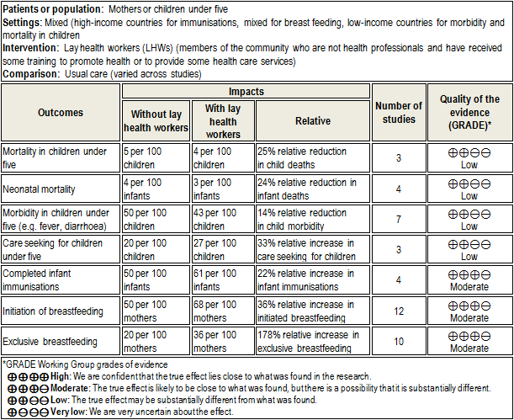
Lay health workers as an add on to usual care

Slide 7
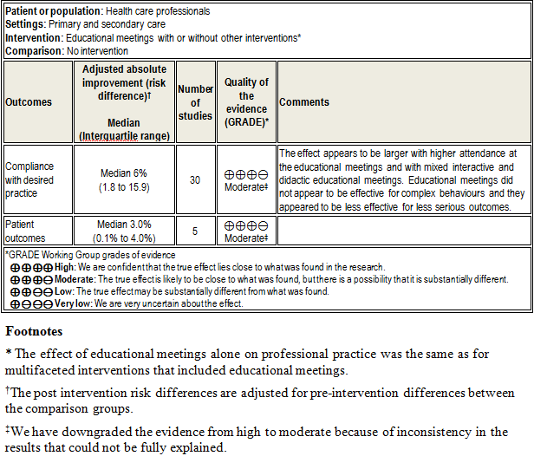
Educational meetings for health professionals

Slide 8
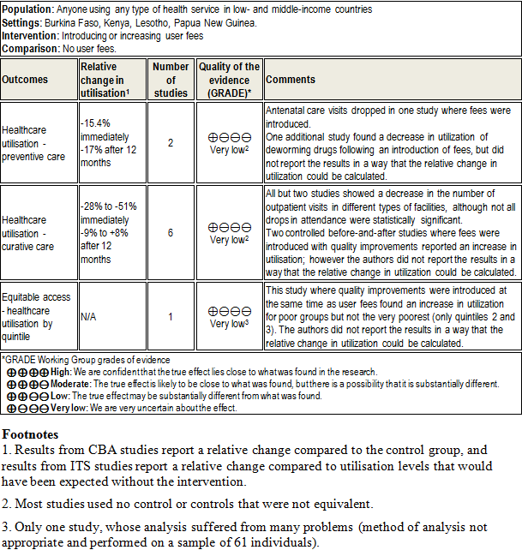
Introducing user fees

Slide 9
Introduction to GRADE

Slide 10
Why bother about grading the quality of evidence?
People draw conclusions about the quality of evidence
Systematic and explicit approaches can help
protect against errors
resolve disagreements
facilitate critical appraisal
communicate information
However, there is wide variation in currently used approaches

Slide 11
What is quality of evidence and how should it be graded?

Slide 12
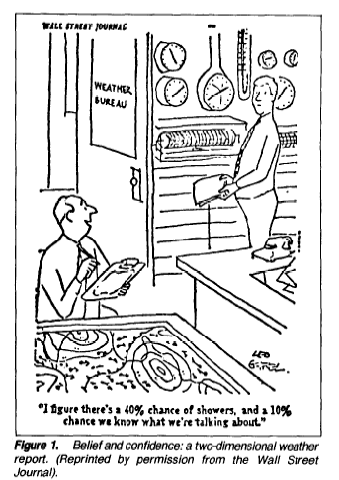

Slide 13
Quality of evidence
The quality of evidence reflects the extent to which we are confident that an estimate of effect is correct

Slide 14
The quality of evidence needs to be considered for each important outcome
The quality of evidence may be different for different outcomes
Decision makers (and review authors) need to consider the relative importance of outcomes

Slide 15
Although the degree of confidence is a continuum, we suggest using four categories
High
Moderate
Low
Very low

Slide 16
Categories of quality
High: We are confident that the true effect lies close to that of the estimate of the effect.
Moderate: The true effect is likely to be close to the estimate of the effect, but there is a possibility that it is substantially different.
Low: The true effect may be substantially different from the estimate of the effect.
Very low: Any estimate of effect is very uncertain.

Slide 17
Study design is important
Early systems of grading the quality of evidence focused almost exclusively on study design
Randomised trials provide, in general, far stronger evidence than observational studies.
Randomised trials start out at High
Observational studies start out at Low
However, other factors may decrease or increase the quality of evidence

Slide 18
Factors that can lower the quality of evidence
Study limitations (risk of bias)
Inconsistency of results
Indirectness of evidence
Imprecise results
Publication bias

Slide 19
There are also factors that can raise the quality of evidence
Large magnitude of effect
A dose response relationship
All plausible confounding

Slide 20
Questions or comments?

Slide 21
Making judgements about factors that can lower the quality of evidence

Slide 22
Study limitations (Risk of bias) for randomized trials and controlled before-after studies
Was the allocation sequence adequately generated?
Was the allocation adequately concealed?
Were baseline outcome measurements similar?,
Were baseline characteristics similar?
Were incomplete outcome data adequately addressed?
Was knowledge of the allocated interventions adequately prevented during the study?
Was the study adequately protected against contamination?
Was the study free from selective outcome reporting?
Was the study free from other risks of bias?

Slide 23
Study limitations (Risk of bias) for interrupted time-series analyses
Was the intervention independent of other changes?
Was the shape of the intervention effect pre-specified?
Was the intervention unlikely to affect data collection?
Was knowledge of the allocated interventions adequately prevented during the study?
Were incomplete outcome data adequately addressed?³
Was the study free from selective outcome reporting?
Was the study free from other risks of bias?

Slide 24
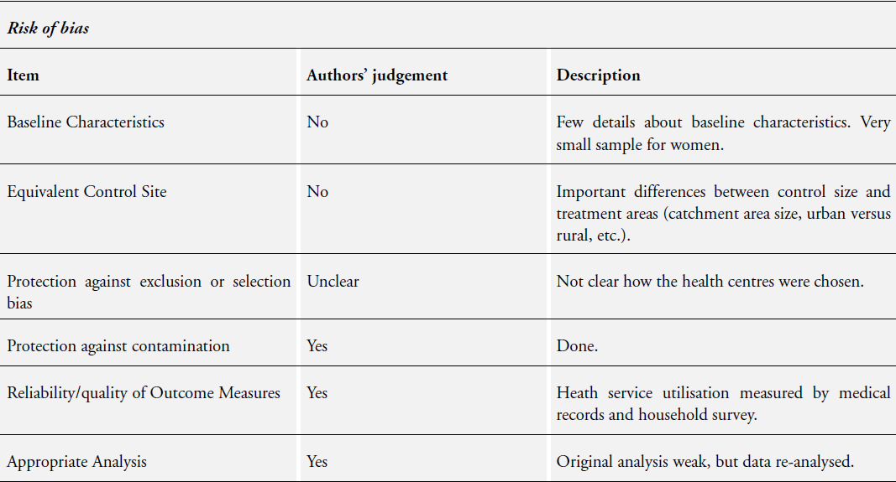
Assessment of the risk of bias

Slide 25
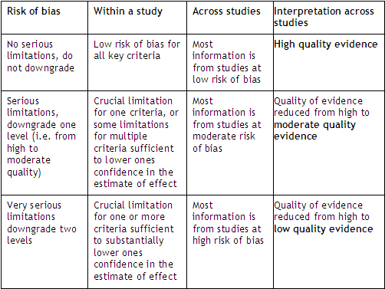
Summarizing study limitations for randomized trials

Slide 26
Questions or comments about assessing risk of bias?

Slide 27
Inconsistency of results
Look for explanation
patients, intervention, outcome, methods
Judgement
variation in size of effect
overlap in confidence intervals
statistical significance of heterogeneity
I²
τ2 (tau square)

Slide 28
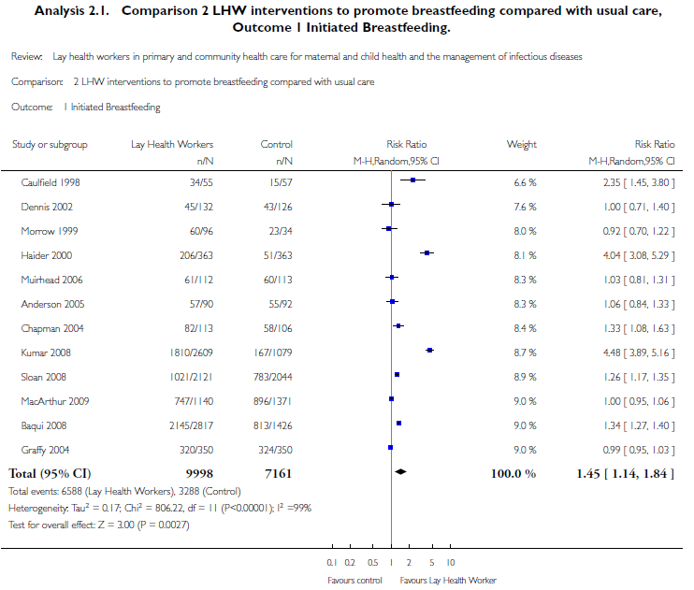
Lay health workers

Slide 29
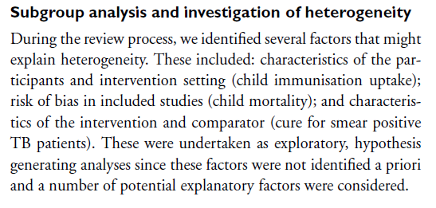
Possible explanations (protocol)

Slide 30
Possible explanations
The reasons for this heterogeneity will be explored in the next update and include factors such as
study setting (low, middle, or high income country)
control group breastfeeding rates (for example < 30%; > 30%)
timing of the start of the intervention (in the first or second trimester of pregnancy, in the third trimester only)

Slide 31
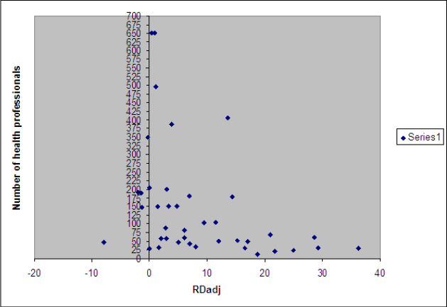
Educational meetings

Slide 32
Possible explanations
The main explanatory factors that we considered were the:
type of intervention (educational meetings alone, with or without educational material, or multifaceted interventions that included educational meetings)
contribution of educational meetings as a component of the intervention for multifaceted interventions
intensity of the educational meetings
attendance at the educational meetings
setting of care (primary care versus hospital)
interactive versus didactic educational meetings
complexity of the targeted behaviour;
seriousness of the outcomes;
baseline compliance;
risk of bias (low, moderate, or high)

Slide 33
Questions or comments about assessing inconsistency?

Slide 34
Indirectness of evidence
Question of interest
Relative effectiveness of community health workers (CHWs) and health professionals
Source of indirectness
Indirect comparison: Randomized trials have compared CHWs to no intervention and health professionals to no intervention, but trials comparing CHWs to health professionals are unavailable.

Slide 35
Indirectness of evidence
Question of interest
Integrated management of childhood illness (IMCI)
Source of indirectness
Differences in Outcome: A randomized trial shows improvements in practice, but follow-up did not find improvements in health outcomes

Slide 36
Indirectness of evidence
Question of interest
Community health workers for chronic diseases
Training for traditional birth attendants
Conditional cash transfers in Africa
Source of indirectness
Differences in Population: trials of lay health workers in high income countries, but not CHWs in low income countries
Differences in Intervention: trials of educational meetings, but not of a complex intervention including supportive supervision
Differences in Comparison: trials of conditional cash transfers in Latin America, but not Africa

Slide 37
Questions or comments about assessing indirectness?

Slide 38
Three challenges in assessing imprecision in systematic reviews
Thresholds are critical

Slide 39
1. Downgrading for imprecision: Thresholds are key
Ischemic stroke
2.0
0.5
0
0.5
Favors Intervention
Favors Control
Risk difference in %

Slide 40
1. Downgrading for imprecision: Thresholds are key
Threshold NNT = 200
Ischemic stroke
2.0
0.5
0
0.5
Favors Intervention
Favors Control
Risk difference in %

Slide 41
1. Downgrading for imprecision: Thresholds are key
Ischemic stroke
Threshold NNT = 100
2.0
0.5
0
0.5
Favors Intervention
Favors Control
Risk difference in %

Slide 42
Thresholds depend on judgements about values
Therefore different definitions and judgements are needed for guidelines and reviews

Slide 43
Definitions of quality of evidence
In the context of making recommendations
The quality of evidence reflects the extent to which our confidence in an estimate of the effect is adequate to support a particular recommendation.
In the context of a systematic review
The quality of evidence reflects the extent to which we are confident that an estimate of effect is correct.

Slide 44
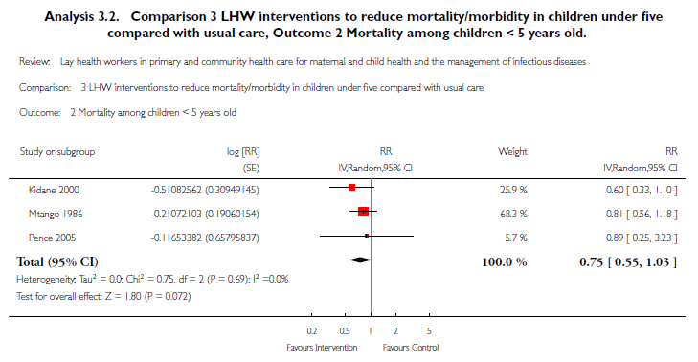
Lay health workers

Slide 45
Questions or comments about assessing imprecision?

Slide 46
Publication bias
Reporting of outcomes
Selective outcome reporting
Reporting of studies
Publication bias
number of small studies
industry sponsored
High likelihood could lower quality

Slide 47
Educational meetings

Slide 48
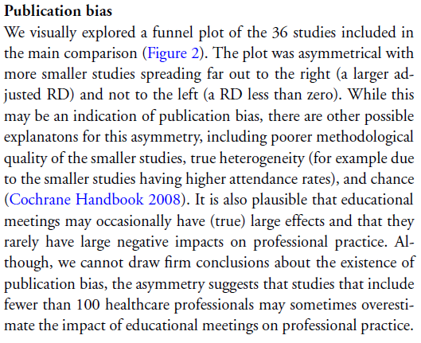
Possible explanations

Slide 49
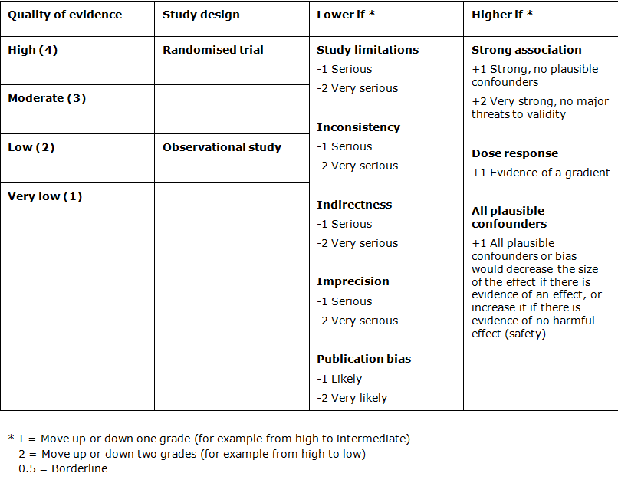
Quality assessment criteria
Notes:
49

Slide 50
What is the overall quality of evidence across criteria?
High: Further research is very unlikely to change our confidence in the estimate of effect.
Moderate: Further research is likely to have an important impact on our confidence in the estimate of effect and may change the estimate.
Low: Further research is very likely to have an important impact on our confidence in the estimate of effect and is likely to change the estimate.
Very low: Any estimate of effect is very uncertain.

Slide 51
Threshold for downgrading
rate down quality
OK
lowest
highest

Slide 52
Questions or comments about assessing the quality of evidence across criteria for an outcome?

Slide 53
Introduction to the worksheets

Slide 55
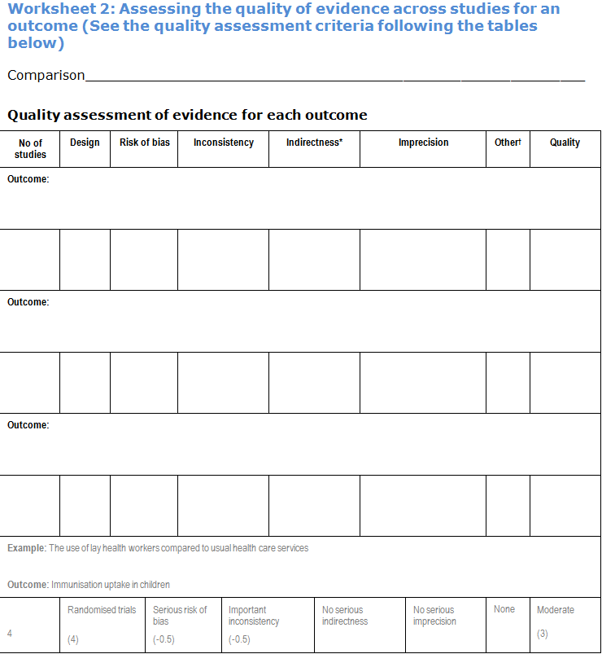

Slide 56
Quality assessment criteria
Notes:
56

Slide 57
Summarizing study limitations for randomized trials

Slide 62
Plain language summaries

Slide 63
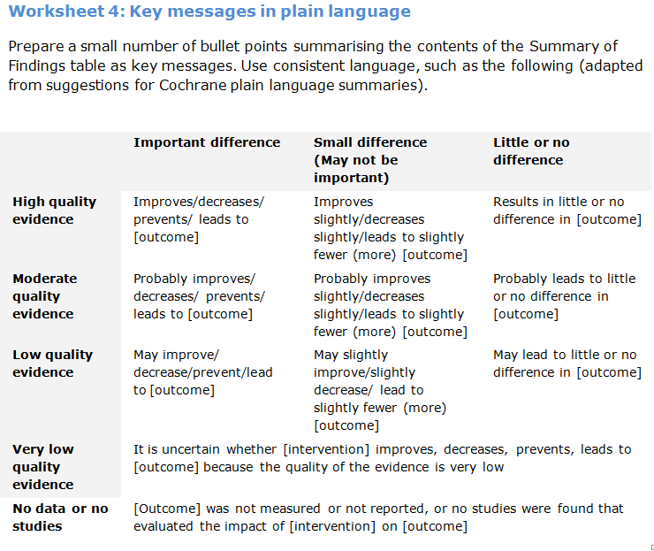
Plain language summaries

Slide 64
Examples
Using lay health workers as an add-on to usual care
Probably increases immunisation coverage and breast feeding
May increase care seeking behaviour for children under five and reduce morbidity and mortality in children under five and neonates
Substitution of nurses for physicians in primary care
Nurses and physicians may lead to similar health outcomes for patients
It is uncertain whether there is any difference in the cost of care provided by nurses compared to the cost of care provided by physicians
Educational meetings for health professionals
Probably improve compliance with desired practice and patient outcomes

Slide 65
Questions or comments regarding plain language summaries?

Slide 66
Any other questions or comments?

