Slide 1
Organising and running policy dialogues
What are the objectives?
Who will participate?
How will the dialogue be organised?
What needs to be done following the dialogue?
A framework for going from evidence to health systems decisions

Slide 2
Formal discussion and careful consideration before deciding (deliberation) is generally desirable for health policy decisions
Deliberative processes are starting to be seen as
Providing a promising type of contextualized “decision support”
A way to give voice to stakeholders, including patients and the public
Little attention has been paid to the use of deliberative processes to facilitate evidence-informed health policymaking

Slide 3
Policy dialogue
A deliberative process (a structured discussion) focused on a policy brief
Can contribute to the development of evidence-informed health policies by
Adding to the value of the policy brief
Helping to clarify the problem and solutions, and develop a shared understanding
Contributing to developing and implementing effective policies
Contributing to good governance and democracy

Slide 4
Health policy decisions require a great deal of judgement
The importance of the problem and its causes
Which options to consider to address the problem
The likely impacts of those options
Barriers to implementing the options
Which implementation strategies to consider to address those barriers
The likely effects of those strategies
Priorities for monitoring and evaluation

Slide 5
Most judgements must be made by those preparing a policy brief and should be open to discussion by those using the policy brief
Judgements about the balance between the advantages and disadvantages of the options and implementation strategies that are considered viable need to be made by those using the policy brief and it requires careful consideration of the values that are attached to the expected advantages and disadvantages

Slide 6
The judgements that need to be made are complex
They require input from people with different types of expertise and different perspectives
The idea of bringing people together to discuss a policy brief is based on the understanding that they all have something to contribute
Thus, it is essential that policy dialogues are designed to
Bring together an appropriate group of people
Use a process that ensures that all participants can be heard and have the opportunity of influencing the outcome of the process

Slide 7
Little is known about the optimal mix of participants in a policy dialogue or how best to structure the discussion to ensure that the objectives of the dialogue are achieved
Policy dialogues may have different objectives
It is unlikely that there is a single recipe for policy dialogues that is appropriate across different policy briefs and different settings
However, a structured approach to deciding on the participants and process can help to ensure that a policy dialogue is appropriately designed to achieve its objectives

Slide 8
What are the objectives of the policy dialogue?
Policy dialogues share a common aim: discussion and careful consideration that will contribute to a well-informed health policy decision
However, the specific objectives of a policy dialogue can vary in several ways
In relationship to the timing of the dialogue and the policy development process
The importance of different ways in which it can contribute to the development and implementation of a policy that is evidence-informed
The extent to which the aim of the dialogue is to reach a consensus
The ways in which the policy dialogue is intended to feed into the policy development process

Slide 9
What is the timing of the dialogue and the policy development process?
Policy dialogues may occur at different times in relationship to the policy development process
They can occur early in the process
The objectives may focus primarily on clarifying and framing the problem and identifying viable solutions
And less on the descriptions of options and their implementation
They can occur later in the process after the problem and options have been clarified and agreed
The focus would likely be primarily on the advantages and disadvantages of the options and implementation strategies that are being considered
And less on the problem description and identification of viable options

Slide 10
The timing of the policy development process may also vary
There may be an urgent need to address a problem or make a policy decision because of the nature of the problem or a window of opportunity
The objective of a policy dialogue might be more focused on contributing towards achieving a consensus and reaching a decision
The problem and circumstances may be such that a longer time frame is better suited to the policy development process
The objective might be more explorative and focused on contributing towards achieving a process that will result in a good decision and which is perceived as credible

Slide 11
What are the most important ways in which the policy dialogue can contribute to the development and implementation of an evidence-informed policy?
While it is unlikely to be helpful to have a long list of objectives, it may be helpful to have a checklist
This can be used to help reach agreement on
What the most important objectives are
To design the dialogue to ensure that priority is given to achieving those objectives
Who is invited to participate
How the dialogue is organised

Slide 12
Possible objectives Adding to the value of the policy brief
Providing a check on the quality and contents of the policy brief
Clarifying judgements that were made in the policy brief
Introducing relevant evidence not incorporated in the policy brief
Helping to ensure that the contents of the policy brief are understandable and understood
Helping to ensure that the policy brief is taken into account and used in developing policy

Slide 13
Possible objectives Clarifying the problem and solutions, and developing a shared understanding
Further clarifying options for addressing the problem
Developing a shared understanding of the pros and cons of different options
Identifying and clarifying barriers to implementing the options
Identifying and clarifying strategies for addressing those barriers
Developing a shared understanding of the pros and cons of relevant implementation strategies
Clarify important uncertainties
Developing a shared understanding of uncertainties and needs for monitoring and evaluation

Slide 14
Possible objectives Contributing to developing and implementing effective policies
Facilitating dialogue among people with different types of expertise and different perspectives
Bringing potential opposition into the policy development process
Exposing, clarifying or resolving disagreements regarding the evidence
Clarifying judgements that need to be made based on the policy brief
Clarifying the values used in judgements about the balance between the pros and cons of the options and implementation strategies; and exposing, clarifying or resolving differences in those values
Generating ideas and actions by policymakers and stakeholders that can help to expedite development and implementation of effective policies
Giving credibility to the policy development process and the policies that evolve

Slide 15
Possible objectives Contributing to good governance and democracy
Involving people in their own governance
Helping to ensure transparency
Helping to ensure accountability
Building capacity for evidence-informed policymaking
Providing a learning opportunity for stakeholders and the public

Slide 16
How is the policy dialogue intended to feed into the policy development process?
Policy dialogues may vary widely in terms of how they are intended to feed into the policy development process
At the one extreme, they may be organised by public policymakers to feed formally into a decision
At the other extreme, the initiative may come primarily from people without decision-making authority and the policy dialogue may be one of many inputs into the development of a policy
The specific objectives and outputs of a policy dialogue (and how it should be designed) will depend on how it is intended to fit into the policy development process

Slide 17
To what extent is it feasible and desirable to achieve a consensus?
How desirable it is to achieve a consensus will depend on
The timing of the dialogue
The most important ways in which it can contribute to evidence-informed policymaking
How it is intended to feed into the policy development process
If a decision needs to be made urgently, developing a shared understanding of the pros and cons of the options being considered is a high priority, and the policy dialogue is intended to feed directly into a decision, it is more likely that the objective of the dialogue will be to obtain a consensus
If a decision does not need to be made urgently, it is early in the policy development process, clarifying and framing the problem and identifying viable solutions are high priorities, and the dialogue is intended to be one of many inputs into the policy development process, obtaining a consensus is unlikely to be important
In many situations it could be counter-productive to try to obtain a consensus, although this does not preclude a consensus emerging spontaneously

Slide 18
How will you know if the policy dialogue has achieved its objectives?
After agreeing on specific objectives for a policy dialogue, it may be helpful to identify measurable markers of success for each objective
These can help to guide what needs to be done following the policy dialogue as well as its evaluation

Slide 19
Questions or comments about the objectives of policy dialogues?

Slide 20
Who will participate in the dialogue?
Different political systems may have requirements or traditions regarding which individuals and how many individuals will be invited to meetings to discuss policy issues
It may not be possible, or desirable, to deviate from these requirements or traditions
But arbitrary or biased selection of participants should be avoided and careful considerations should be given to who will participate in a policy dialogue

Slide 21
A policy dialogue should include people with relevant expertise and perspectives
Identifying an appropriate mix of people may require several steps
Mapping the range of stakeholders with an interest in the policy issue
Mapping the range of expertise that is relevant to the policy issue
Identifying individuals that can represent relevant stakeholders and perspectives and have relevant types of expertise
Selecting those individuals who will be invited
Inviting individuals to participate

Slide 22
Stakeholder mapping
Entails creating a list categories of people, groups or organisations with an interest in the specific policy issue
Policymakers
Including elected officials, political staff and civil servants - in the national government and sub-national governments, and from different departments, and not just health or finance department
Managers
In districts or regions, healthcare institutions (e.g. hospitals), non-governmental organisations, and other relevant types of organisations
Civil society groups
Including consumer groups, health professional associations, industry associations, and other relevant groups
Researchers
In national research institutions, universities, and from other countries

Slide 23
Mapping the range of expertise that is desirable
Entails creating a list of the types of expertise for the specific issue
Researchers from different disciplines
Health professionals from different professions and specialities
Civil servants and managers from relevant programmes
Professionals and consumers with practical experience
People with expertise in political, policy development and group processes

Slide 24
Mapping different factors that need to be understood
To ensure that participants bring to the dialogue understanding of a range of factors such as the
Regulatory and institutional constraints
On-the-ground realities and constraints
Values and beliefs of those who will be affected
Underlying incentives, and influence and authority within and among key interest groups
Social, political and economic factors beyond the health sector that affect the problem and potential solutions
International factors that affect the problem and potential solutions, including the influence of donor strategies, actions and aid modalities

Slide 25
A list of individuals representing relevant stakeholders with relevant types of expertise and understanding can then be generated
Individuals can be identified by asking relevant stakeholder organisations for nominations
Important to specify the types of people that are needed in terms of expertise or perspective and in terms of selection criteria
It should be made clear whether participants are being invited to represent
An interest group officially or
Only themselves

Slide 26
Examples of criteria that can be used to select participants
The ability to
Articulate the views and experiences of a particular constituency
Engage with participants drawn from other constituencies and listen to them
Appreciate the value of scientific and other types of evidence and understand the role of evidence in informing decisions
Champion the implementation of options to address the problem within their constituencies

Slide 27
It may be helpful to ask for several nominations from each stakeholder group so the most appropriate people can be selected
People may fill more than one role
E.g. by representing a stakeholder perspective and having relevant expertise and understanding of important factors
Or through previous experience, such as health professionals or researchers who have become policymakers or managers
First generating a list of individuals and then selecting participants from the list can
Facilitate selecting a group with the desired range of perspectives and expertise
Allow for consideration of other potentially important characteristics (e.g. geographical representation)

Slide 28
How many participants?
Balanced representation of all key constituencies
Active participation by everyone
The ideal size of a group depends on
The range of stakeholders with an interest in the policy issue
The nature of the policy issue and the types of expertise that are needed
National traditions and culture
More than 18 people may create coordination problems and limit the extent to which people are able to participate fully
At least two ways of coping with having a larger group
Some full participants and others as observers
Break up into smaller groups for discussions
Important to manage any reporting back
Reports back should be succinct and focus on key issues only
Assigned rapporteurs can meet during a break and synthesise what came out of the small groups
This also facilitates focusing follow-up discussion on issues that most warrant it

Slide 29
Another way of increasing participation while limiting the number of people at the dialogue
Ask people who are nominated and who cannot be included (because there are too many nominees or because they are not available) to comment on the policy brief
If this is done in advance of the dialogue, relevant comments can be interjected at the dialogue

Slide 30
Once key individuals have been identified, care should be taken to ensure that they are interested and able to participate
Select a convenient date
Check to ensure that there are not likely to be important conflicts
Set the date well in advance
Ensure that the dialogue starts and finishes at convenient times
Select a convenient location and venue
Invite participants well in advance
Ensure that the dialogue is convened by relevant organisations
Ensure that invitations come from appropriate people
Ensure that the invitation letter will appeal to those who are invited

Slide 31
The invitation should be brief and compelling
Ensure that the following will appeal to those invited:
The organisations that are hosting the dialogue
The title of the dialogue
How the dialogue will feed into policy development
Clear, achievable and relevant objectives
The range of people invited to participate
The agenda and format for the dialogue
The expected outputs of the dialogue
In addition, it may help to contact some or all of those invited by telephone

Slide 32
Questions or comments about participants in a policy dialogue?

Slide 33
How will the dialogue be organised?
Should optimise the likelihood of successfully achieving the objectives
Not a single optimal way of organising a dialogue
Consideration should be given to
The type of meeting
How the discussion will be organised and managed
Pre-circulation of materials
The agenda
Who will facilitate or chair the dialogue
The extent to which the dialogue will be open or closed
Practical arrangements

Slide 34
Face-to-face meetings are best suited to achieving the objectives of most policy dialogues
It may be possible to have a telephone or virtual meeting in addition to a face-to-face meeting
This might facilitate involving a wider range of participants or clarifying a specific aspect of the problem or potential solutions

Slide 35
Various degrees of structuring are possible
E.g. nominal group technique
Collection of ideas from each participant and then their systematic playing back to the group by a facilitator in such a way as to ensure that all ideas are openly addressed
Because of the complexity of the issues addressed in most policy dialogues and the objectives, it is likely to be helpful to structure discussions around specific issues, but not to structure each of these discussions
E.g. the problem, each option, and implementation considerations
Any structure that is used should be designed to maximise contributions from all of the participants and interactions among them
It is possible that a structure that explicitly separates consideration of different types of evidence can increase the degree to which the outcomes of the dialogue can be traced back to the evidence

Slide 36
The policy brief should be circulated far enough in advance of the dialogue that participants have time to read it and reflect
Generally, at least two weeks should be allowed
Sometimes more time may be desirable, for example to allow participants time to consult with their constituencies
Other times a dialogue may need to be organised on short notice because of the urgency of the problem or political expediency

Slide 37
Assuming that the policy brief has been read in advance of the meeting and letting participants know that this is expected
Allows time for reflection and possibly consultation prior to the dialogue
Allows more time for discussion at the dialogue
But may sometimes not be reasonable to expect participants to read the policy brief in advance of the meeting

Slide 38
Care should be taken not to overwhelm participants with information
The agenda and a list of participants can also be circulated in advance
Circulating additional background documents may
Distract attention from key information, which should be summarised in the policy brief
Discourage careful reading of the policy brief

Slide 39
The agenda
Should include a maximum amount of time for interactive discussion and a minimum amount of time for presentations
Care should be taken not to talk at participants
It may be best not to allow PowerPoint presentations, so as to limit any inclinations to give presentations
If it is not assumed that the policy brief has been read, time should be allowed for participants to read at least the executive summary
And it may be necessary to introduce each discussion by summarising the key information from the policy brief
If it is assumed that the policy brief has been read, far less time is needed to introduce each discussion
But it may still be desirable to begin discussions by drawing attention to the relevant key messages and inviting comments on those

Slide 40
The agenda should include deliberation about the problem, each option for addressing the problem, implementation considerations, and next steps
It is logical to organise the agenda so that there are separate deliberations about each section of the policy brief
There may be reasons to organise the agenda differently
E.g. discussing implementation considerations together with each option
Depending on the timing and objectives of the dialogue, it may be desirable to give more time to some considerations than others
E.g. it may be desirable to spend more time discussing the problem early in the policy development process, if there are conflicting views regarding the problem, of if there are important uncertainties about the problem
Conversely, it may be desirable to spend less time discussing the problem and more time discussing solutions, if there is already a shared understanding of the problem

Slide 41
Length of a policy dialogue
It is necessary to balance
Allowing sufficient time for a fruitful discussion with participation of all of the participants
Minimising demands on participants’ time
Between one and two days is likely to be an appropriate length
But this may vary depending on
The objectives of the dialogue
Schedules and travel arrangements for participants
The extent of controversy

Slide 42
Chair or facilitator
A skilled, knowledgeable and neutral chair or facilitator is required to ensure that the
Time that is available is used well
Policy dialogue is run well.
Experience and skill is needed to
Keep the discussions focused on relevant issues
Ensure that all participants contribute
Probe for the basis of important assumptions that are made without a clear basis
Challenge constructively possible misinterpretations of the evidence or the viewpoints of others

Slide 43
Chair or facilitator
The facilitator should guard against individual participants dominating the discussion or inappropriately influencing the discussion
E.g. by drawing on their perceived authority (e.g. their position or research background), talking too much or cutting off others
Some knowledge about the problem and potential solutions and the context is needed to be able to
Appropriately interpret contributions and the dynamics of the discussion
Determine when and how to intervene
Neutrality is necessary to
Ensure that all participants feel that their contributions will receive a fair hearing
Avoid the dialogue being manipulated or perceived as being manipulated to support a particular viewpoint

Slide 44
Open versus closed dialogues
The extent to which the dialogue is open or closed may affect how participants contribute
It is necessary to find a balance between transparency and privacy
Privacy may be necessary for discussion to flow freely and for participants to be comfortable admitting ignorance, enquiring openly, and trying out ideas
Transparency is generally desirable, but may inhibit contributions and encourage “playing to the audience”
One way of balancing these competing needs is to be open on about procedures, while the actual deliberations (apart from any agreed upon outputs) are closed
If deliberations are closed, there should be clear rules that are discussed and agreed on at the beginning of the dialogue
E.g. the Chatham House Rule states that:
Participants are free to use the information received during the meeting, but neither the identity nor the affiliation of the speaker(s), nor that of any other participant, may be revealed.
This ensures that participants can use and act on what they have learned while ensuring the privacy that is needed for them to contribute freely and openly

Slide 45
Practical arrangements
Decide who is responsible for the practical arrangements
Secure a venue that is convenient and conducive to discussion (with break-out rooms, if these are needed)
Manage travel arrangements for participants
Ensure a suitable seating arrangement (ideally board room style)
Make sure that the meeting room is easy to find (e.g. putting up signs or providing instructions, if needed)
Arrange for name tags, refreshments, writing materials, translation if needed, etc.

Slide 46
Questions or comments about organising a policy dialogue?

Slide 47
What needs to be done following the policy dialogue?
The outcomes of a policy dialogue depend on the objectives and how public (open) the dialogue is
Possible actions that may be needed following the dialogue to ensure that its objectives are successfuly met include:
Preparing and disseminating a report
Disseminating the policy brief
Other dissemination activities
Further consultation with stakeholders
Follow-up on any next steps that were identified
Evaluation of the policy dialogue

Slide 48
Report
Preparing and disseminating a report with key messages from the policy dialogue is likely to be a minimum criterion for ensuring that the objectives of the dialogue were met
If the dialogue was closed, the report needs to respect this
E.g. if the Chatham House Rule was used, the report should not include comments that are attributed to identified individuals or to individuals with identified affiliations and the summary should not include a list of dialogue participants

Slide 49
A more detailed report may be desirable
Should be agreed in advance
If obtaining a consensus was an objective of the dialogue, or if a consensus emerged spontaneously, a consensus statement would likely need to be prepared and disseminated
It would be important to have an appropriate process to ensure that participants were in agreement with the statement
It would also likely be important to agree that dialogue participants would be named as signators of a consensus statement

Slide 50
Suggestions for preparing a report of a policy dialogue
The purpose of a policy dialogue report is to capture the views, opinions, insights and understandings (or misunderstandings) of the individual participants.
The target audience may vary, but generally includes policymakers and stakeholders with an interest in the problem both in the country and internationally.
Participants in the dialogue should be informed that a report will be prepared. It should be agreed that opinions will be reported without attribution and consent should be given to list the dialogue participants in the report.
Careful notes should be kept during the dialogue. Consent should be sought to audio or video record the dialogue, if this is desired.

Slide 51
Suggestions for preparing a report of a policy dialogue
The report should not be comprehensive. It should focus on key views, opinions and insights that are likely to be of interest and relevance to the target audience.
The report should be readable and understandable to someone who was not a participant in the dialogue.
Abbreviations, acronyms and jargon should be avoided. When they are used, they should be explained.
A draft report should be circulated to the participants and the report should be revised taking account of any corrections or concerns of the participants.

Slide 52
Template for a policy dialogue report

Slide 53
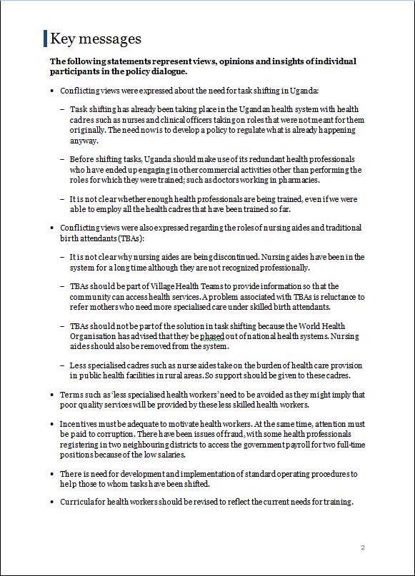
Template for a policy dialogue report

Slide 54
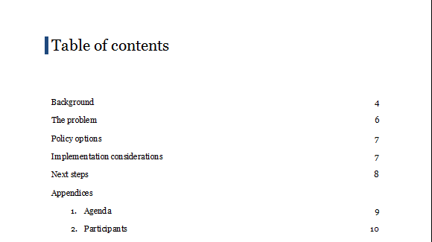
Template for a policy dialogue report

Slide 55
Dissemination of the policy brief
May also be a minimum criterion, if the policy brief was not disseminated prior to the dialogue
If an objective of the policy dialogue was to help clarify the problem or solutions, it may be desirable to revise the policy brief, taking account of inputs from the dialogue, prior to disseminating it more widely
Effective dissemination may require a range of activities, such as
Preparing a press release
Organising a press conference
Tailored dissemination targeted at specific groups or constituencies

Slide 56
Further consultation with stakeholders or another policy dialogue may be warranted
For example, if important gaps in knowledge, uncertainties or controversies may be identified
Consulting with relevant groups or individuals may be desirable to fill the gaps and reduce uncertainties or to clarify and potentially resolve controversies
Following further consultation, or if there was not time to sufficiently discuss important issues that arose at the policy dialogue, it may be desirable to have another policy dialogue

Slide 57
Next steps and evaluation
Any specific actions that were identified at the policy dialogue as next steps towards developing and implementing a policy should be recorded and disseminated to participants
Including who is responsible for following up on each action
The policy dialogue should be evaluated
This should include evaluating
The extent to which its objectives were met
Its contribution towards addressing the specific problem
What more needs to be done to ensure that the objectives of the policy dialogue are met and appropriate actions are taken to address the problem that was addressed
The way in which the policy dialogue was organised and conducted

Slide 58
Questions or comments?

Slide 59
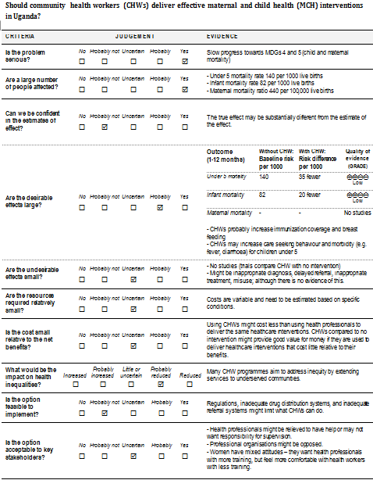
A framework for going from evidence to health system decisions

Slide 60
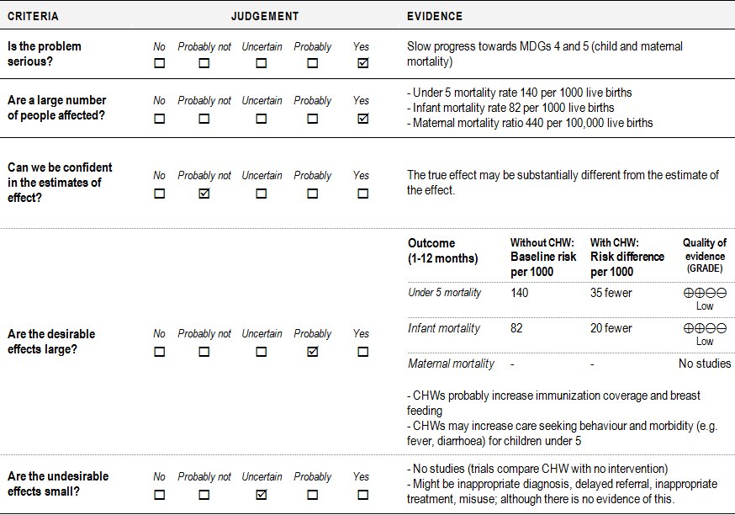

Slide 61
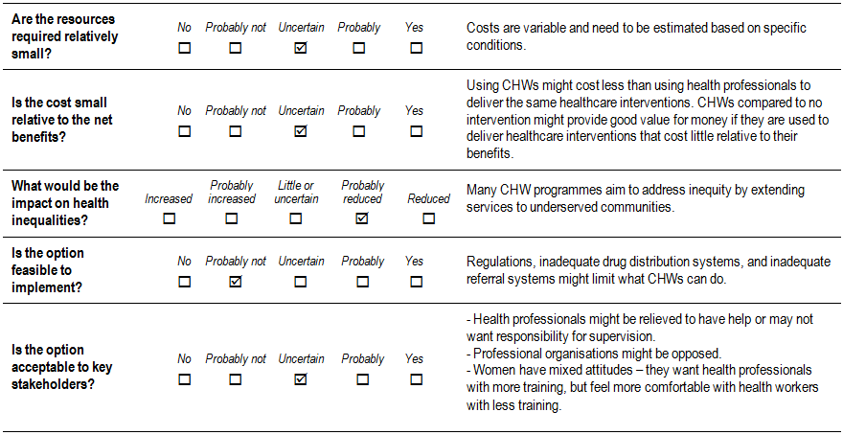
A framework for going from evidence to health system decisions

Slide 62
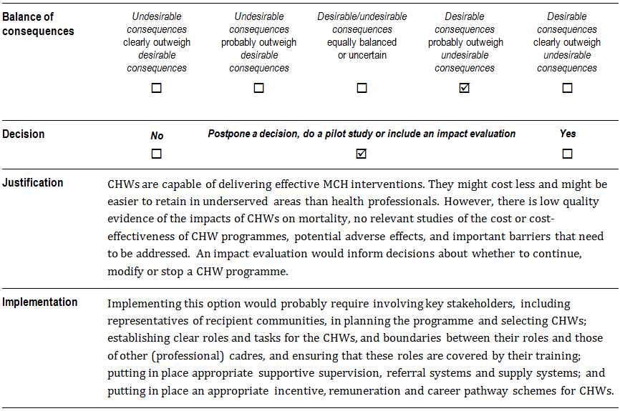
A framework for going from evidence to health system decisions

Slide 63
Questions or comments?

